Slide 1
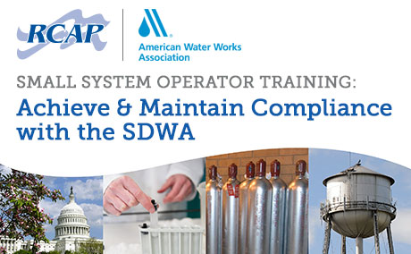
Notes:
Prior to the start of the presentations, introduce the workshop’s presenters/facilitators.
Thank you for joining us for this workshop designed to give you the tools necessary to find solutions to operators face on a daily basis.

Slide 2
Additional RCAP Resources
RCAP is a national non-profit providing training and technical assistance to small communities on water and wastewater issues.
RCAP has over 160 field staff including certified operators; engineers; and specialists in utility management, finance, and administration. RCAP is funded by federal agencies and state contracts, and provides free services across the United States and its territories.
More information can be found at www.RCAP.org.
Notes:
DO NOT SKIP THIS SLIDE. Please note that: Attendees are encouraged to visit the RCAP website for more free resources.
Facilitator: Add RCAP regional/local contact info if appropriate.

Slide 3
Additional AWWA Resources
Community Engineering Corps®
An alliance between AWWA, American Society of Civil Engineers, and Engineers Without Borders-USA to provide technical expertise to underserved US communities with infrastructure needs. www.communityengineeringcorps.org
Partnership Programs
An alliance of six drinking water organizations to improve the quality of water delivered to customers by optimizing water system operations. www.awwa.org/partnership
Notes:
AWWA has a variety of resources to small systems. Encourage attendees to visit he AWWA website for more information.
Facilitator: Add AWWA Section contact info if appropriate.

Slide 4
Additional AWWA Resources
Small Systems Resource Community
Free online portal to tools and discussions of issues and developments related to small water systems. www.awwa.org/smallsystems
The Water Equation
AWWA’s Water Equation provides academic and operator scholarships, student programs, and supports the Community Engineering Corp. volunteer program. The Association and its Sections partner to invest in the future of water and the industry’s workforce. For more information, go to www.awwa.org/we
Notes:
AWWA has a variety of resources to small systems. Encourage attendees to visit he AWWA website for more information.
Facilitator: Add AWWA Section contact info if appropriate.

Slide 5
Today’s Workshop
Interactive review of the skills needed to solve today’s challenges to providing safe water
Includes the most common problems and challenges
Discover the most effective field-tested solutions
Topics include: Regulatory compliance, Disinfection, Nitrification, DBP control, and Source Water Protection
Networking – Important component of training
Learn from wealth of experience in the room
Notes:
Instructors to mention the interactive purpose of the workshop, including:
Examples of distribution system problems will be shared and solutions discussed
We (workshop participants) will also share previous experiences that we have had with these issues, and learn from each other’s experiences

Slide 6
Library of Content
#1: SDWA Workshop Introduction - 10 min (REQUIRED) #2: Coliform Sample Collection - 45 min
#3: DBP Treatment Strategies - 60 min
#4: Disinfection Byproducts - 35 min #5: Disinfection Overview - 60 min #6: Distribution System Infrastructure - 45 min #7: Distribution Water Quality - 45 min #8: Flushing - 45 min #9: Main Breaks and Cross Connections - 45 min #10: Regulatory Review - 120 min #11: Arsenic Rule Compliance - 60 min #12: Nitrate Rule Compliance - 80 min #13: Radionuclides Rule Compliance - 60 min #14: Source Water Assessment and Protection - 120 min #15: Controlling Lead and Copper in Drinking Water - 140 min #16: Cyanotoxins - 60 min
#17: Premise Plumbing/Legionella - Coming in July 2018
#18: Learning Lab: Water Quality Monitoring (approx. 3.5 hrs) - Coming in July 2018 #19: Board Support for Water Systems - 120 min

Slide 7
20/21 Vision
Strengthening RCAP/AWWA relationship – to better serve rural communities
Multi-barrier approach to equipping communities:
RCAP – Credibility, Comprehensive, Service, SS Expertise, Field-tested solutions
AWWA Sections, Volunteers, Manuals/Standards, Tools, CE Corps, Water Equation Operator Scholarship, Partnership, eLearning
Blended Learning
Knowledge/Comprehension online
Application/Analysis/Synthesis/Evaluation IN-PERSON

