Slide 1
Case Study: Bench Scale Testing to Identify Lead and Copper Treatment Technique for LCR Compliance
2018 RCAP Conference
April 25, 2018

Slide 2
“The fundamental obstacle to creating community sustainability and implementing an effective strategy is capacity; a lack of time, resources, knowledge, and staff.”
Nathan Ohle
Executive Director RCAP
Notes:
This is a story of one tribal system that at one time or another faced all these obstacles, but overcame or compensated for most in dealing with lead challenges except very specialized knowledge. As technical assistance providers RCAC assisted the Tribe in securing the necessary knowledge to bring the system into compliance.

Slide 3
Location
Big Valley Rancheria - Lake County, CA
Tribe: Big Valley Band of Pomo Indians of the Big Valley Rancheria
Serves:
38 Residences
Konocti Vista Casino
Motel
Tribal Offices
RV Park
Plans: 200 more residences
Notes:
The Rancheria is located approximately 80 miles northwest of Sacramento.

Slide 4
Challenges To Be Addressed
Intermittent Lead and Copper Exceedances for 14 years
Bad Raw Water Quality
Inadequate Treatment
Sewer and Water Treatment equipment in same building
Notes:
Quality Issues: High - corrosivity, iron, manganese, hardness, CO2, turbidity, color
Treatment Issues: Greensand Treatment Iron removal rate 60% causing excessive sludge in finished water tank

Slide 5
Original Treatment Features (2003)
• Potassium Permanganate Injector
• Ozone and Air Preparation System
• Iron Filters
• Ultraviolet Light System
• Multimedia Filters
• Carbon Filters
• Water Softener
• Chlorine Injection System
• External Potable Water Holding Tank
• Grundfos Boosterpaq Pumps
• Diesel Fire Pump

Slide 6
Original Treatment Features (2015)
• Potassium Permanganate Injector
• Ozone and Air Preparation System
• Iron Filters
• Ultraviolet Light System
• Multimedia Filters
• Carbon Filters
• Water Softener
• Chlorine Injection System
• External Potable Water Holding Tank
• Grundfos Boosterpaq Pumps
• Diesel Fire Pump

Slide 7
Existing Water and Sewer Components
Swr Wtr Softeners Carbon Multimedia Swr Swr Pumps Chem Pumps Filters Filters Screen Pumps

Slide 8
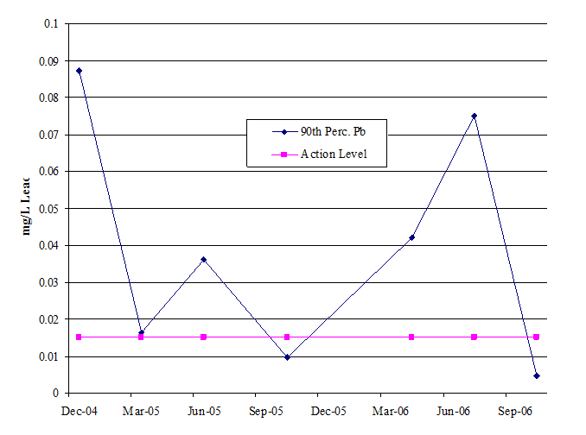
Lead and Copper Rule Compliance History
Three years after the plant went on line a report chronicled lead exceedances

Slide 9
Water Quality Conditions
High corrosivity Constant
High iron Variable
High manganese Constant
High hardness (Motel softens water)
High CO₂ Constant
High turbidity Periodic
High color Periodic
Taste Okay
Odor Okay

Slide 10
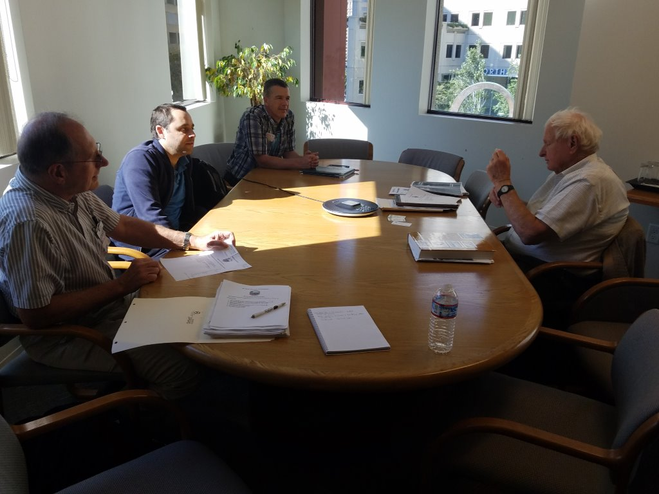
Creative Process
Professional Search
EPA Collaboration
Contract Negotiation

Slide 11
Contract
EPA Funded Investigation: $25,000
Corrosion control and quality improvement testing: Kennedy/Jenks Consultants
Corrosivity Evaluation
Corrosion Control Options
Pilot Testing
Comparison of alternatives
Cost: Capital and Operations
Report and Recommendations

Slide 12
Corrosion Control Theory and Testing
Water Quality Parameter Testing
Plotting the balance/imbalance of chemical compounds at Various Points in System

Slide 13
Corrosion Control Options
pH Elevation:
Air stripping
Caustic addition
Adding Corrosion Inhibitors:
Phosphates
Silicates
Notes:
Phosphate: Previously used 3 mg/L, 30% ortho, and 70% poly blend and other phosphate blends and dosages. Not sufficiently effective.
Silicate: Too much silica with 80 mg/L in well water can inhibit iron and manganese removal at pH above 7.2

Slide 14
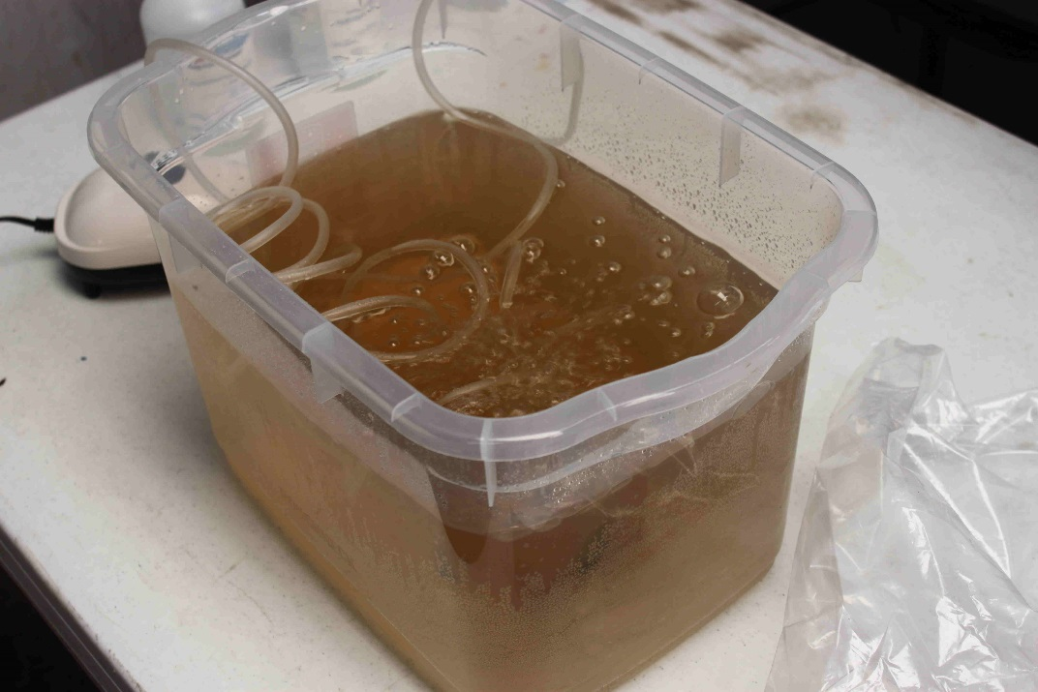
Actual Testing
18 – Liter Capacity Tub
3.4 Liters per Minute small aquarium aerator
Notes:
A small aquarium aerator was used to supply the air through several plastic tubes that were
placed in the bottom of an 18-liter capacity plastic tub which had a depth of 15 inches. The
aeration capacity was 3.4 liters per minute and two air tubes were placed in the bottom of the
filtered water that had initial pH ranges of 6.6 to 6.8.

Slide 15
Lead and Copper LPR Probes in Tub Cover

Slide 16
Bench Scale LPR Test Assembly Tested Each Week after Aeration CO₂ Stripping

Slide 17
Linear Polarization Testing Each Week of CO₂ Stripped, pH Elevated Phosphate Inhibited Water

Slide 18
Corrosion Rate Readout in mils/year

Slide 19
Copper Probes – Before and After

Slide 20
Lead Probes – Before and After

Slide 21
Bench Scale Corrosivity Testing
Week | Existing Water |  | CO₂ Stripped Water |  |  | Corrosion Reduction Percent
 | pH | Copper Corrosion Rate mils/yr | pH | Copper Corrosion MPY | Lead Rate MPY
0 | 6.9 | - | 8.2 | - | - | -
1 | 6.9 | 8.02 | 8.2 | 2.2 | 2.1 | -
2 | 6.7 | 0.69 | 8.3 | 0.18 | 0.16 | 73
3 | 7.5 | 0.88 | 8.0 | 0.23 | 0.14 | 74
4 | 7.5 | 0.76 | 8.0 | 0.14 | 0.11 | 83

Slide 22
Recommended Interim Water Treatment Improvements
Interim:
Diffused air stripper: 60-minute detention at 130 GPM
Improved iron and manganese removal: Pyrolusite media to three existing and conversion of two GAC and four Zeolite filters to pyrolusite to reduce loading rate by two-thirds.
Notes:
The apparent best alternative for a relatively low cost interim treatment to reduce the corrosivity of the water is to provide air stripping of CO2 with about an hour detention and concurrent pH elevation to about 8.0. An 8,000-gallon tank located near the storage tank would receive filtered and disinfected water and provide gravity flow into the storage tank. It is also desirable to improve the iron and manganese removal by retrofitting all of the GAC and zeolite pressure

Slide 23
Recommended Interim Water Treatment Improvements - Continued
Interim:
Storage tank: Sludge removal and cathodic protection
Cost: $200,000 interim treatment and $300,000 wastewater treatment plant separation by containment wall ($100,000 CO₂ stripping and $100,000 improved iron removal)

Slide 24
Long Range Treatment (for wastewater separation)
CO₂ Stripping
Water Softening by Lime with Iron-Manganese Precipitation
Filtration
Chlorination
Phosphate Inhibitor
Cost: $3 million
Notes:
The long range solution involves the construction of a new water treatment facility that will achieve physical separation of wastewater treatment activities. The new plant will incorporate the CO2 stripping and the treatment processes will incorporate more automatic functions designed to treat the raw water quality that has been quantified by years of operation of the present plant.

Slide 25
Project Outcome
Interim Water Treatment Improvements
Components:
Diffused air stripper
Improved iron and manganese removal
Storage tank sludge removal and cathodic protection
Cost: $200,000 interim treatment ($300,000 with wastewater separation) to achieve:
Projected 80% reduction in corrosion rate
Lead and Copper Rule compliance
Lower treatment costs (Chemicals and Labor)
New treatment plant process improvements identified
Notes:
Improved iron and manganese removal reducing loading rate by two-thirds

Slide 26
Project Outcomes
Tribal technical and managerial capacities expanded
Confidence built in outcome
Better understanding of responsibilities

Slide 27
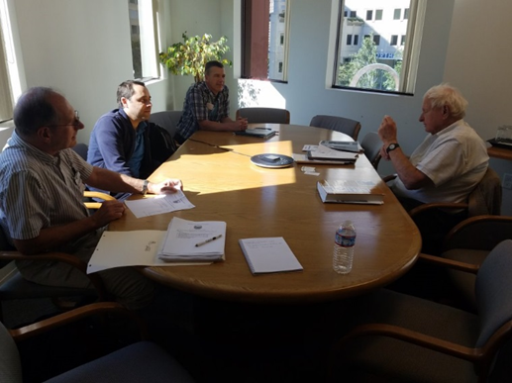
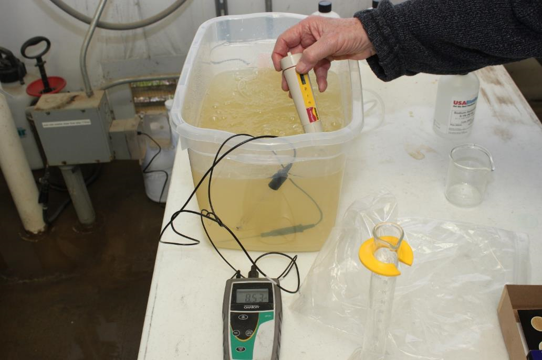
RCAC Assistance
Corrosion control and quality improvement testing
RCAC provided Assistance with:
Funding application
Finding qualified engineering consultant
Professional service consultant contract provisions
Bench scale testing
Reviewing report and recommendations

Slide 28
Big Valley Rancheria Corrosion Control Study Lessons Learned
Find the right engineer/scientist
The importance of collaboration between involved parties
Teachable Lessons
Obvious treatment methods aren’t
Importance of monitoring

Slide 29
The Collaborators
John Gicucki – Big Valley Rancheria Public Works Manager
John Cruz – Big Valley Rancheria Lead Operator
Sarah Ryan – Big Valley Rancheria Environmental Director
Jason Gambatese – EPA Region 9 Project Manager
Robert Ryder – Kennedy/Jenks Engineers

Slide 30
Big Valley Rancheria Corrosion Control Study
For Further Information
Lee Schegg
lschegg@rcac.org
916-704-8134

Slide 31
Big Valley Rancheria Corrosion Control Study
Questions?

