Slide 1
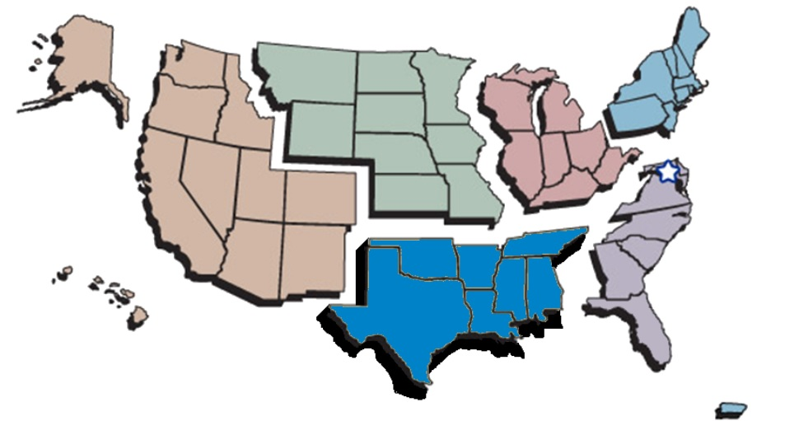
2017- 2018
Program Highlights
2017- 2018

Slide 2
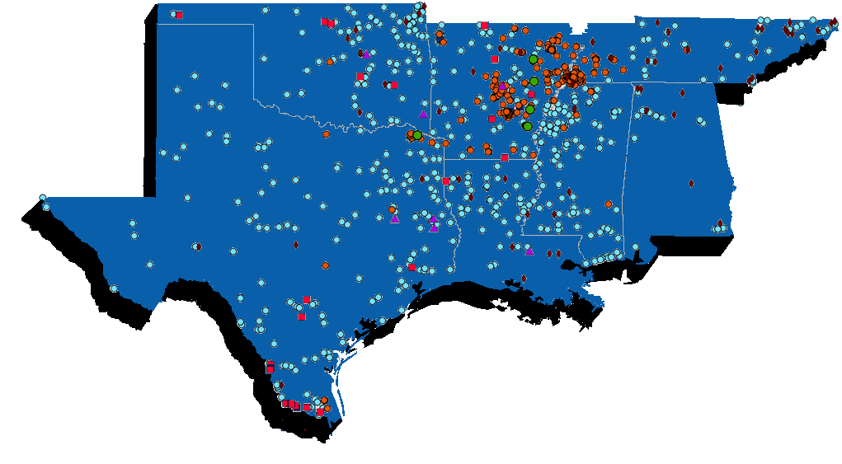
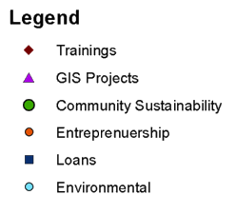
2017 Impact Map

Slide 3
2017 Impact Numbers
2.1 Million People Served
493 Communities Assisted
781,572 Households Served
$54.3 Million Leveraged
$2.4 Million Loaned by CU
51% Minority Population
24% Low Income Population

Slide 4
2018 Impacts – First 6 Months
1.9 Million People Served
389 Communities Assisted
498,734 Households Served
$45.7 Million Leveraged
$3.8 Million Loaned by CU
55% Minority Population
36% Low Income Population

Slide 5
2018 Other Program Highlights
Hurricane Harvey Recovery
23% Increase from FY2017 Budget
3 New State Contracts (MS, AR, TX)
24% Increase in Number of Field Staff
7-8 Additional New Field Staff Expected to be hired before October 2018.

