Slide 1
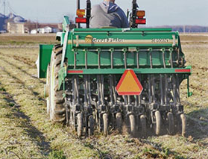
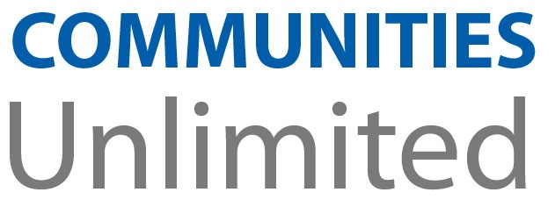
The WealthWorks Toolkit A Strategy for Success in Economic and Community Development in Rural America
Carol Cohen, RCAC
Ines Polonius, Communities Unlimited
April 25, 2018

Slide 3
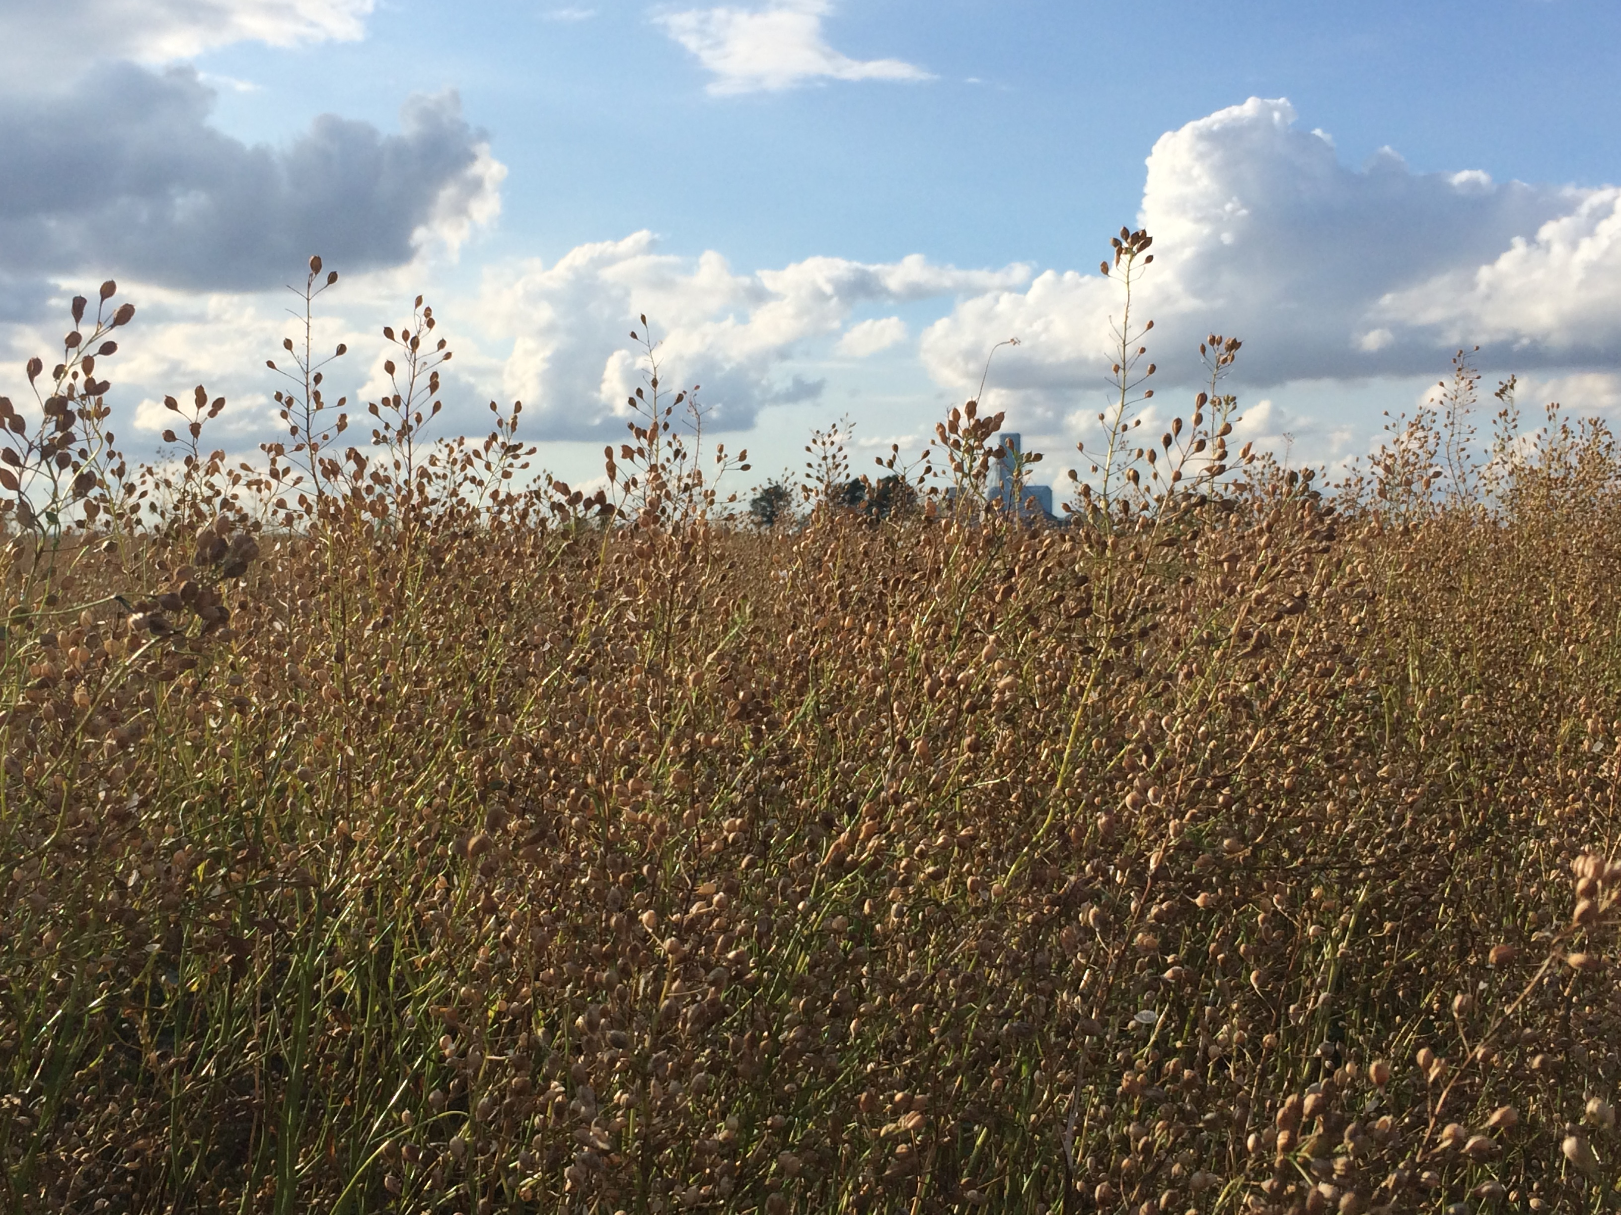
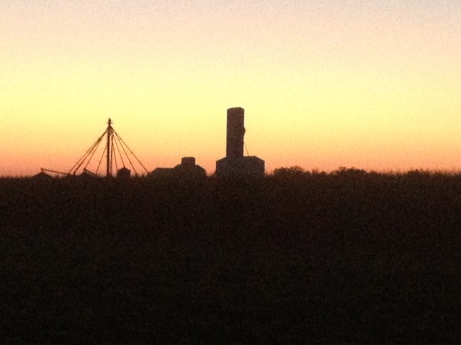
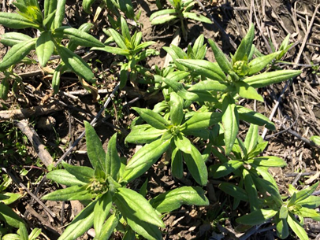
Why WealthWorks?
Expands your economic development toolkit
Focuses on community assets, not deficiencies
Maximizes local wealth retention + creation
Leads to new small business development
Rooted in deep collaboration which creates shift in
community, leading to secondary benefits

Slide 4
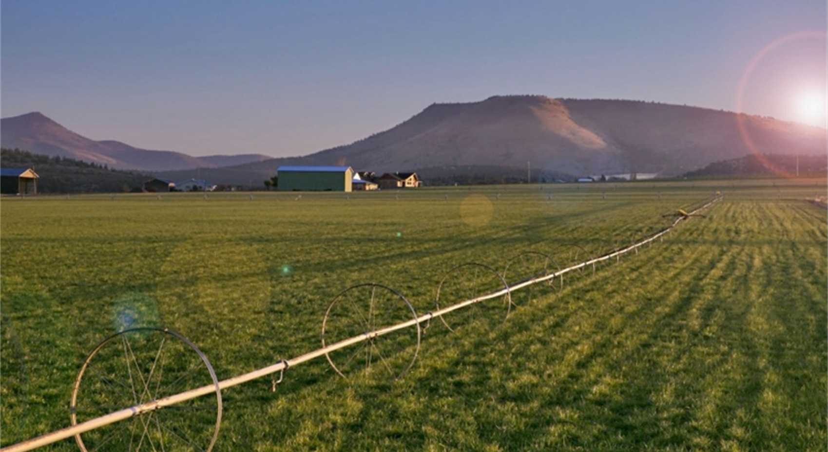
What and Who is WealthWorks?
National network providing rural communities an alternative to
“attraction based economic development”
Regional Hubs
Coaches
National Organizations
RCAC and CU are Regional Hubs
Build value chains
Replicate value chains
Provide training and coaching on methodology
Doing “economic development differently” by combining successful
community economic development models

Slide 5
WealthWorks Regional Hubs
http://www.wealthworks.org/connect/hubs

Slide 6
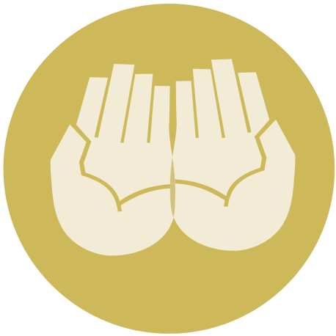
Principles of Value Chain Construction
#1 – Create wealth, broadly defined, and aspire to do no harm.
#2 – Root wealth in local people, places and firms through local ownership, control and influence.
#3 – Build lasting livelihoods by intentionally including people and firms on the economic margins.
Notes:
Wealth building framework has three critical goals:
Create wealth broadly defined – includes 8 capitals
Build lasting livelihoods especially for people and firms on the margins – many of the strategies we discussed yesterday are important building blocks of lasting livelihoods
Root wealth in place – pay attention to who owns, controls and influences the wealth that’s created.
Let’s explore each of these more deeply.

Slide 7
Wealth Components: Eight Capitals
Intellectual
Knowledge and innovation
Individual
Skills, education, health
Assessment
Design
Measurement
Social
Trust and relationships
Natural
Natural resources
Built
Infrastructure
Political
Influence on decision makers & shapers
Financial
Savings and investment
Cultural
Traditions, customs & ways of doing
Notes:
Realize that you all are familiar with the triple bottom line. This isn’t really different … just unpacks the three capitals into greater detail… The other addition is that this approach focuses on both inventory and then investing in building our “stocks” of these capitals/assets. We recognize that without active investment, resources will depreciate.

Slide 8
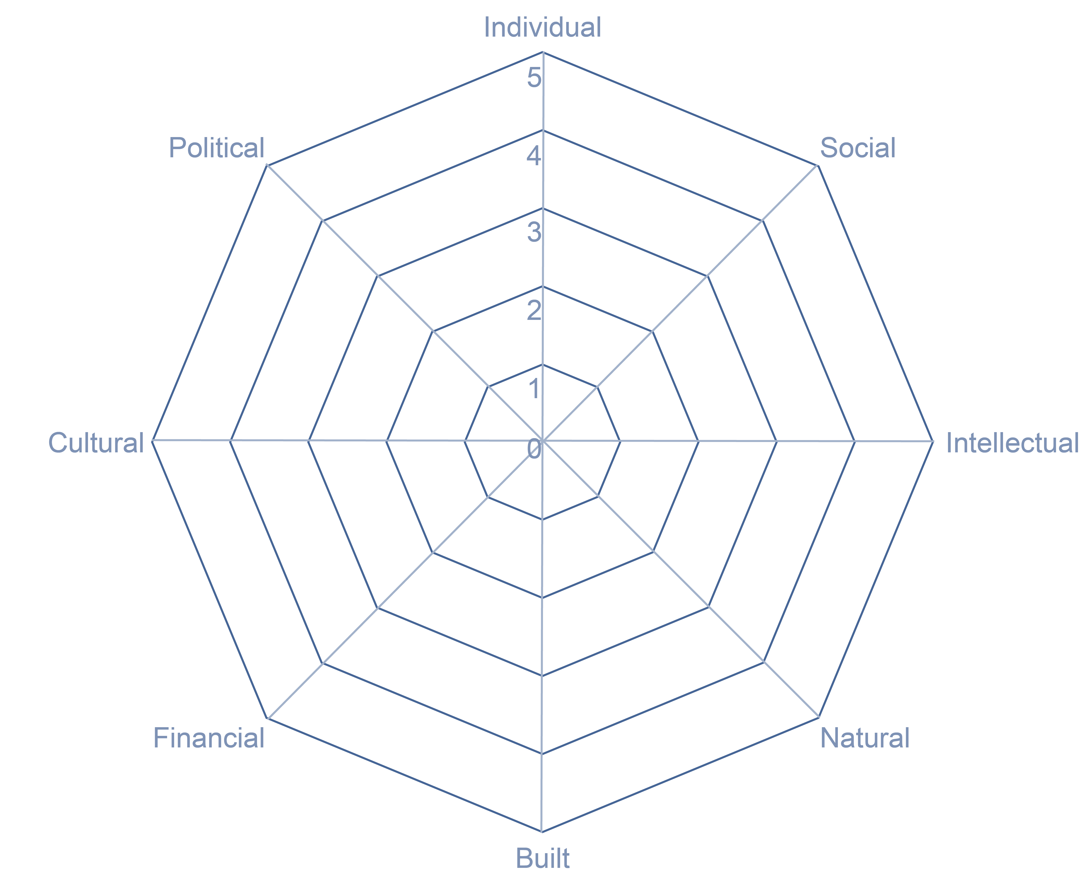
Evaluating Your Region: Spider Diagram
What kinds of wealth and how much of each does that region have?
Remember, it is only wealth if it is healthy and fully functional
and if the region owns or
controls it and can make
decisions about how to
maintain it and use it.

Slide 9
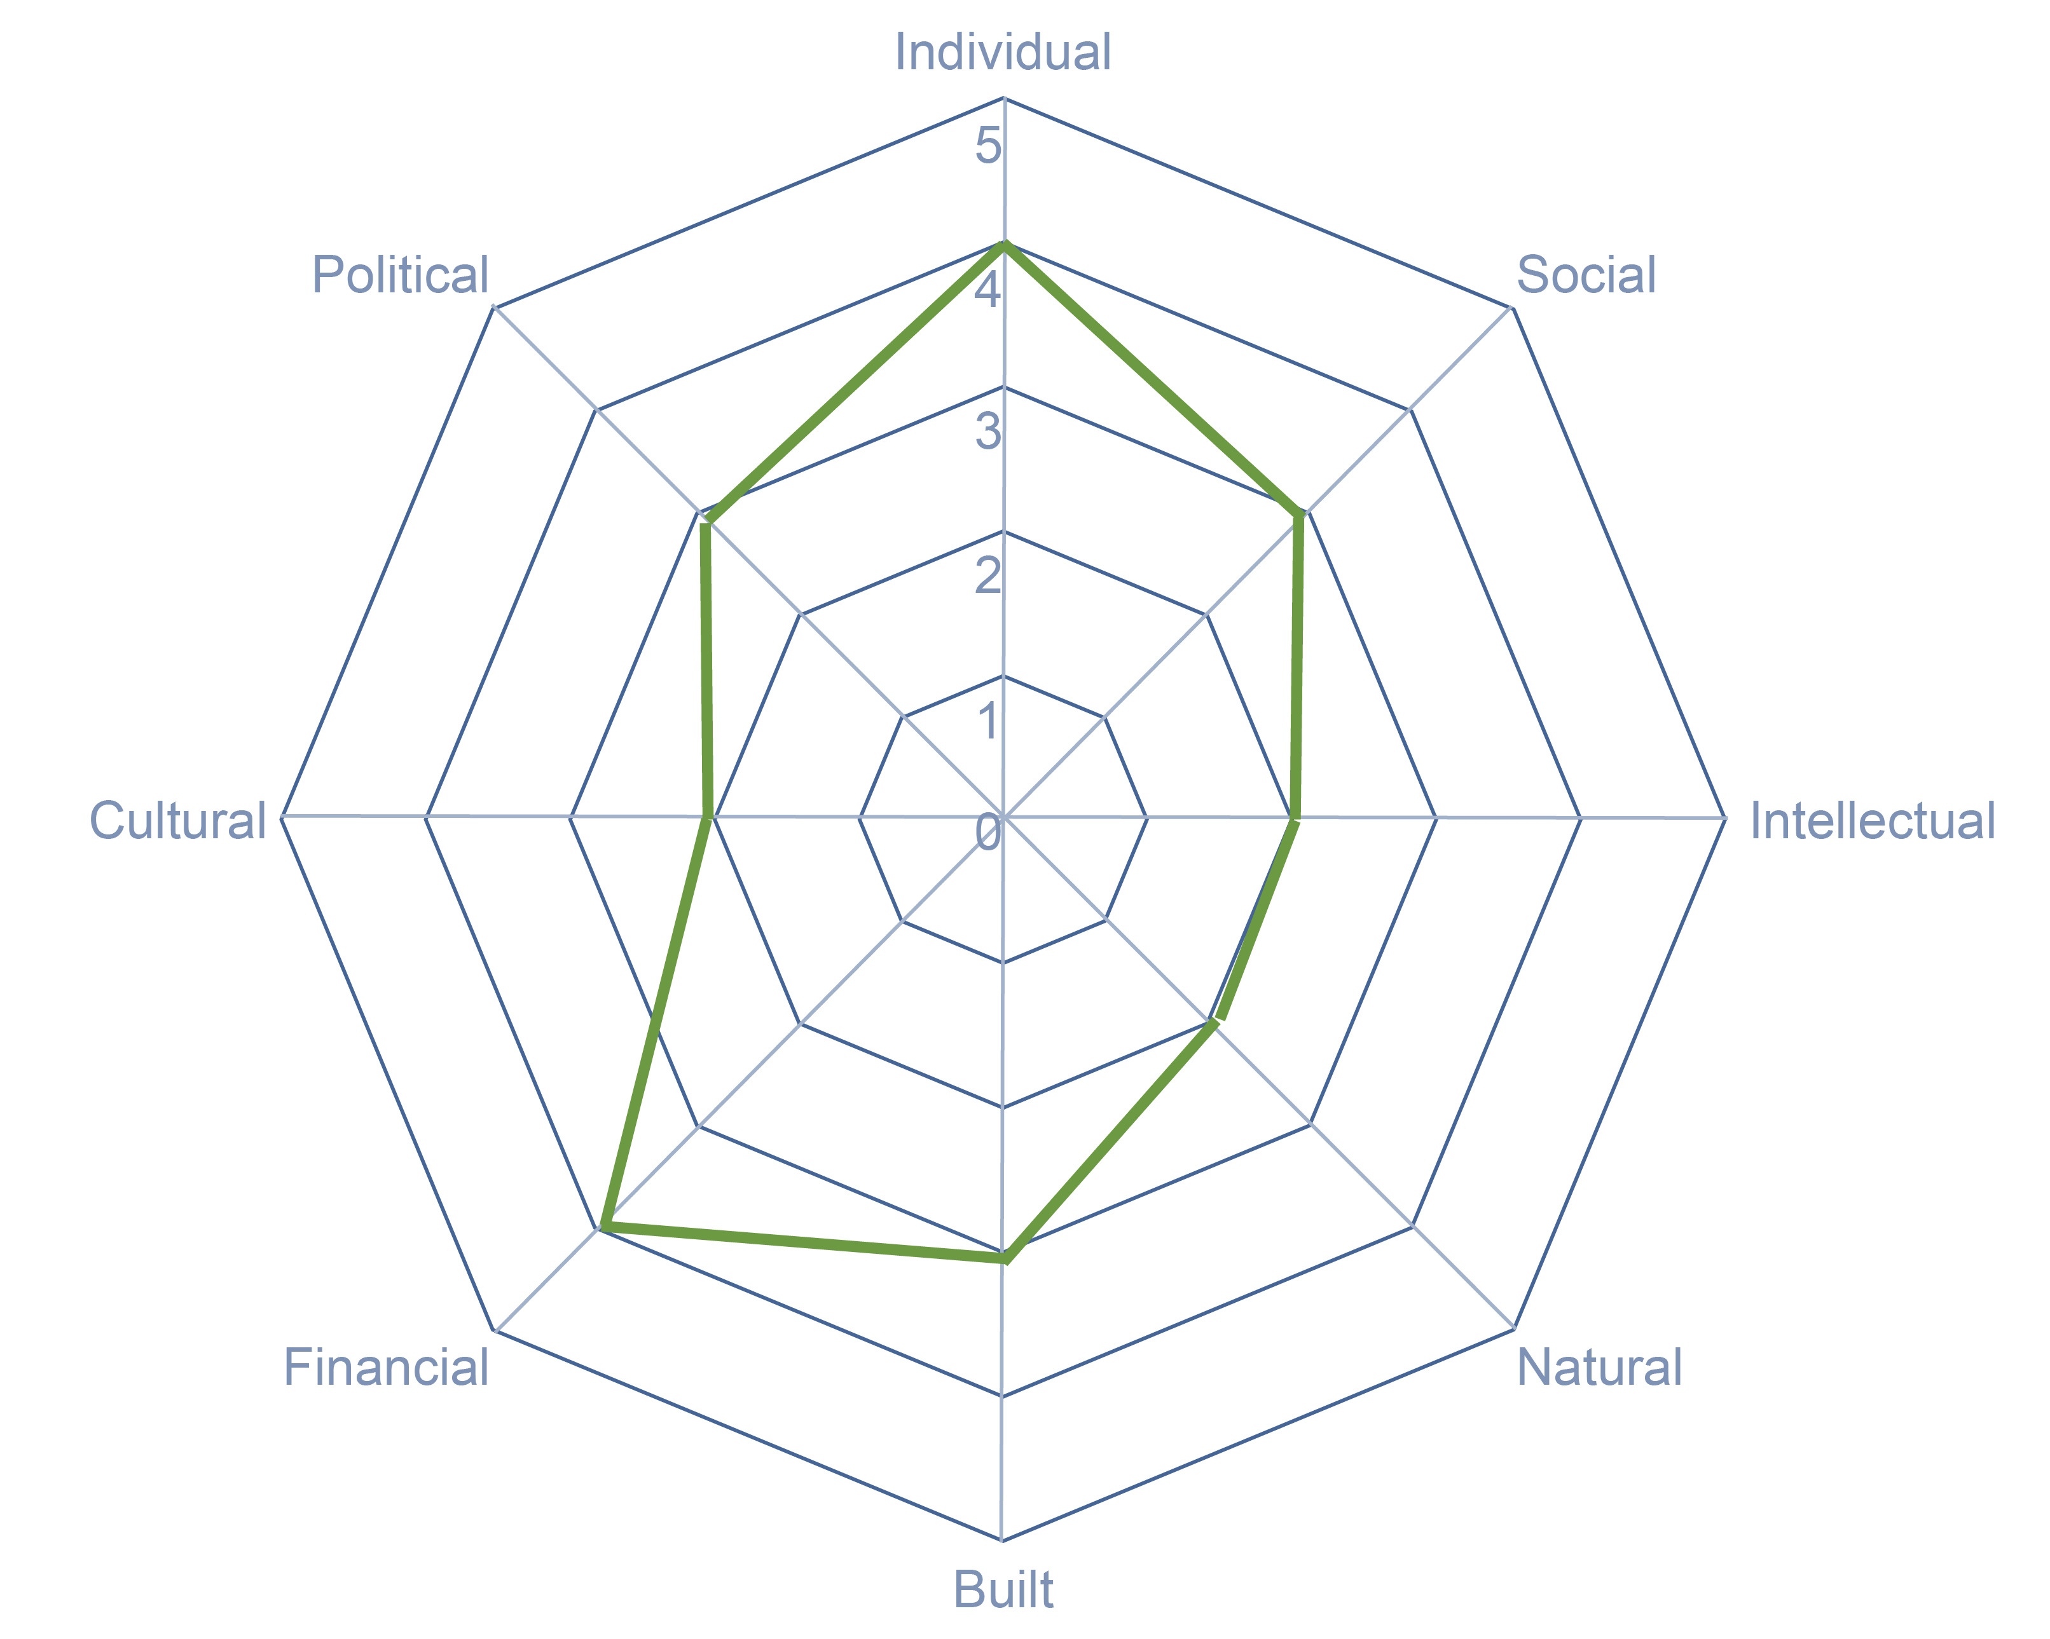
Evaluating Your Community
Instructions
Using the spider diagram and the scale of 0 to 5 (where 0 is the
weakest and 5 is the strongest),
map out the strengths of each of
the capitals for your region.
Then share with someone else.
Explain what you came up with
and why.
Where are your strengths?
Weaknesses?

Slide 10
Value Chain as Wealth Building Tool
A WealthWorks value chain is:
a network of people, businesses, organizations & agencies
addressing a market opportunity to meet demand for specific products or services
advancing individual interests, while finding mutual interests and shared benefits
building rooted local and regional wealth that sticks
and intentionally including people and firms on the economic margins
with open and transparent communications

Slide 11
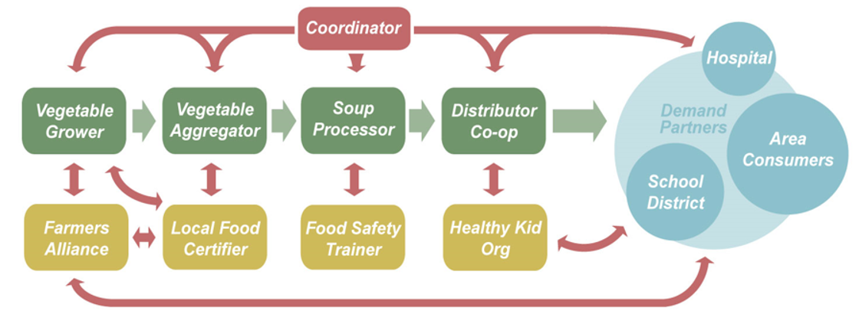
Value Chain Diagram
DEMAND PARTNERS
TRANSACTIONAL PARTNERS
SUPPORT PARTNERS

Slide 12
Value Chain Partners “Stakeholders”
Transactional
Support
Demand
Buyers, Consumers
Provide Infrastructure
Support Transactional
Suppliers, Distributers,
Wholebuyers

Slide 13
Value Chain “Stakeholders”
Demand partners:
Buyers of goods and services (people, businesses, orgs.)
Transactional partners:
People, businesses, orgs. direct role in sourcing, producing, distributing
Suppliers: provide specific inputs to other VC partners
Producers: create goods / services
Aggregators: bundle products / services
Wholesale buyers: Purchase goods /services for resale
Support partners: people, businesses, orgs. provide infrastructure that helps the transactional partners obtain resources needed to produce the product /services
Business and technical assistance
Financing (philanthropic, debt and equity)
Policy, regulation
Media
Research

Slide 14
Value Chain Exercise
Step 1: Take a card
The cards represent the stakeholders in the Value Chain
Some cards are blank- represent “Gaps” in the Value Chain
Step 2: Network with each other
Find the link in the value chain: who can help you? Add value..
Step 3: Assemble the Value Chain
Line up in a row
Left: start with “Demand”, the market or customers
Right: Moving right, in order of function, “Transactional Partners”
“Support Partners” stand outside of the line near the function you support

Slide 15
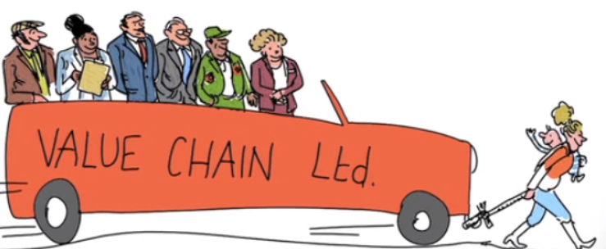
Reflections
What surprised you
about this process?
Did you identify “Gaps or
opportunities” in the chain?
What challenges did you find in building the chain?
List the key elements needed to build a Value Chain?
Hint…. Communication, Relationship, Self Interest, SharedInterest….

Slide 16
Welcome Lewistown to Recharge Our Community (ROC)

Slide 17
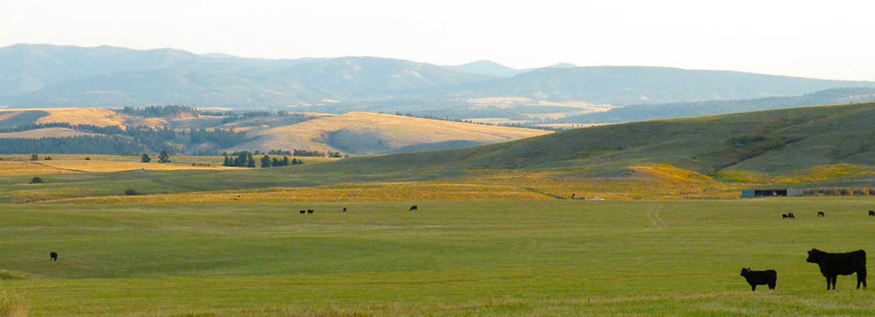
Lewistown, Montana
Notes:
It started like this… DEMAND, TRANSACTIONAL, SUPPORT

Slide 18
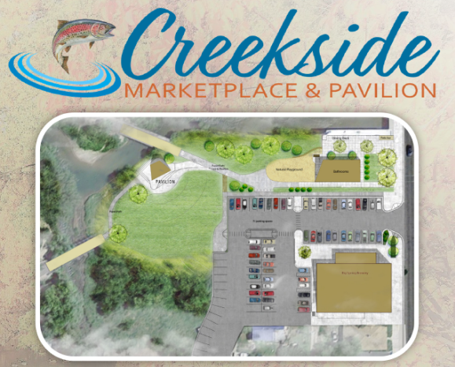
Creekside Marketplace and Pavilion
Lewistown, Montana
Notes:
It started like this… DEMAND, TRANSACTIONAL, SUPPORT

Slide 19
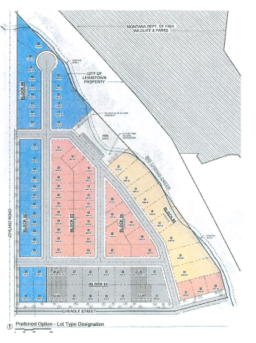
Berg Property
Workforce Housing
Lewistown, Montana
Notes:
It started like this… DEMAND, TRANSACTIONAL, SUPPORT

Slide 20
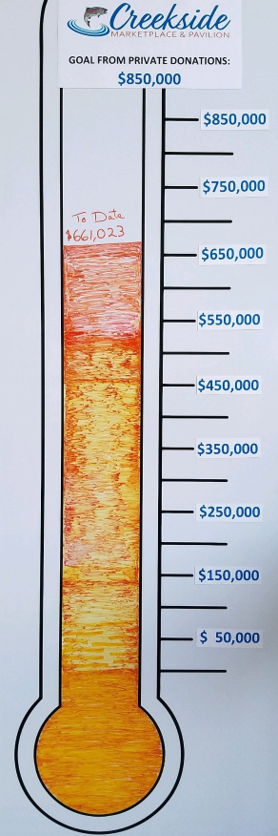
Creekside Marketplace and Pavilion
$1.4 Project
Lewistown, Montana
Notes:
It started like this… DEMAND, TRANSACTIONAL, SUPPORT

Slide 21
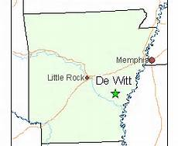
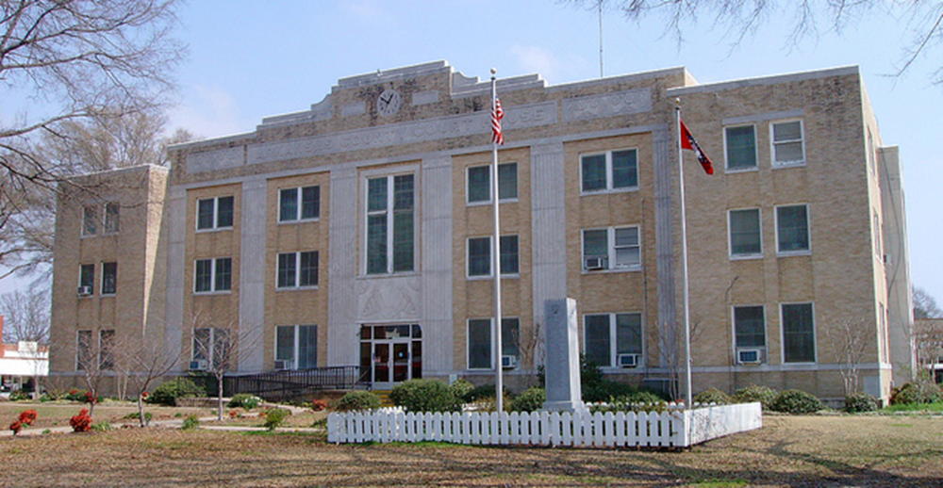
Welcome to DeWitt, AR in 2013
3200 people
Losing 10% of population
24% of people live in poverty
Geographically Isolated
Lack of pride
And many
Assets

Slide 22
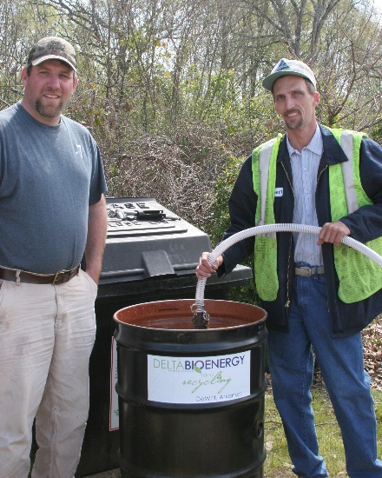
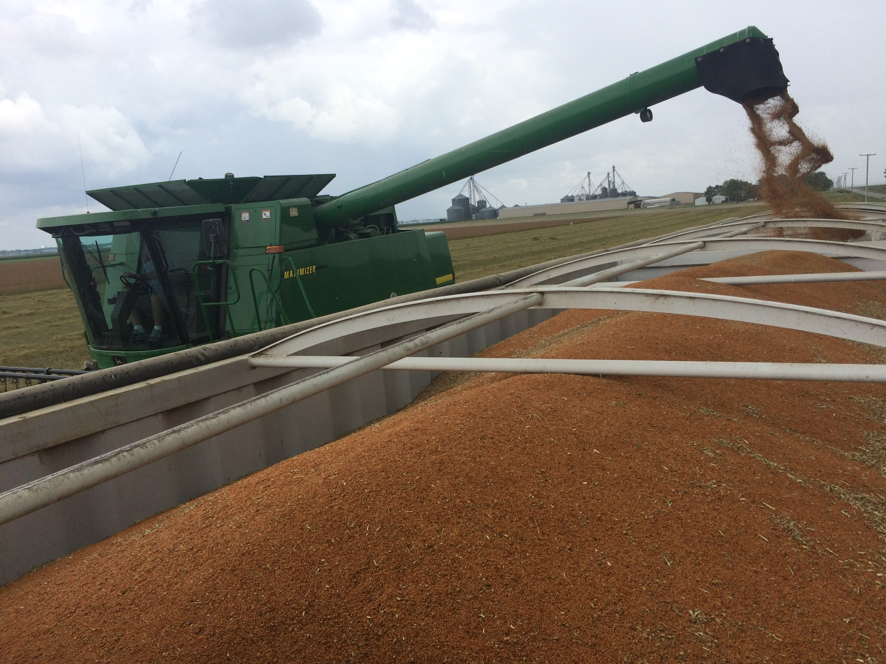
Demand Driven
10,000 gallons
Local Small Farms & Restaurants
6 million gallons
Notes:
VC = Local Food
Background
This value chain is being coordinated by the High Desert Food and Farm Alliance in partnership with the Central Oregon Intergovernment Council. The individuals involved in this work had been involved in the local food movement for a number of years before the introduction of WealthWorks in 2014.
Demand: There is a strong and growing demand for local fresh food in this region, and supply is limited. The population (particularly of Bend) is growing and the area is becoming more urbanized, which is creating a strong center of demand to draw from small farms in a 3-county region. The desire of this population (like national trends) to have a deeper connection to its food source is expanding. Demand is coming from individuals (who buy through CSAs and farmers markets), and also local restaurants (such as Jackson’s Corner, the Bad Wolf Bakery and Bistro, and the Broken Top Bottle Shop and Ale Café)
Value Chain Constraints: There are a number of small farm and ranches (about 40) producing food for local consumption, but they are not well connected to demand. They have very limited information about market demand; limited skills in marketing, and limited understanding of what wholesale and restaurant buyers require in terms of quality and capacity to meet those requirements. Connections to buyers are weak. (For example, farmers do not prepare their lettuce and other produce to the cleanliness standards that most wholesalers require, and they often do not have skills or time for marketing.
Opportunities: the team saw potential to improve the functioning of this value chain by
improving production efficiency and quality (through use of greenhouses, processing at wholesale standards, using land more efficiently,
strengthening linkages between farmers and buyers by matching growing choices to demand, potentially creating a food Hub, and increasing demand for and purchases of local food among institutions and restaurants
This would increase incomes, since local farmers also spend their money locally and add to the economy that way.

Slide 23
DeWitt Ecosystem 2018
Sense of vibrancy and pride
53 new jobs filled by local residents
6 new businesses
$ 4 million in new economic activity
$140,000 in additional sales taxes
collected by city
Delta BioEnergy – Arkansas’ first
multi-stakeholder cooperative

Slide 24
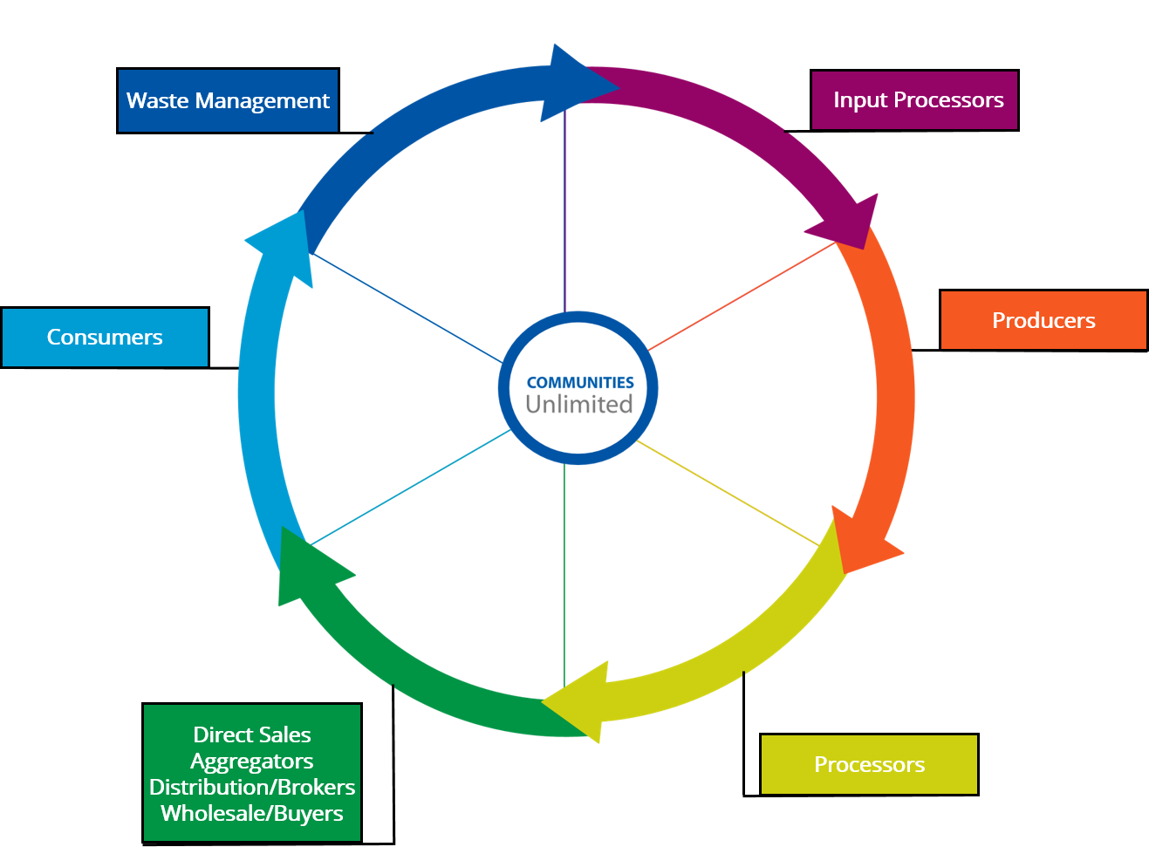
Mid-South Food LINC Value Chain
Waste Management/
Composting
Project Green Fork
St. Jude Children’s
Research Hospital
Shelby County
Schools
Memphis Medical
District Collaborative
Brown Baptist
Knowledge Quest
North Delta Produce
Assoc.,
Bean Family Produce (AR)
Benson Creek Produce, LLC (AR)
Chick-n-Bee (AR)
Conway Wholesale Produce (AR)
D&S Produce (AR)
Denton Farms (MS)
Evansingston Farms (AR)
Girls Inc. (TN)
Green Leaf Learning Farm (TN)
Hawkins Farms (AR)
Landmark Training Dev. (TN)
Loch Holland Farm (TN)
Lockard’s Produce (TN)
Washington Farms (AR)
W&W Produce, LLC (AR)
MS Delta Council for Farm Worker Opportunities, Inc (Coop of 60 Growers)
Memphis Tilth
EAEC
Coop
Memphis
ROCKS
Memphis Tilth
Delta Cuisine
Marks Vegetable Processing
Trainers/Extension | Financing | GAP Certifiers | Economic Developers | Researchers | National Organizations
Knowledge Quest McIntosh Seed U of AR Extension Service Brown Baptist UAPB Small Farm Program | DRA USDA Hyde Family Assisi Foundation |  | East Arkansas Planning and Development District NW Miss. Community Foundation | Ag Innovation Group Mississippi State University | USDA Strike Force
Notes:
Mapping the food value chain

Slide 25
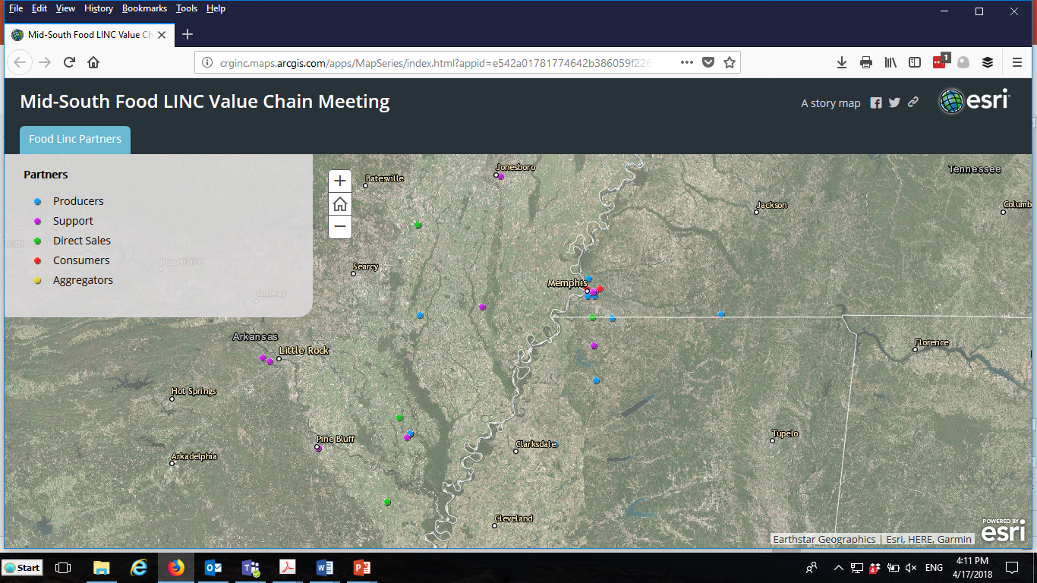
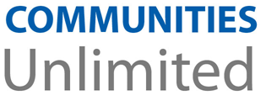

Slide 26
Take this with you…
Eight forms of capital are a great tool to:
Assess assets in communities
Define the strategy
Measure your impact
Value chains connect assets in a community to real market demand to create sustainable economic development
There are practitioners around the country ready to help communities explore their value chains

Slide 27
