Slide 1
GIS Services & Future Development
By Thi Pham, RDS

Slide 2
RCAC GIS Staffs
Thi Pham, RDS
George Schlender, Director of C & E
Heather Cannon, RDS II
Alicia Paz-Solis, RDS
Sharon Wills, Senior Comm. Coordinator
Richard Culp, RDS
Jennifer Hazard, RDS

Slide 3
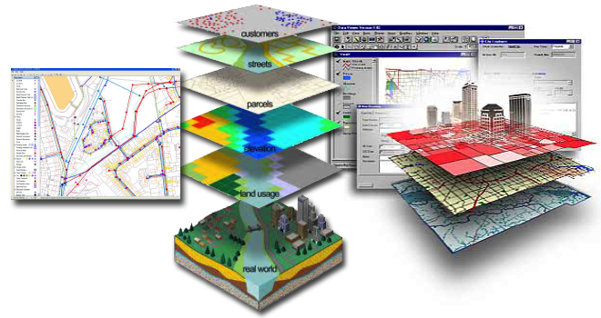
What is Geographic Information System?

Slide 4
Geographic Information System
“A geographic information system (GIS) is a framework for gathering, managing and analyzing data.” - ESRI

Slide 5
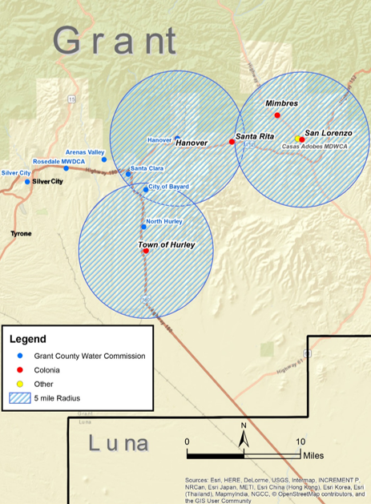
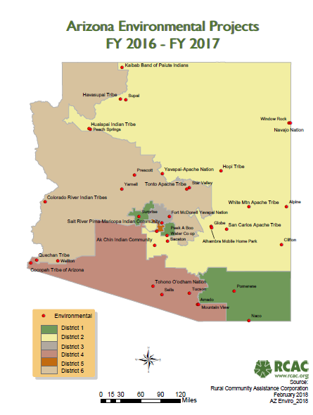
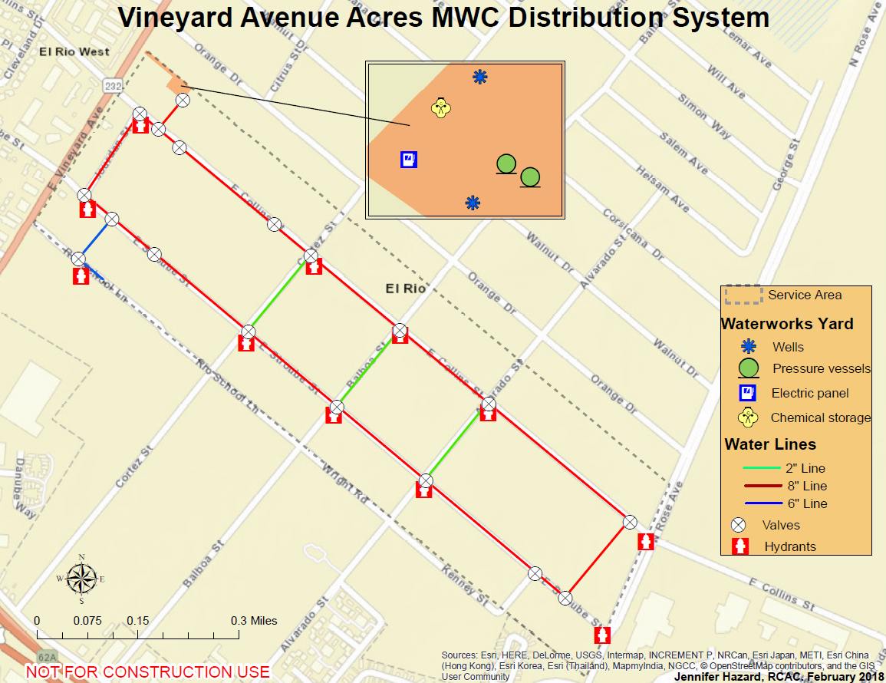
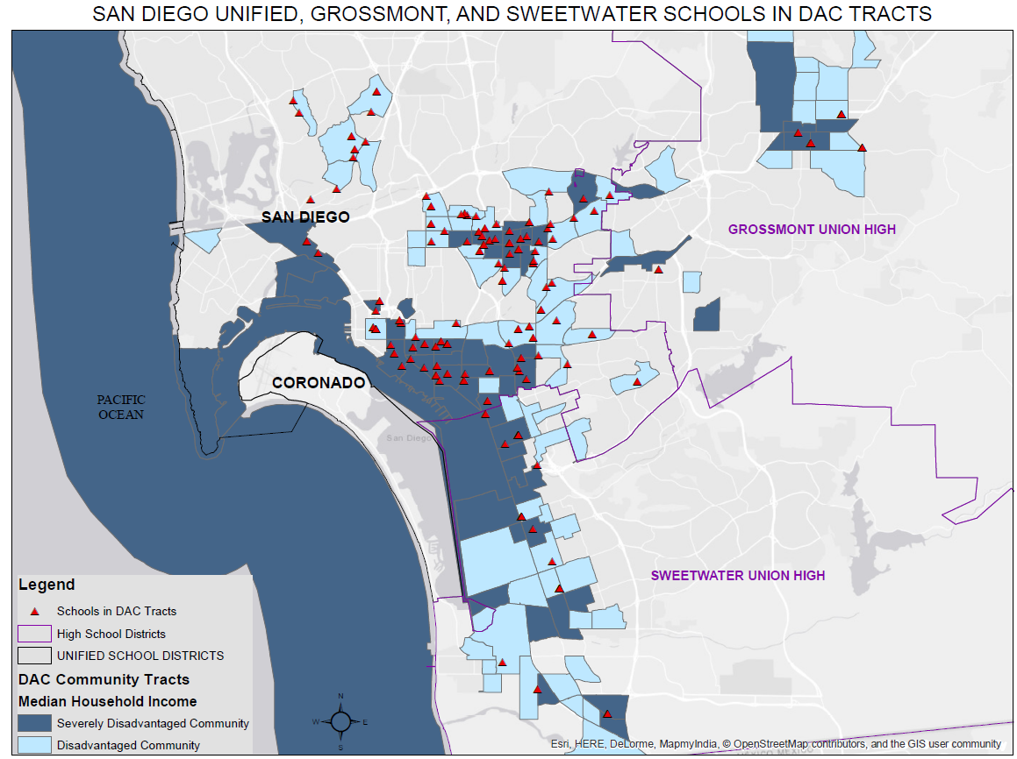
RCAC Maps
Legislative RCAC States Fly-In Maps
Asset Management Inventory Maps
RCAC Project Maps
Interactive Maps

Slide 6
Legislative Fly-In Maps
Created By: Thi Pham & Sharon Wills

Slide 7
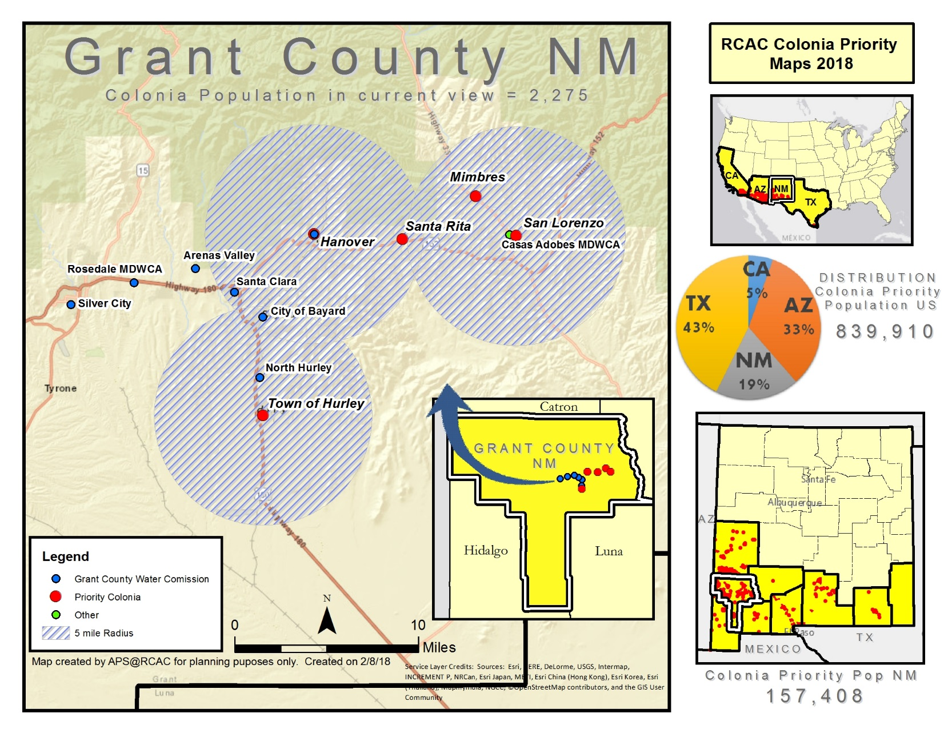
RCAC Priority Colonias, New Mexico Maps
Created By: Alicia Paz-Solis

Slide 8
Asset Management Inventory Maps
Created By: Jennifer Hazard

Slide 9
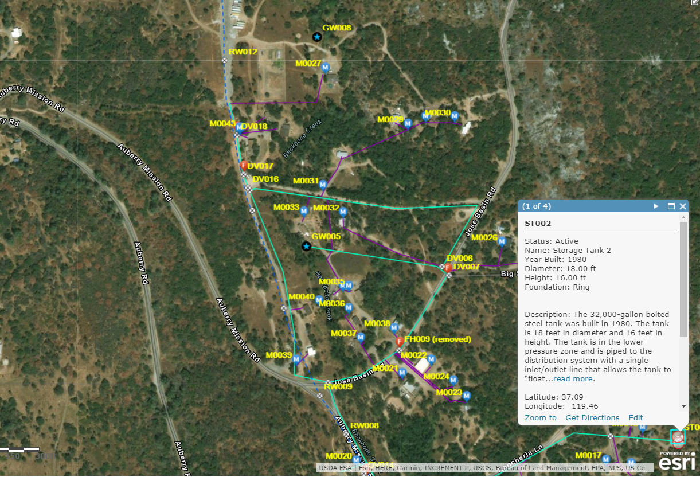
Interactive Asset
Management
Inventory Map

Slide 10
RCAC Highlight Interactive Maps
http://www.rcac.org/impact/rcacs-impact/

Slide 11
Examples RCAC Current GIS Projects
GIS Programs & Partners’ Map Development
Updating RCAC Interactive Maps
Smart Phone Enabled App allowing user-friendly asset inventory mapping
Tribal Source Water Protection Project

Slide 12
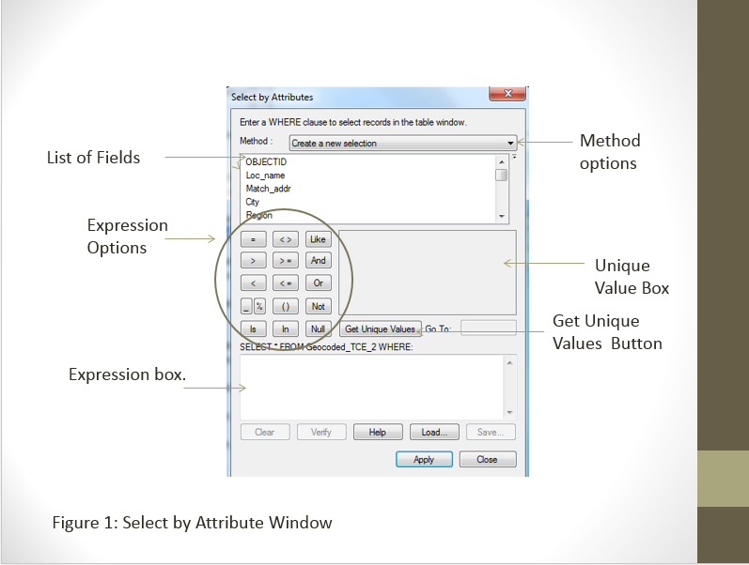

Slide 13
GIS Funders
Environmental Defense Fund Leadership
RCAP Colonias
Integrated Regional Waste Management
SWRCB State Revolving Fund California
SWRCB - Prop 1
Environmental Finance Center
Others…

Slide 14
Tools
Juno 5 Enhanced Trimble GPS
Trimble R1 Receiver GNSS
Apple Ipad Pro

Slide 15
Software/Platform
ArcMap 10.6
Online GIS
TerraSync & GPS Pathfinder
WP Google Map Pro
Google Earth Pro

Slide 16
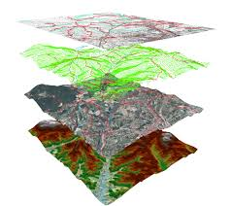
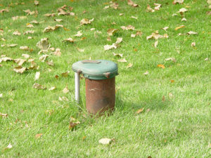
Thi Pham
Rural Development Specialist
Rural Community Assistance Corporation
tpham@rcac.org

Slide 17
Thank You!
Questions?

