Slide 1






Colonias Technical Assistance Program 101: Emerging Trends
RCAP Conference - April 2018
Notes:
Be sure to type in your name and organization. Scroll to the left to drag your region’s logo onto this page.

Slide 2

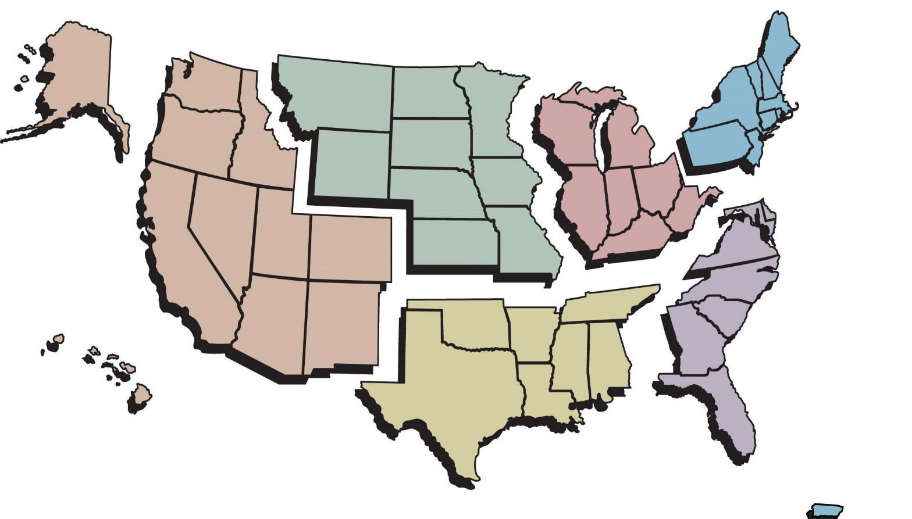






Rural Community
Assistance Partnership
^{Western RCAP}
^{Rural Community}
^{Assistance Corporation}
⁽⁹¹⁶⁾ ⁴⁴⁷⁻²⁸⁵⁴
^{www.rcac.org}
^{Midwest RCAP}
^{Midwest Assistance Program}
⁽⁹⁵²⁾ ⁷⁵⁸⁻⁴³³⁴
^{www.map-inc.org}
^{Southern RCAP}
^{Communities Unlimited}
⁽⁴⁷⁹⁾ ⁴⁴³⁻²⁷⁰⁰
^{www.communitiesu.org}
^{Northeast RCAP}
^{RCAP Solutions}
⁽⁸⁰⁰⁾ ⁴⁸⁸⁻¹⁹⁶⁹
^{www.rcapsolutions.org}
^{Great Lakes RCAP}
^{WSOS Community}
^{Action Commission}
⁽⁸⁰⁰⁾ ⁷⁷⁵⁻⁹⁷⁶⁷
^{www.glrcap.org}
^{Southeast RCAP}
^{Southeast Rural Community}
^{Assistance Project}
⁽⁸⁶⁶⁾ ⁹²⁸⁻³⁷³¹
^{www.southeastrcap.org}
Practical solutions for improving rural communities
^{RCAP National Office}
^{1701 K St. NW, Suite 700}
^{Washington, DC 20006}
⁽⁸⁰⁰⁾ ³²¹⁻⁷²²⁷
^{www.rcap.org | info@rcap.org}
Notes:
First, a word about RCAP.
Non-profit providing training and TA to rural communities & tribes on DW & WW issues
Work in all 50 states, plus PR & USVI – 6 regional offices & one national
Funded by federal grants (USDA, HHS, EPA) and state grants
Staff have expertise in DW & WW treatment, utility financing, management & general administration

Slide 3
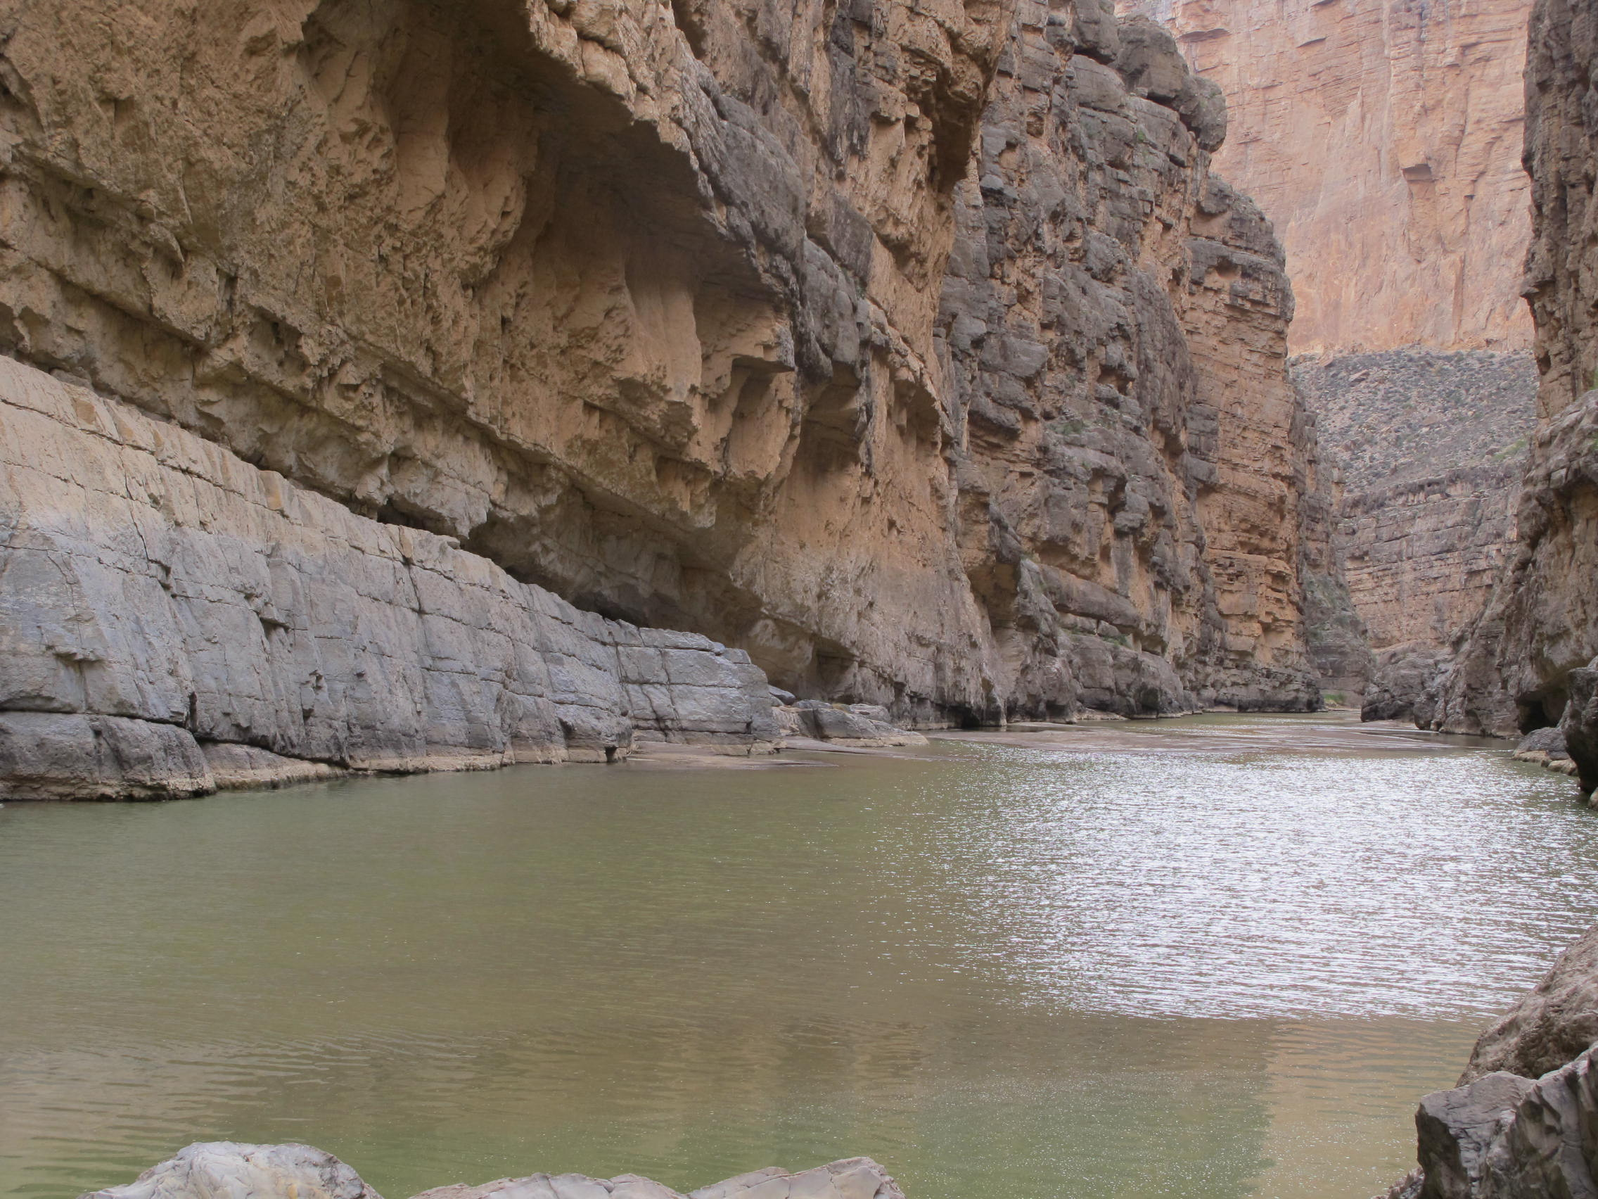

Slide 4
Today’s Presenters:
Olga Morales
Regional Manager
Rural Community Assistance Corporation
Mark Pearson
Development Management Specialist
Communities Unlimited
Ted Stiger
Policy Director, RCAP

Slide 5
RCAP Colonias Project
New TA Program part of Phase IV & V of USDA-RD/EPA Colonias Initiative
Program started September of 2017 and runs until August 2018
Partnership between RCAP National, CU, and RCAC serving the four state colonias region

Slide 6
RCAP Colonias Project
30 projects total in 60 Priority 1 and 2 colonias areas
2 projects must be regional in scope
Project activities:
  Organizational and TMF
  Pre-development
  Application assistance
  Regulatory compliance or regionalization

Slide 7
Colonia Communities - History

Slide 8
What are Colonias Communities?
Colonia communities started as unincorporated and unregulated settlements along the United States-Mexico border. They grew rapidly during the 1980s as thousands of legal and illegal immigrants, primarily Mexican but also Central American, settled in them because they could not pay for other housing.

Slide 9

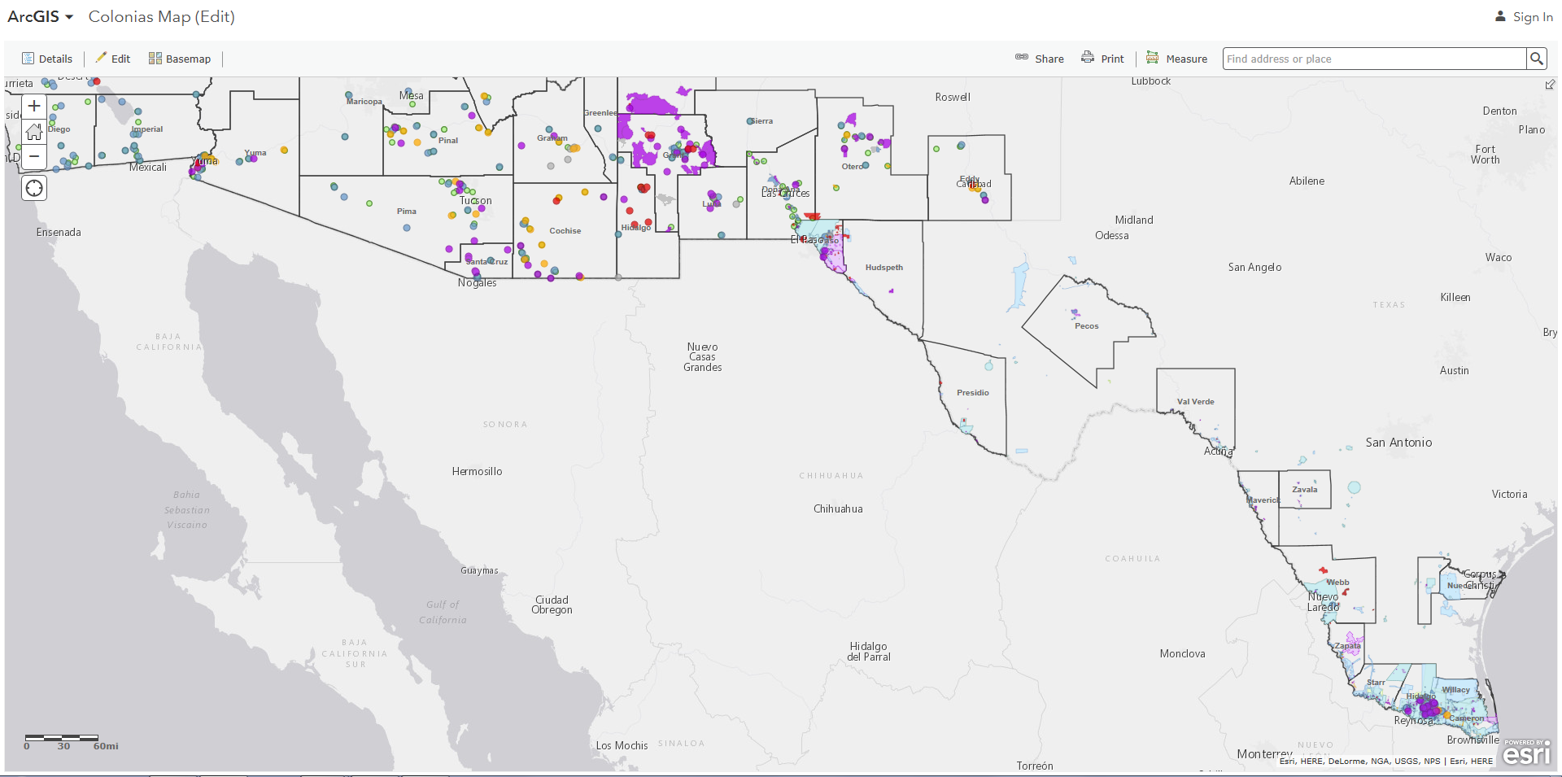

Slide 10
Cranston-Gonzalez National Affordable Housing Act of 1990
The Act defines a colonia as any identifiable community
Located within 150 miles of the United States-Mexico border in Arizona, California, New Mexico and Texas
Which was in existence before November 28, 1990
Lacking a potable water supply, adequate sewage systems, and decent, safe and sanitary housing

Slide 11
USDA – Colonias
Unincorporated and incorporated communities characterized by low income populations, sub-standard housing and lack of or inadequate community water and/or wastewater systems along with other essential infrastructure
It must have existed and been recognized as a Colonia prior to October 1, 1989

Slide 12
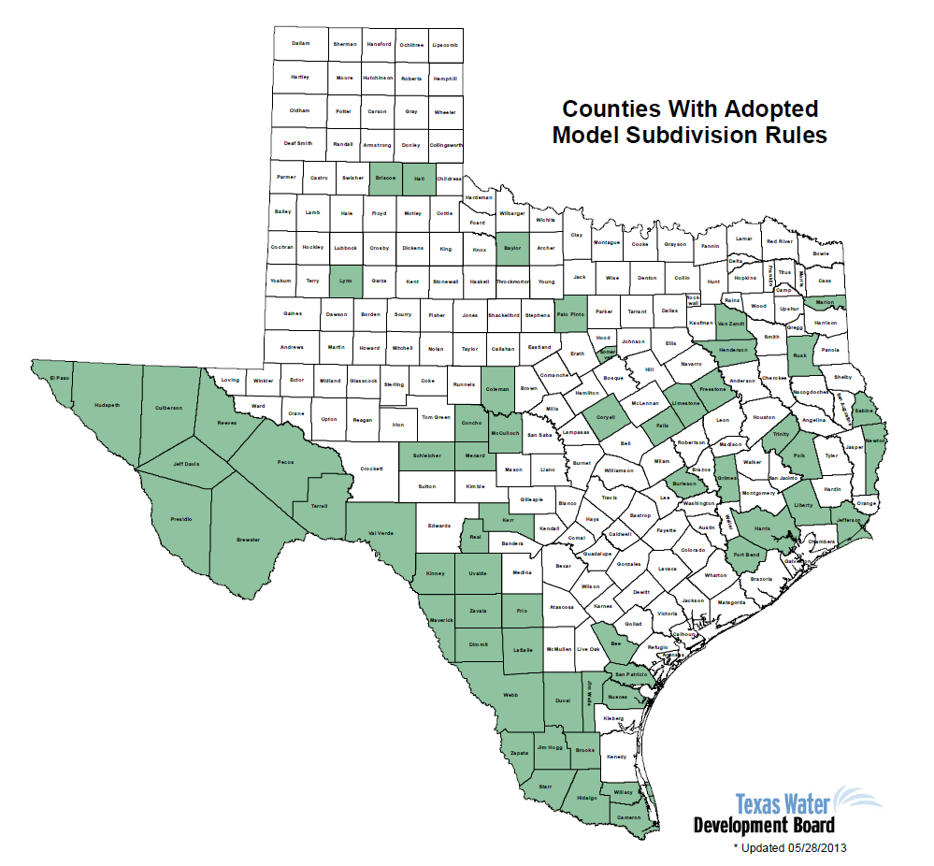
Colonia
prevention history (TX)
1989 Model Subdivision Rules in Texas
“Build it or Bond it”
Tied to state EDAP
Funding.

Slide 13
RCAP and Colonias
RCAP has been working in the colonias region for nearly 30 years
Developed capacity in the areas of water, wastewater, housing and economic development
Accessing funding for infrastructure development projects

Slide 14
USDA / EPA Border Assessment
Phase 1: USDA / EPA Report (Scoping Assessment) – December 2013
Phase 2: USDA RD contracts RCAP to conduct Border Needs Assessment
Fall 2014 – June 2015
…Current Phase FY18: Technical Assistance & Outreach to support project development where feasible and beneficial

Slide 15
USDA / EPA Border Needs
Assessment and Support Project
Scoping assessment (2013)
Targeted outreach (2014 - 2015)
Technical Assistance Strategy Designed (end of 2015)
Technical Assistance Delivery (2015 - 2016)
Impact analysis (2015-2017)

Slide 16
U. S. – Mexico Border Needs Assessment and Support Project (Phase I – Scoping)
Government Accountability Report 2009
Assessment conducted in 2013
Prepared by USEPA & USDA

Slide 17
Phase 1: USDA/EPA Report

Slide 20
Phase I vs. Phase II Colonia Communities
Phase I
Phase II - RCAP
NM =154
TX = 1884
CA = 35
AZ = 104

Slide 21
Phase 2: RCAP Assessment
  Reviewed colonia needs across TX, NM, AZ, CA
  Contacted partner agencies working on colonia issues: prior data, prior projects funding, colonia planning data, SRF PIFs
  Met with Utility Managers & others across 34 counties
  Classified Colonia Needs as Priority 1 – 5
  Narrative Report
  RCAP Colonias Geodatabase

Slide 22
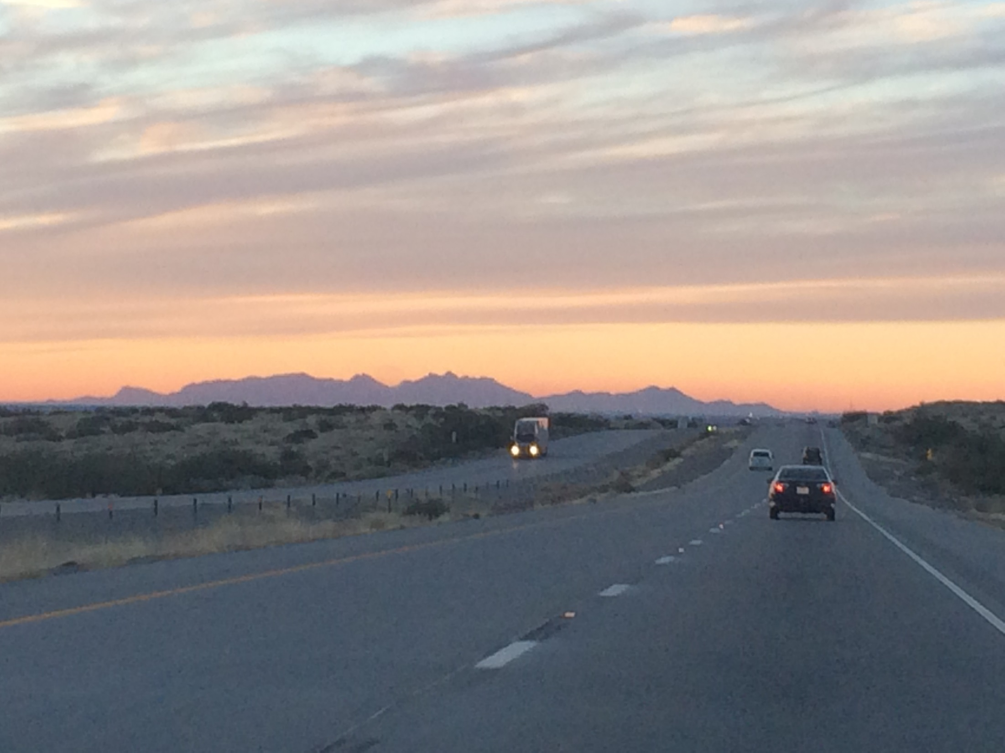

Slide 23
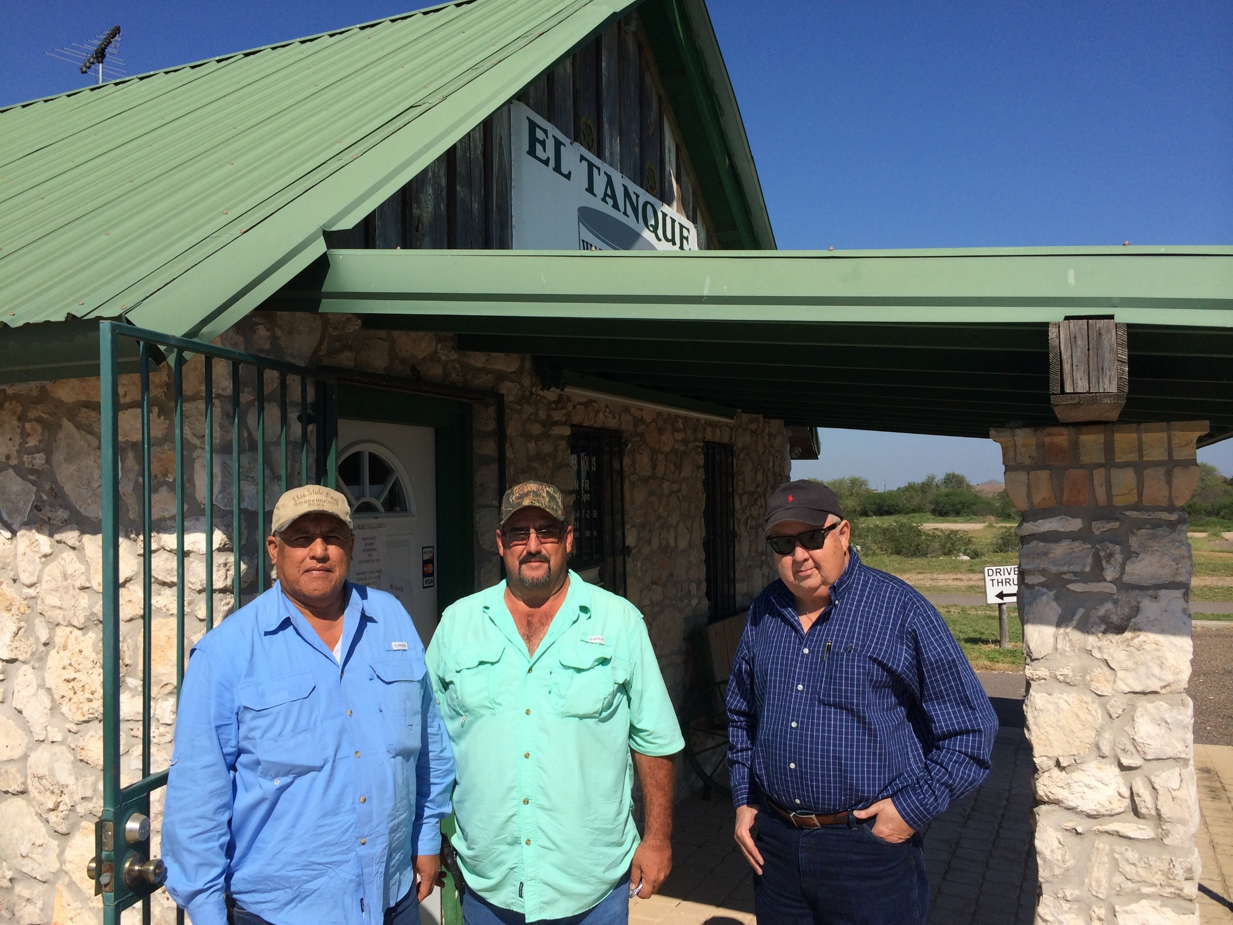

Slide 24
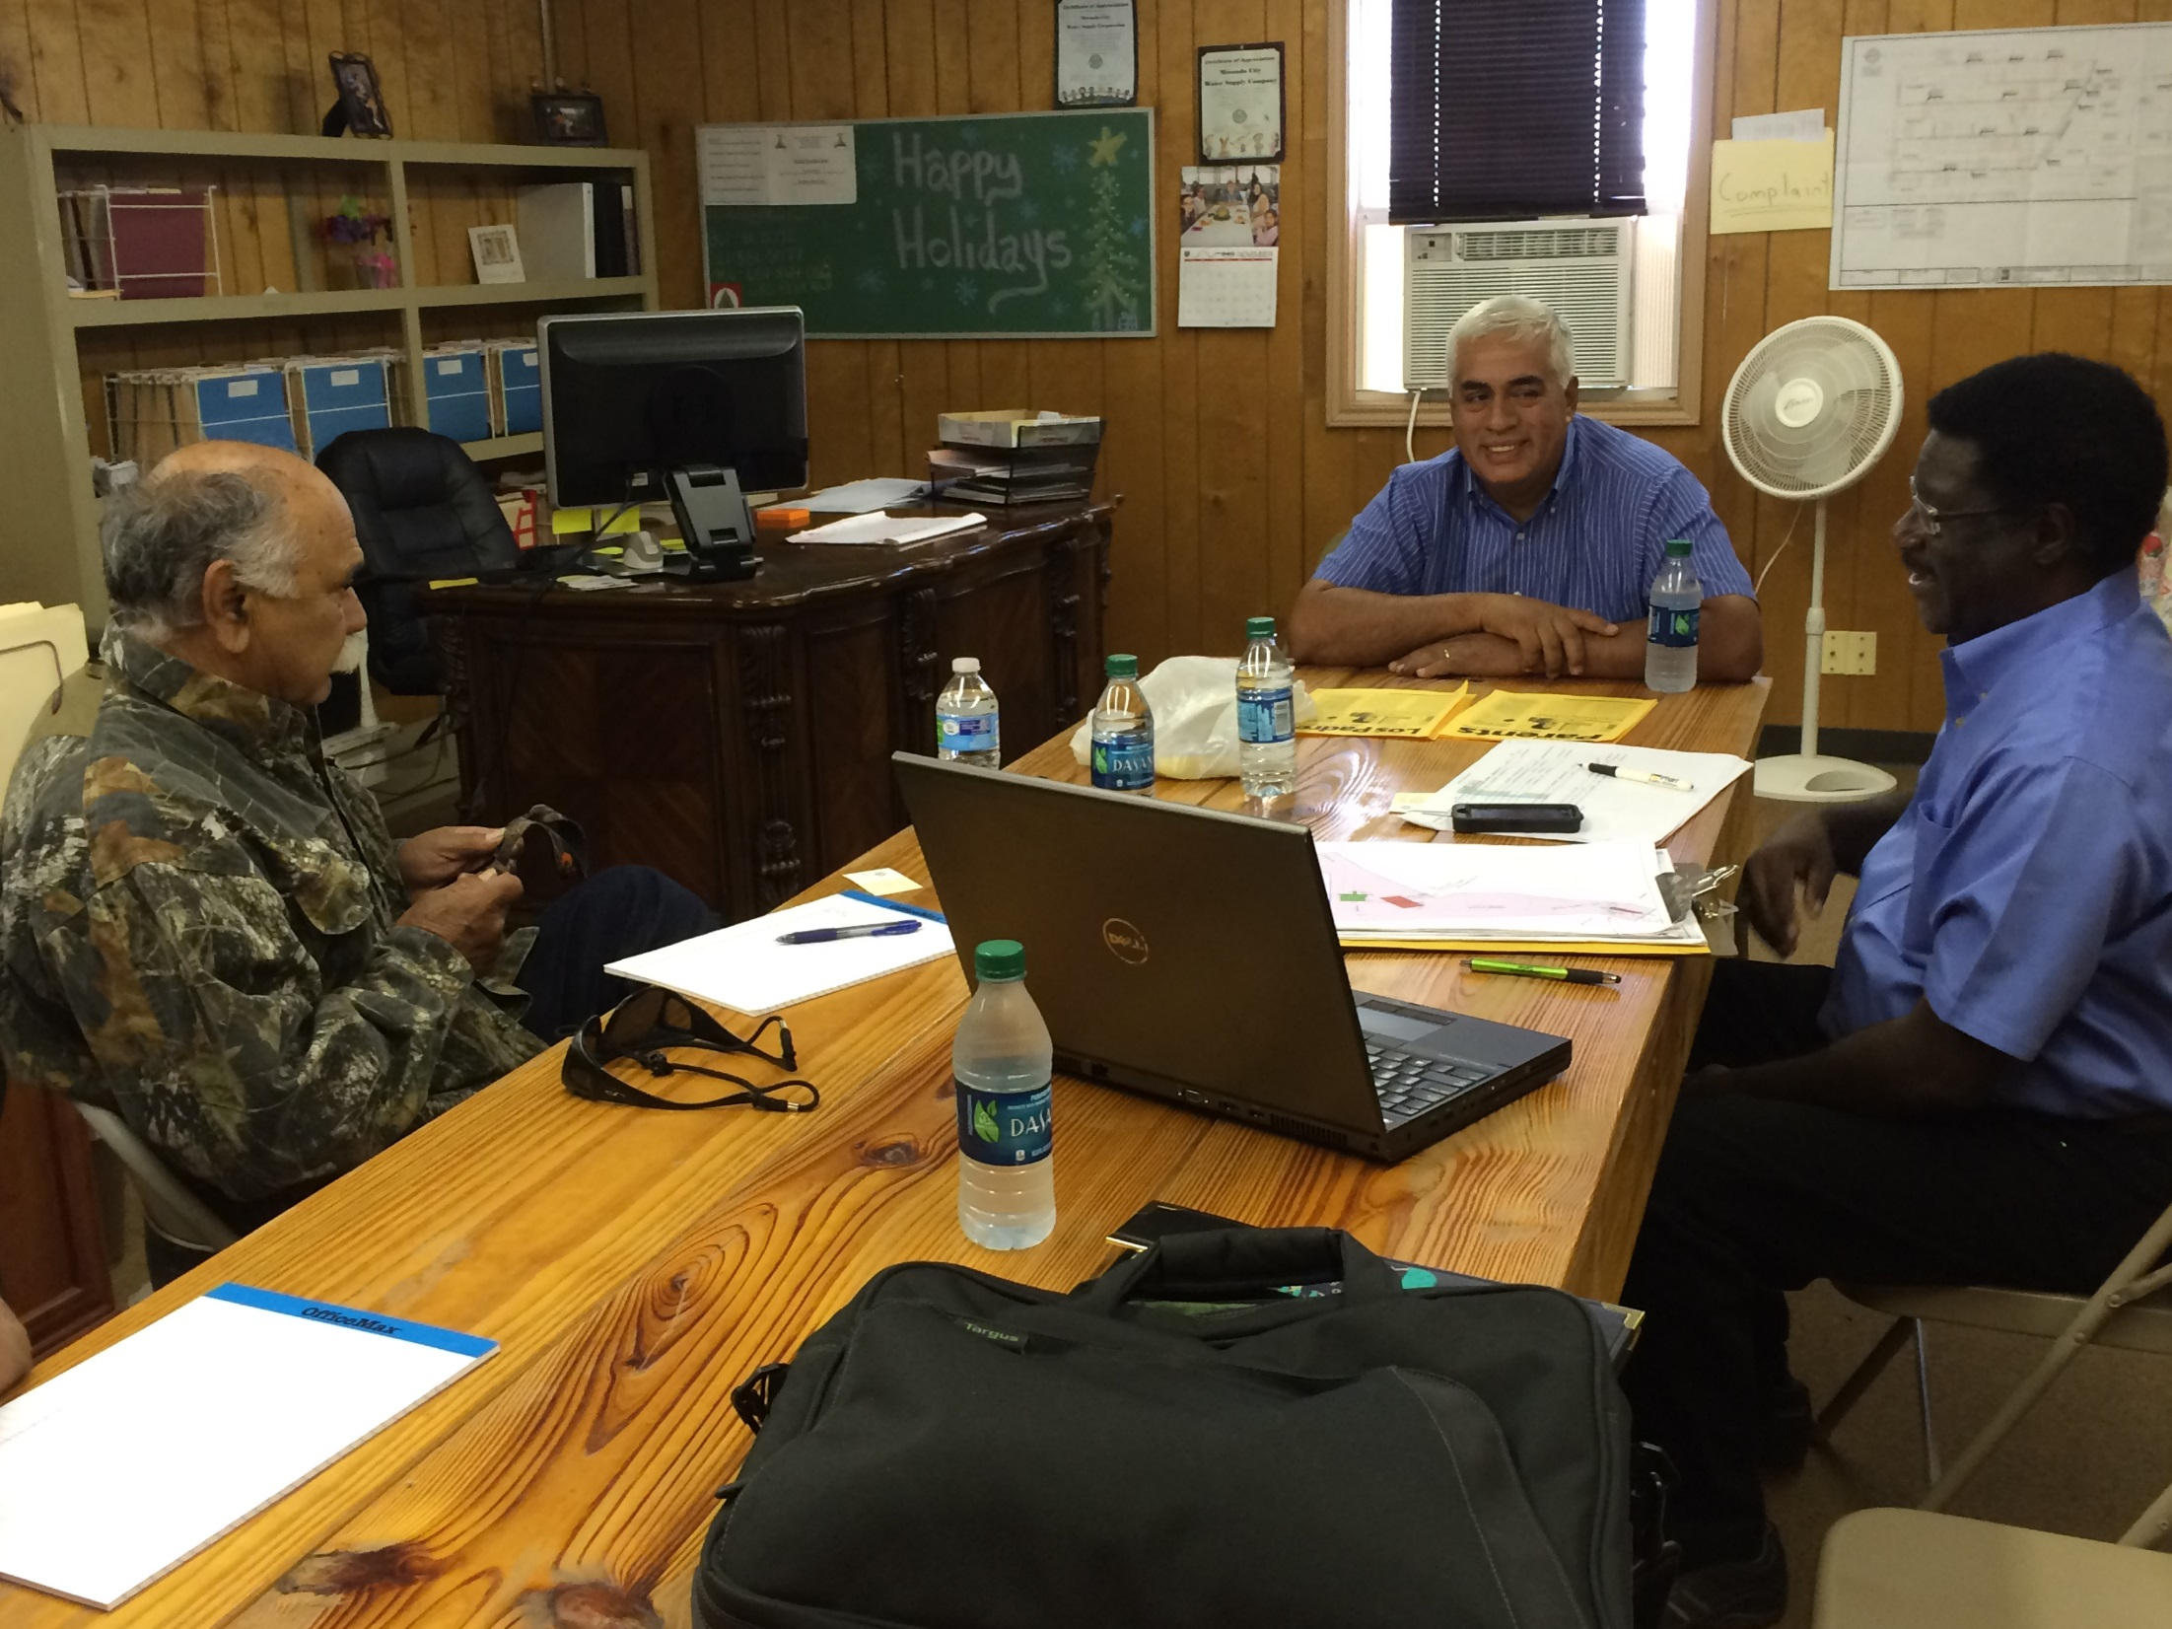

Slide 25
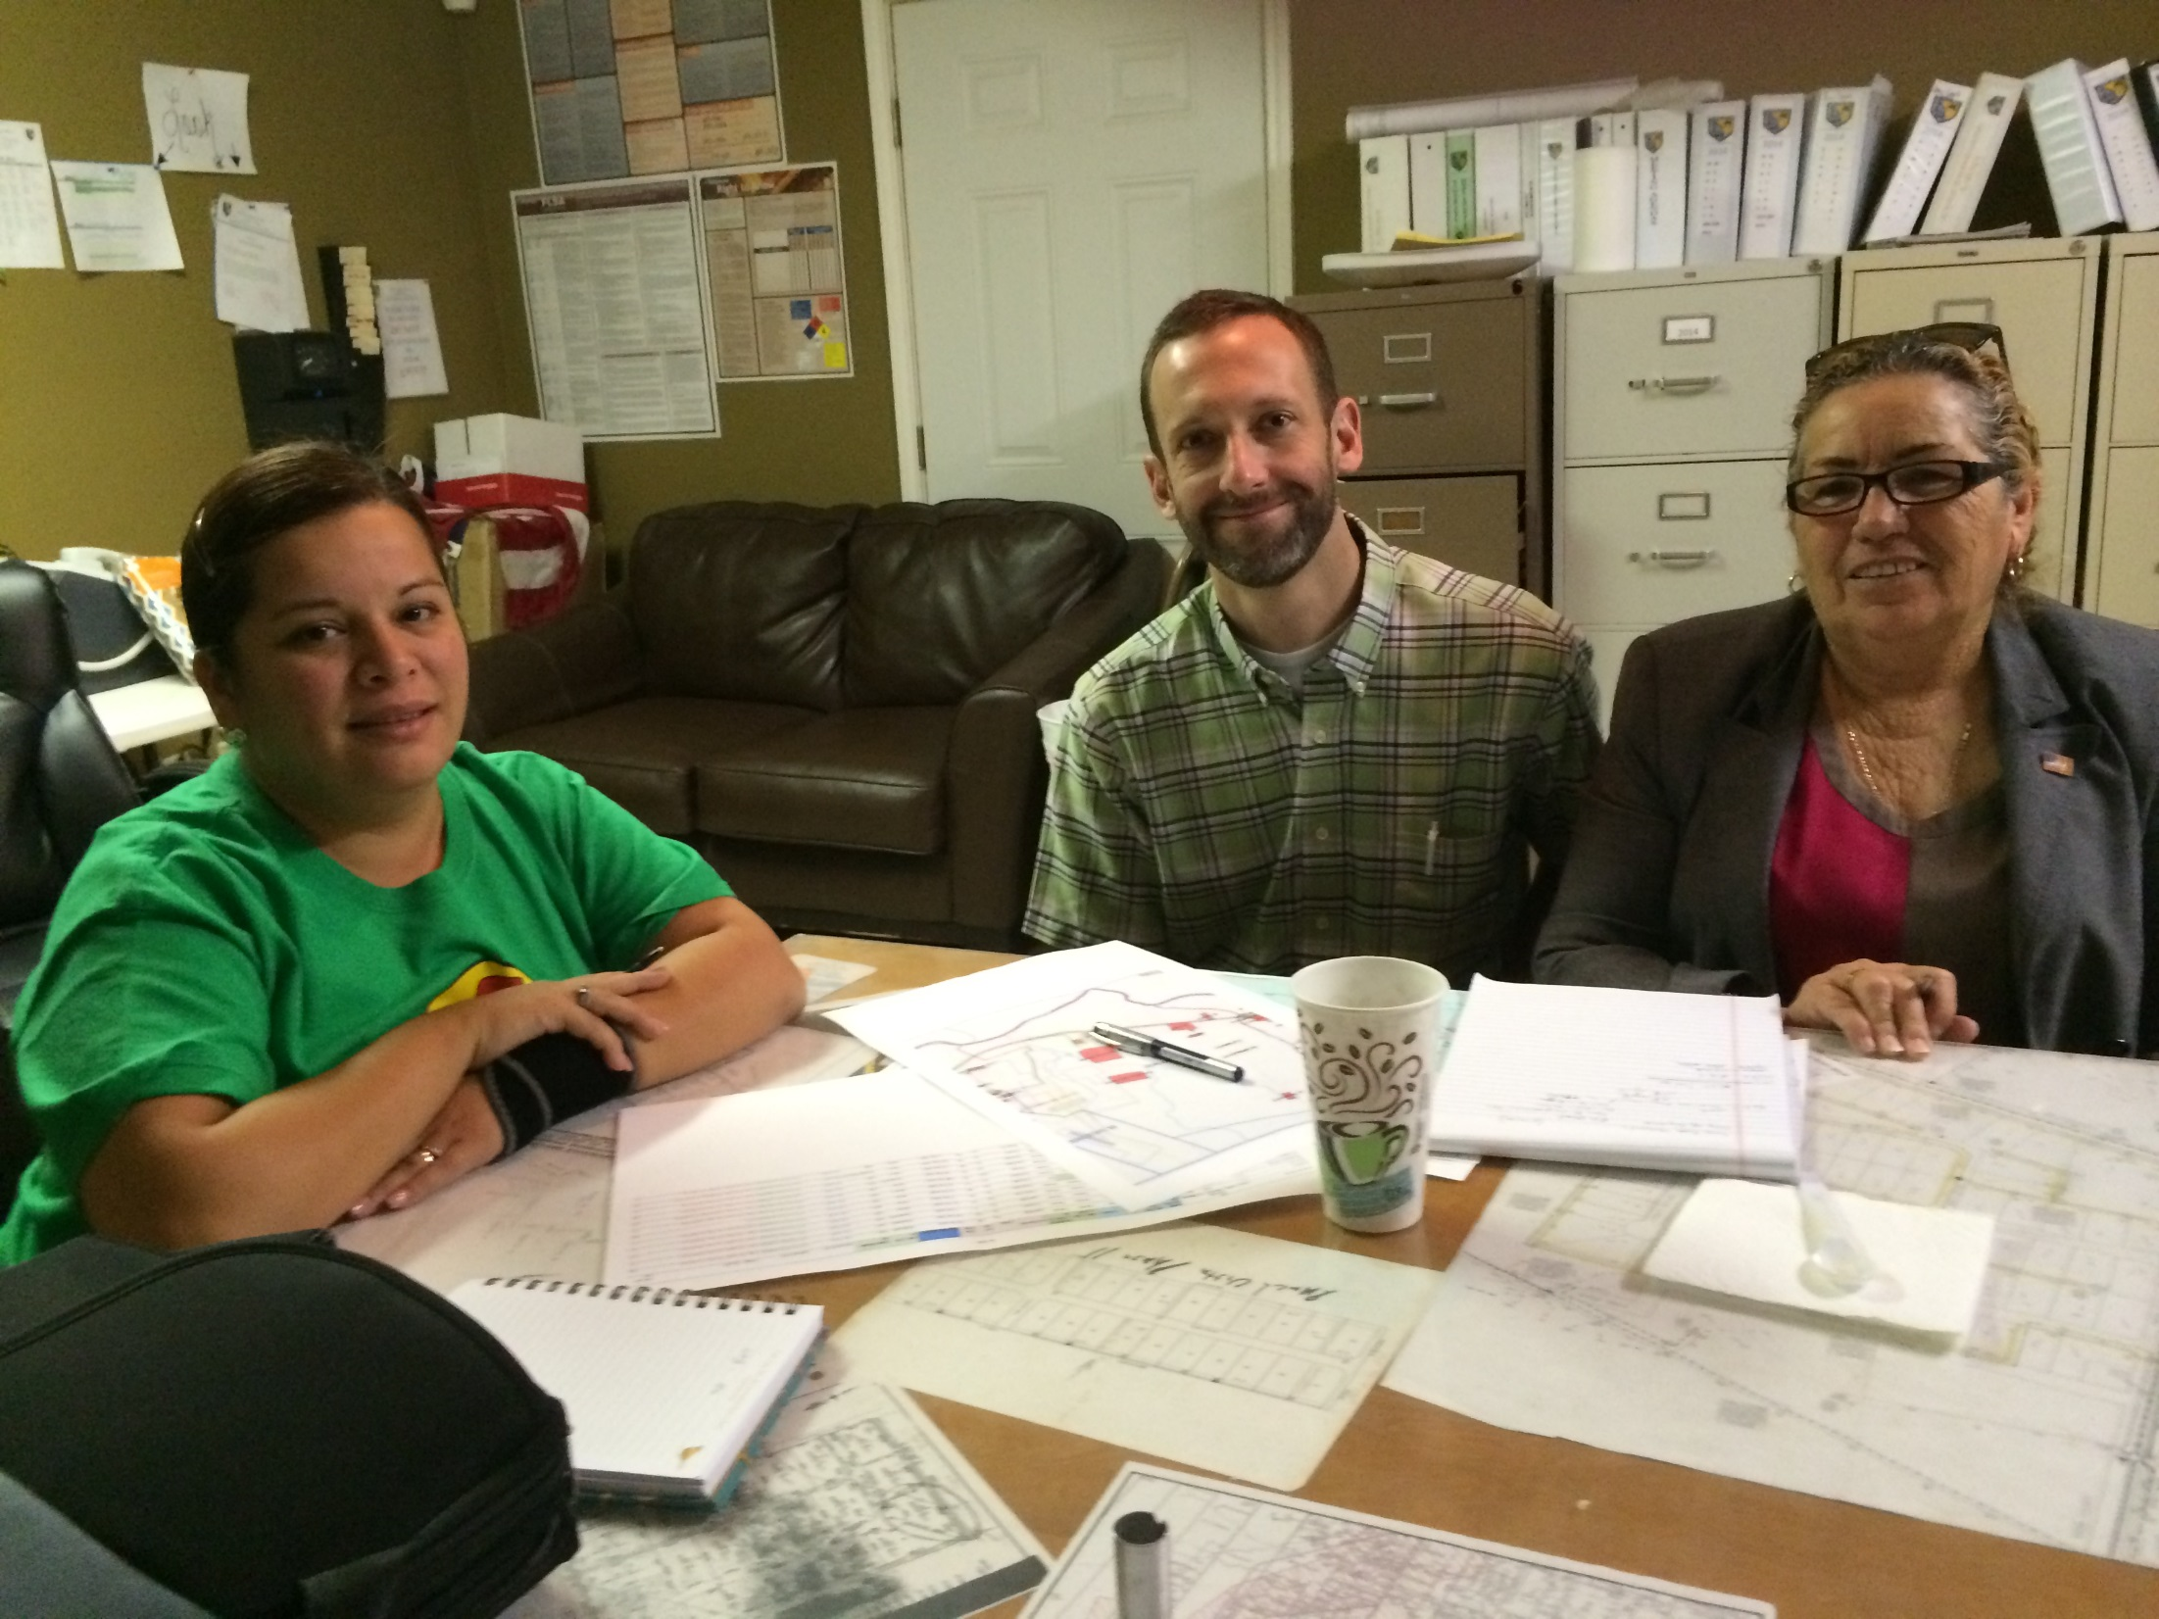

Slide 26
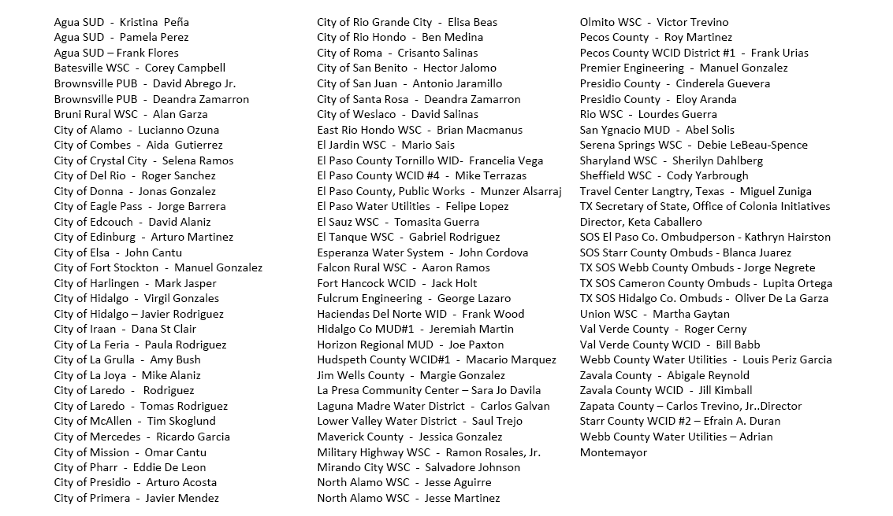
Partnerships: Meeting with Local Utilities and others (TX)

Slide 27
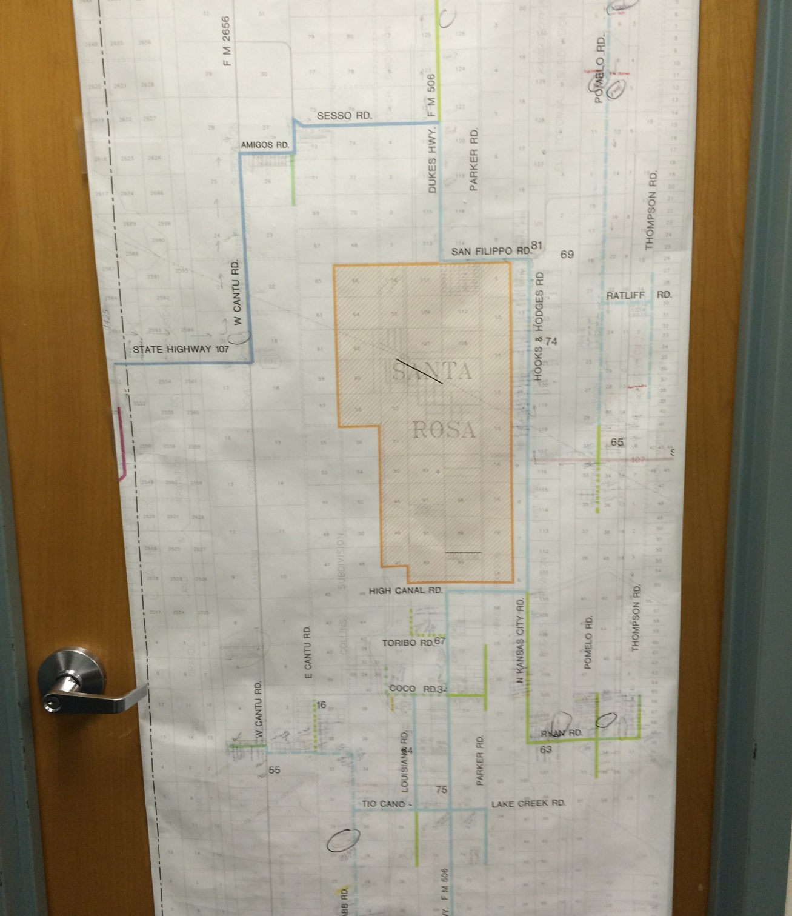

Slide 28
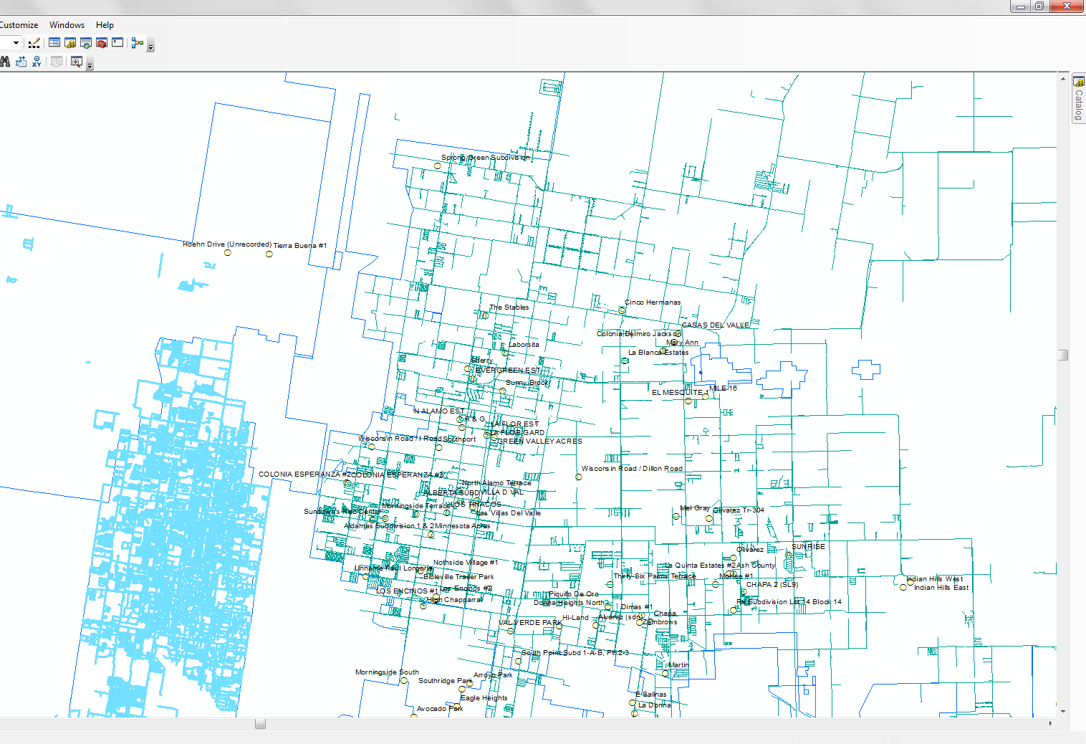

Slide 29
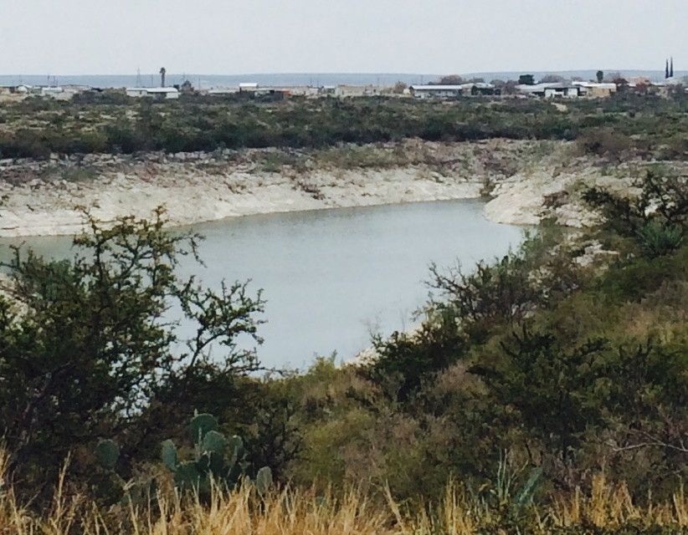
General Findings & Recommendations

Slide 30
Findings & Recommendations
Significant progress to date in improving water/waste infrastructure
About 75% of the 2,177 Phase II assessed colonias with adequate water and waste infrastructure
About 25% (~600) of the colonias were classified as having infrastructure needs
High priority colonias are typically lower in population, isolated, and require high costs per dwelling

Slide 31
Findings & Recommendations
Most utilities serving border counties demonstrate adequate capacity
Many smaller utilities may lack capacity and require general and project-specific technical assistance
No process exists to “de-list” or “graduate” colonias. Some areas may no longer fit the original “colonia” definition.

Slide 32
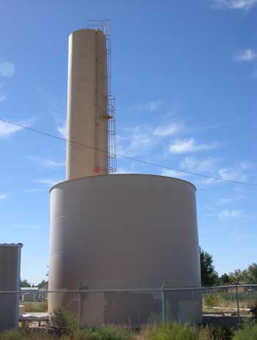
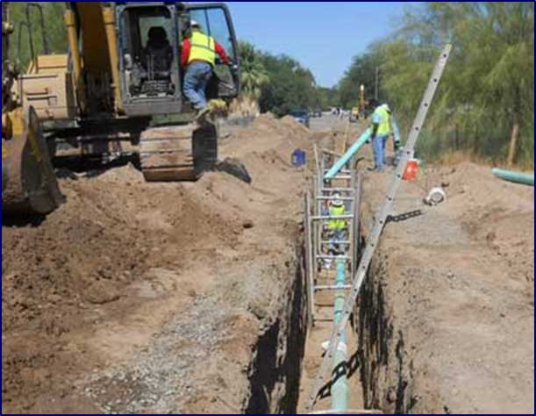
Findings By State

Slide 33
Arizona
104 Colonias-29 Colonias with W/WW needs
Most have access to drinking water but a large number of them are on septic systems
Some septic systems were not permitted; operating conditions are unknown
Small lots with cesspools, private wells, and high ground water = great risk of contamination of ground water
High levels of fluoride in ground water, private wells not tested

Slide 34
California
35 designated colonia communities
One high needs colonia(s)
Most colonias on public water systems
Majority have septic systems
Some not permitted

Slide 35
New Mexico
154 Colonias-81 Colonias with W/WW Needs
Some colonia residents are hauling water
Significant number of colonias with large population numbers without running water or wastewater systems
Drought has greatly impacted private well owners

Slide 36
Texas
1884 Colonias in study area-493 Colonias with W/WW Needs
Many already served and need to be de-listed
Isolated pockets of difficult to reach households
Some unserved colonias have low numbers of residents and often very low incomes
Some unserved colonias have a high cost per connection to be served (feasibility?) or other barriers to potential service

Slide 37
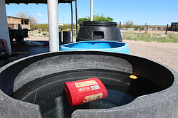
Prioritization of Colonias

Slide 38
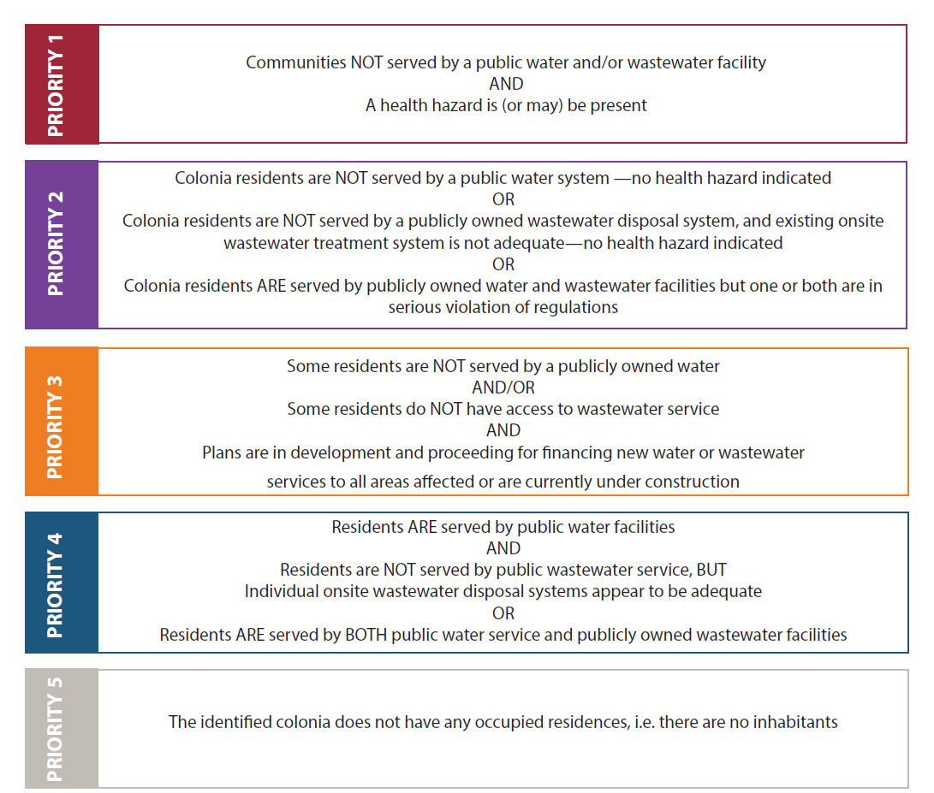
RCAP Study Prioritization
*Focus for TA on Priority 1 + 2 areas

Slide 39
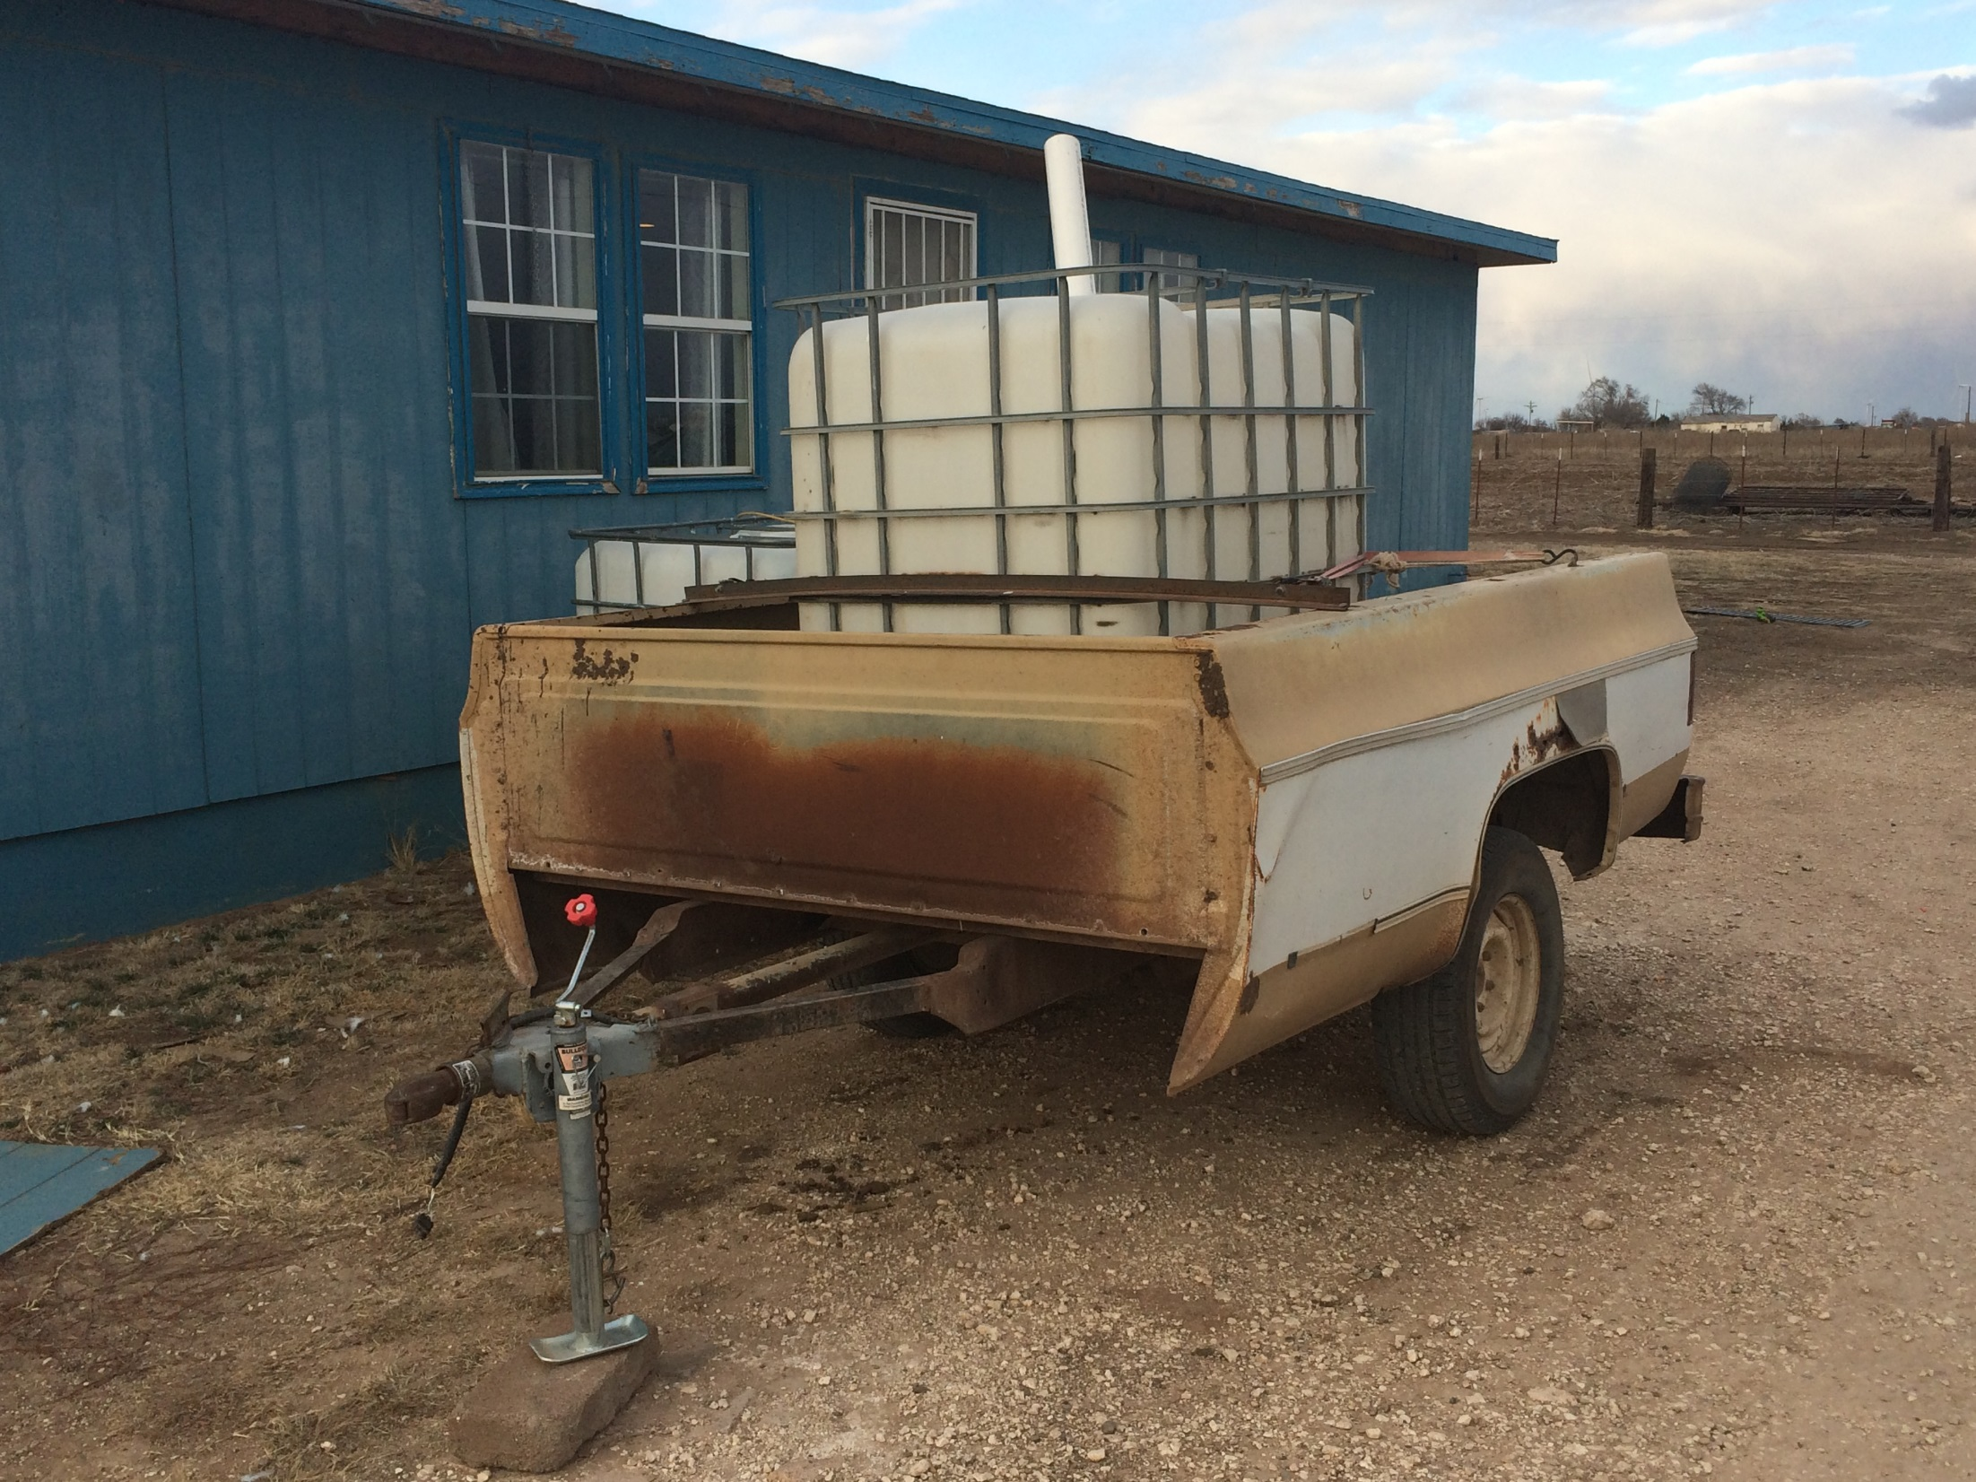

Slide 40
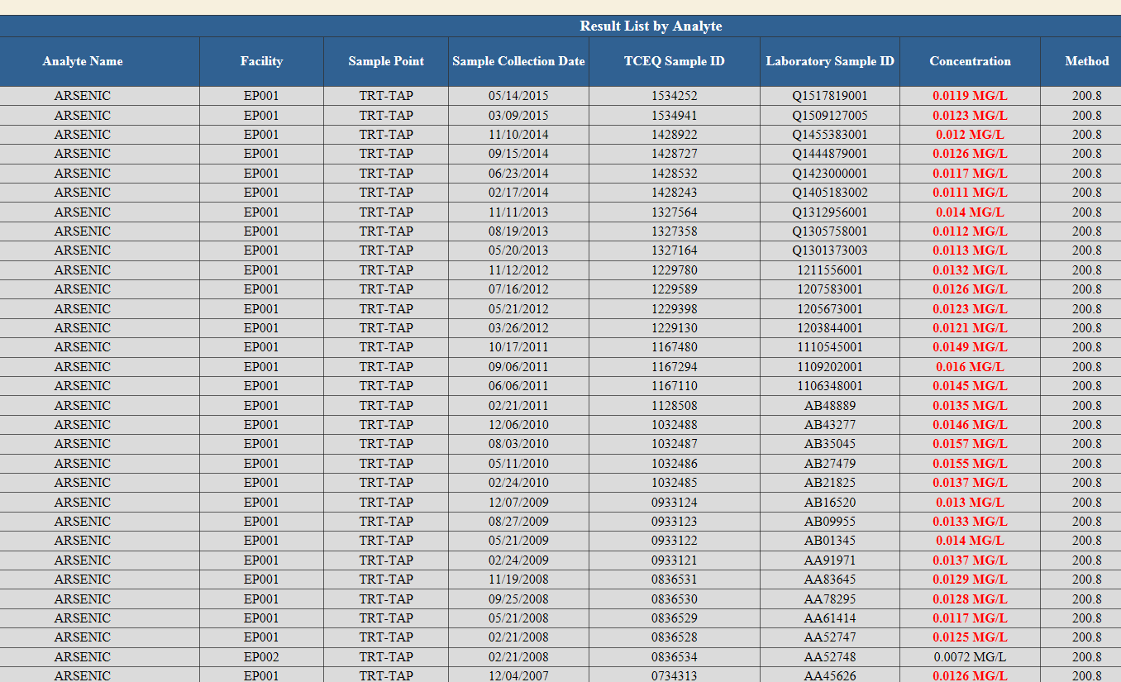
A few existing very small water systems with EPA Order for Arsenic MCL violations

Slide 41
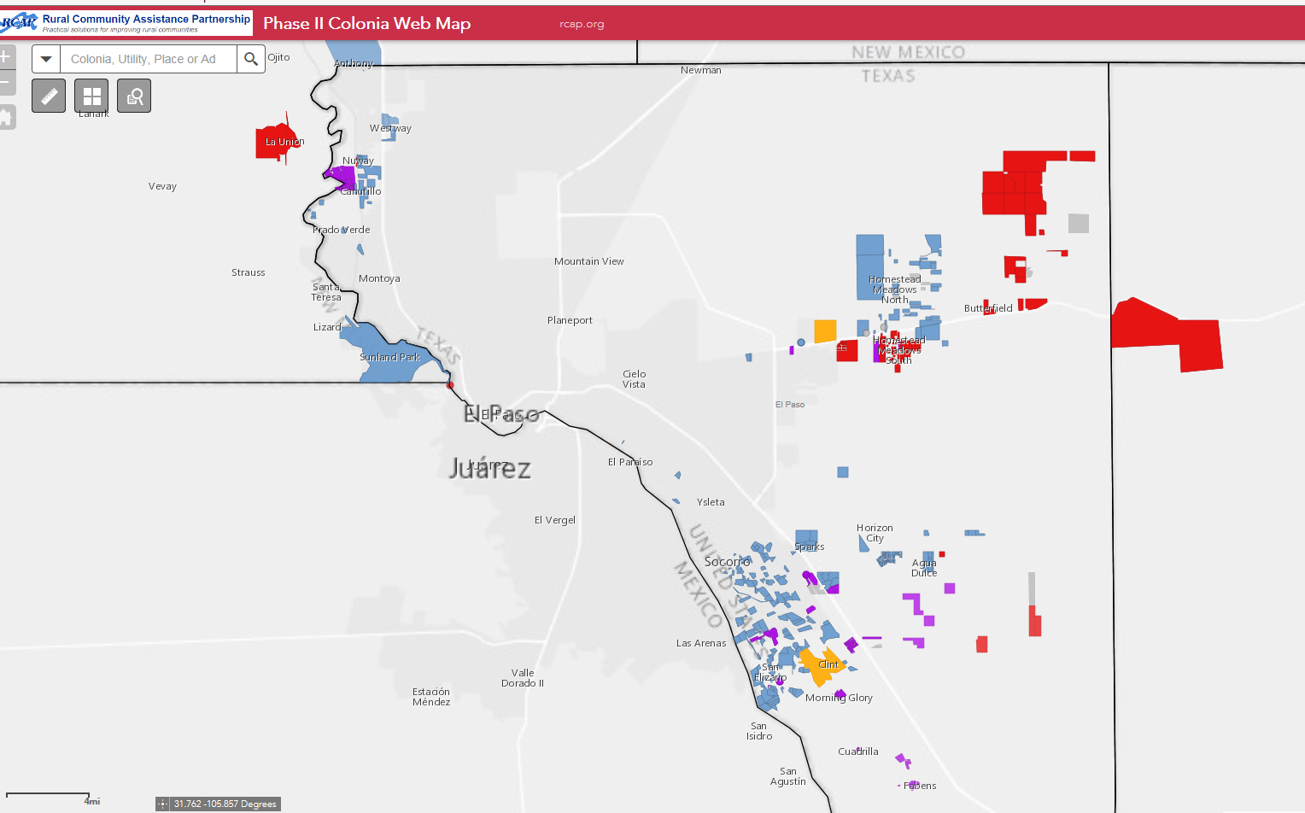
Example of RCAP Colonia GIS database by Priority color. El Paso Co, Texas.

Slide 42
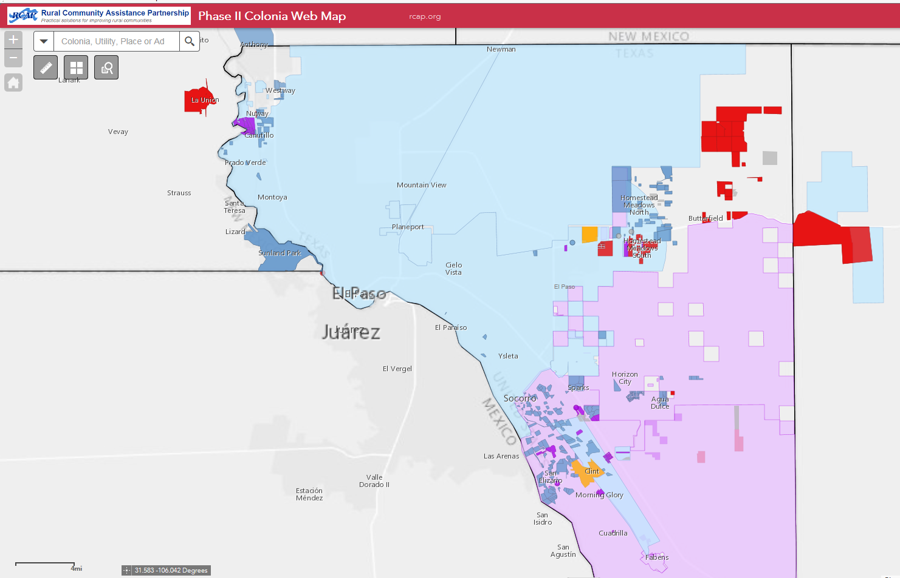
Example overlaying Utility CCN & District Service Areas. RCAP Colonia GIS, El Paso Co, Texas.

Slide 43
Current FY18 RCAP TA Work:
Technical Assistance & Outreach to support project development where needed, feasible and beneficial
1. CU and RCAC working closely with USDA RD Area offices to provide technical assistance where needed for successful project development.
2. Developing pipeline of future USDA 306c and SEARCH/PPG Grant applicants in FY18 and beyond. Note: Does not limit funding from other applicants or other sources.
3. Identifying other funding, partnership opportunities, and technical assistance methods for difficult to serve areas.

Slide 44
Regionalization Projects
Work with communities that are relatively close together facing similar challenges
Eliminate redundancies
Create economies of scale

Slide 46
Discussion on Regionalization

Slide 47
Project funding sources discussion
USDA RD – SEARCH Grants
USDA RD 306c (Colonia funding)
HUD/CDBG
DWSRF & CWSRF
North American Development Bank (and previously BECC)
State or Other funding sources

Slide 48
Continued... funding sources discussion
State:
  Economically Distressed Areas Program (EDAP in TX). Near end of authorized funding.
Other funding sources?

Slide 49
Discussion on Funding

Slide 50
Other Discussion
  Funding. Where is USDA 306c Colonia funding best deployed?
  Potential partnership opportunities? (non-governmental also)
  Capacity development: Types of need and response?
  Past efforts and learning?
  Feasibility issues or alternative types of response needed for “unfeasible” projects?

Slide 51
Resources:
USDA/EPA Phase 1 Report (Scoping Assessment) – Dec. 2013 http://www.rd.usda.gov/files/RD_RUS_Phase1ResearchRpt.pdf
RCAP Colonias Phase 2 Assessment Report http://rcap.org/resource/rcap_colonias-phase-ii-assessment-report/
Public Facing Geodatabase: tinyurl.com/ColoniasPublic

Slide 52
Contact Information
Rural Community Assistance Partnership (RCAP) www.rcap.org
Rural Community Assistance Corporation (RCAC) www.rcac.org
Communities Unlimited (CU) www.communtiesu.org
Olga Morales
Regional Manager, Rural Community Assistance Corporation
575-382-6992 omorales@rcac.org
Mark Pearson
Communities Unlimited
512.284.3000 mark.pearson@communitiesu.org

Slide 53
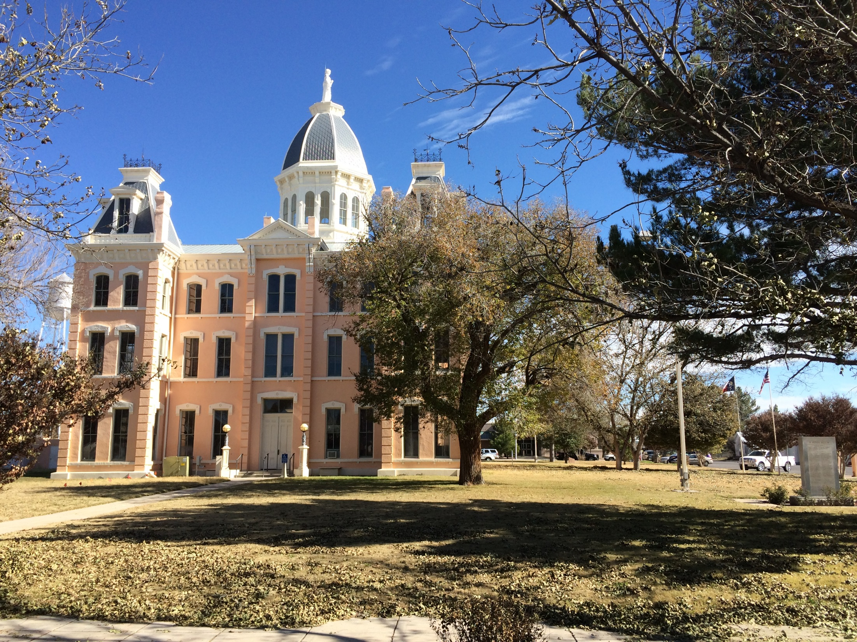

Slide 54
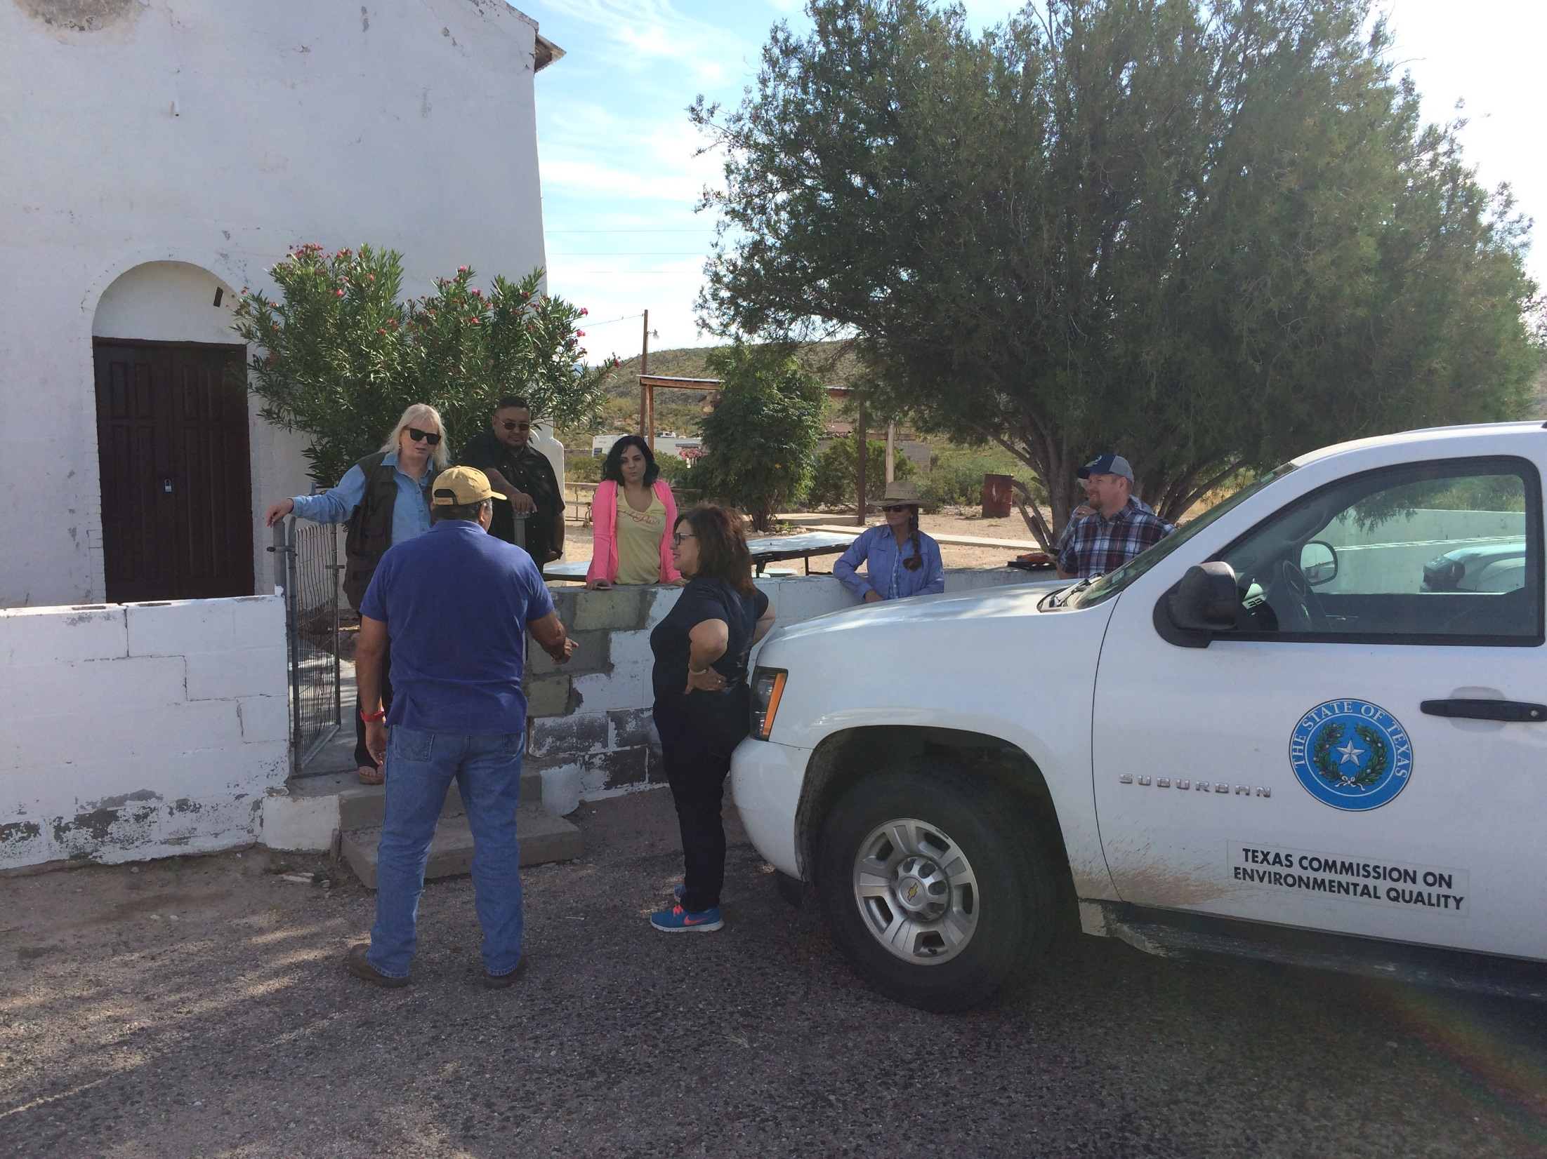

Slide 55
