Slide 1
Thinking Outside the Bin Part 1 Solid Waste Management National RCAP Training Conference April 2018

Slide 2
SWM – Thinking Outside the Bin Part 1
Objectives
Sharing of information
Sharing of resources
Sharing contact information

Slide 3
SWM – Thinking Outside the Bin Part 1
www.greatlakesrcap.org
Solid Waste Management programs within the states of:
Indiana
Kentucky

Slide 4
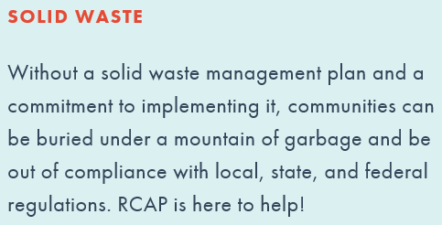
SWM – Great Lakes RCAP
Notes:
Debbie Hackman

Slide 5
SWM – Great Lakes RCAP - Indiana
Association of Indiana Solid Waste Management Districts
Local Solid Waste Management Districts
County Solid Waste Programs
City/Town Solid Waste Programs
Rural Solid Waste Programs
Notes:
Debbie Hackman

Slide 6
SWM – Great Lakes RCAP - Indiana
PROBLEM AREAS
Electronic Waste
Hazardous Household Waste
Recycling Contamination
Rising Cost of Handling Solid Waste (particularly recycling)
Medical Waste (sharps/pharmaceuticals)
Personnel
Green Sword
Legislative Issues
Notes:
Debbie Hackman

Slide 7
SWM – Great Lakes RCAP - Indiana
TRAININGS
Advocacy
Record Retention
State Mandated Reporting
Writing Your Five Year Plan
Policy Development
Leadership and Communication
Landfill Design and Operation
Disaster Debris Planning
Notes:
Debbie Hackman

Slide 8
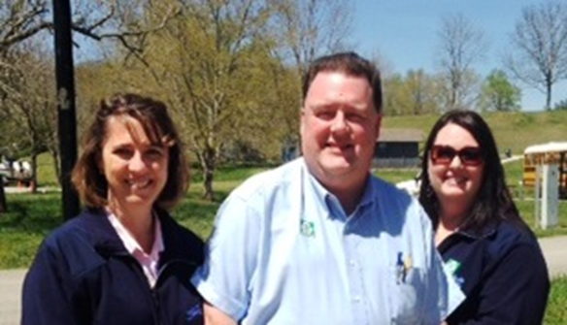
SWM – Great Lakes RCAP - Kentucky
SWM – TAT Approach
Single community
Recycling
Center start-up
Curbside collection
Program Marketing
Environmental Education
Schools
Community Events
Civic Programs
Partnerships
Notes:
Melissa Melton - Our Team of Kim, Chris, and Melissa
KY’s Appoach to date
Displays designed; full marketing programs designed and used in all media outlets
Partnerships w/ County Extension Agencies (4-H Agent), County Conservation Districts (provide 5th Grade Environmental Day – that’s us at a )
Environmental Education – Enviroscapes (SWM
The Kentucky RCAP SWM Team of Kim Padgett, Chris Wells, and myself at a 5th Grade Environmental Day Camp at Dale Hollow SRP Campground.

Slide 9
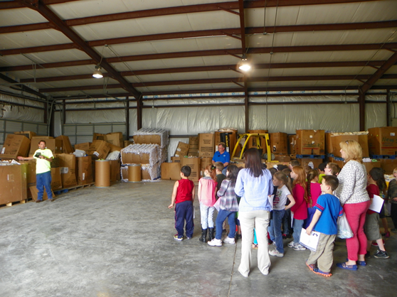
SWM – Great Lakes RCAP - Kentucky
The Minimizer Recycling Crusader
 Scotty
Open House – provided tours to all grades of all local schools, businesses, citizens (Certificates of Participation presented) 
Notes:
Melissa Melton
The Minimizer Recycling Crusader Scotty – Kim Padgett or myself
Scotty is poplar w/ the younger kids from K – 2nd grades
This is Kim within a county Head Start class

Slide 10
SWM – Great Lakes RCAP - Kentucky
Notes:
Melissa Melton
Field Trip for the adjoining county’s Special Needs class. This group performed all day-to-day collection of recycling at the County High School; this photo for the newspaper w/ the Classroom Plague acknowledging their service. Recycling Center Tour and restaurant program celebrating this group’s contributions.

Slide 11
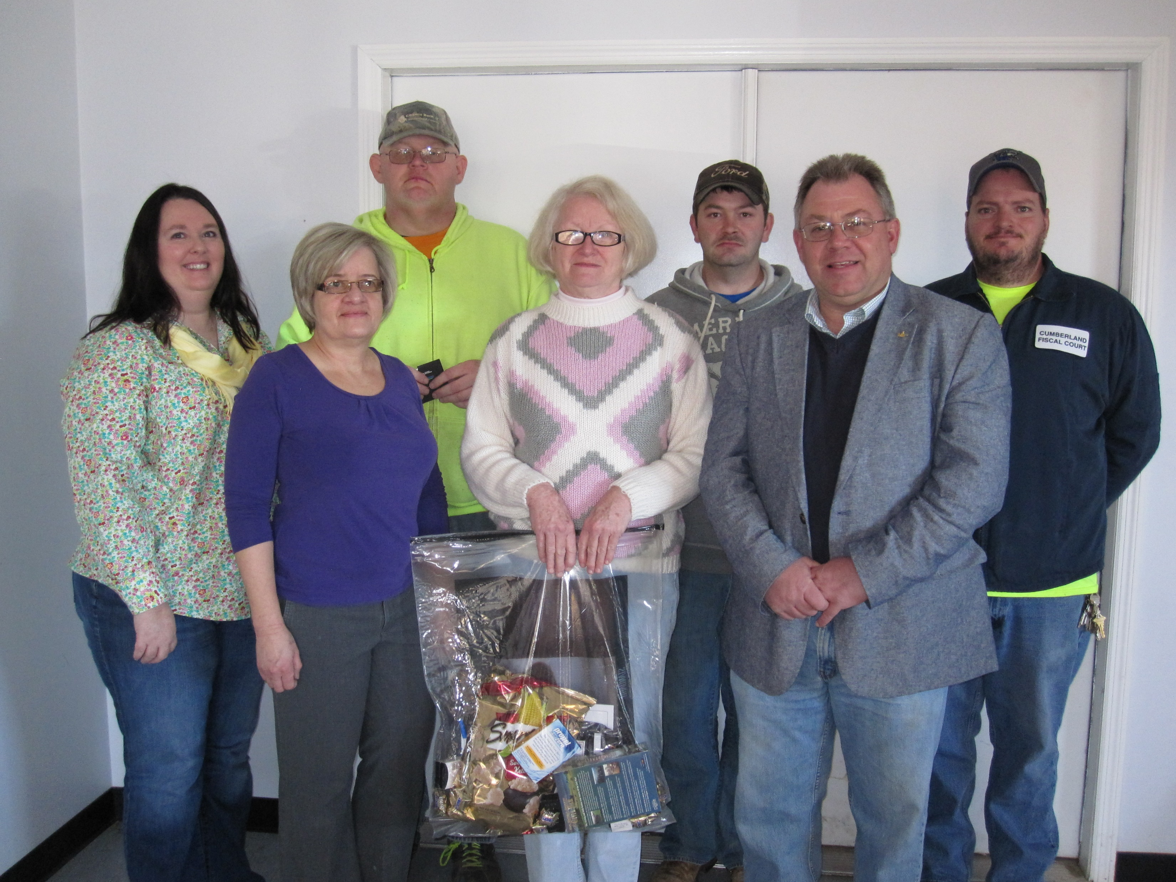
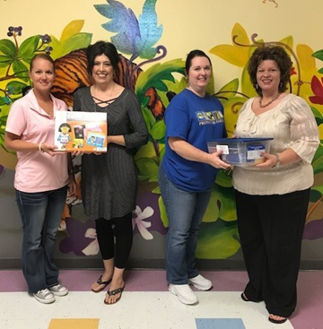
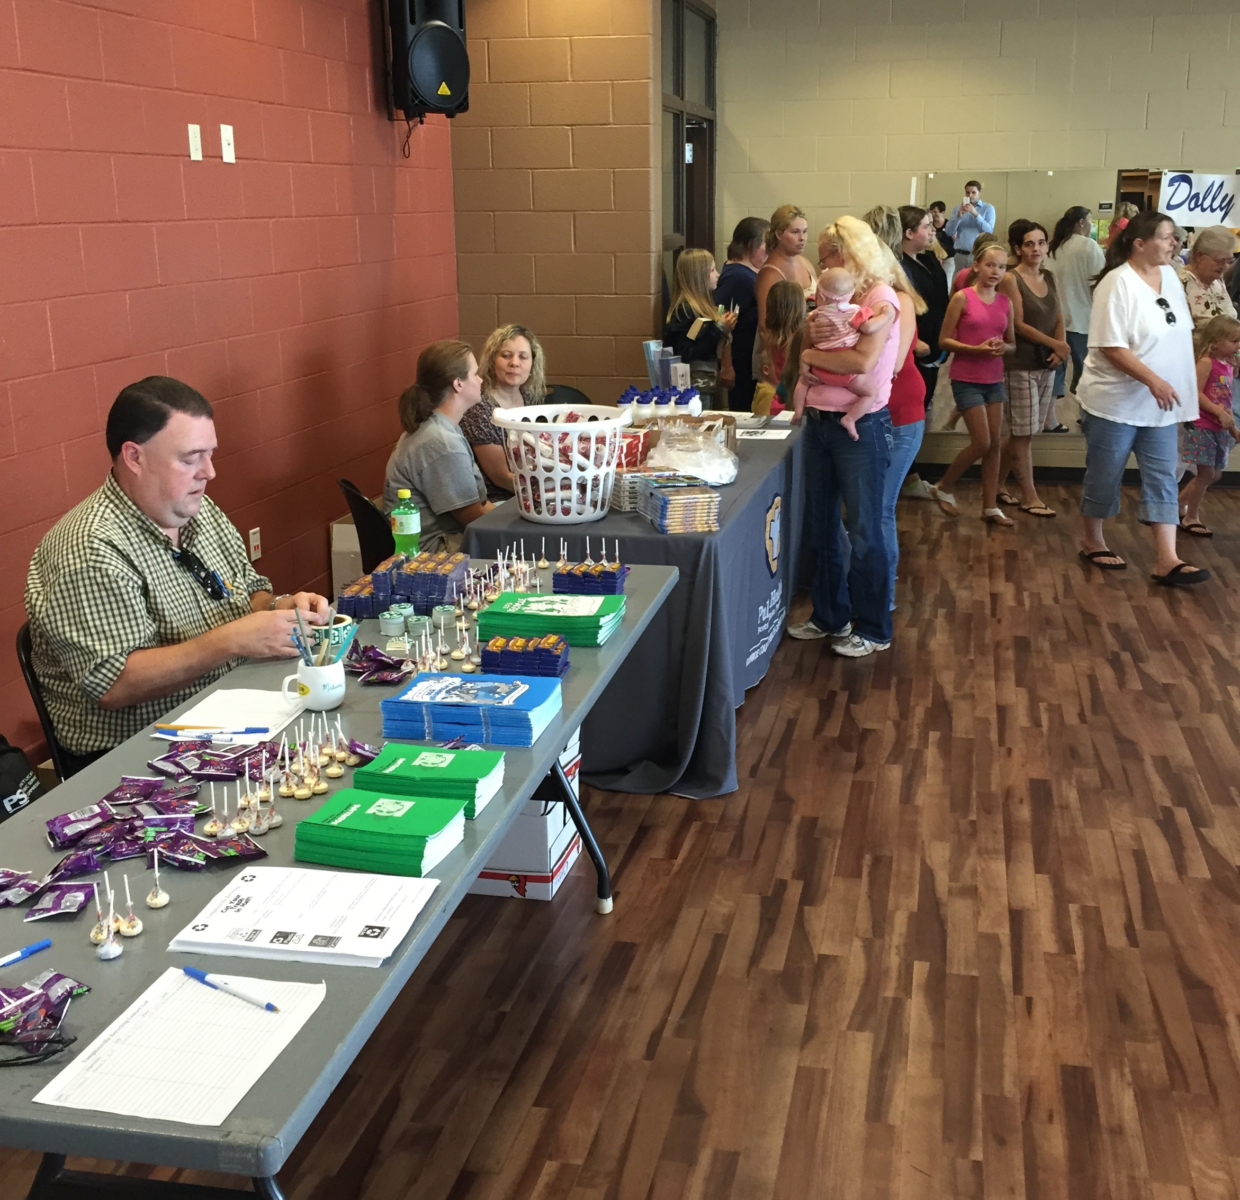
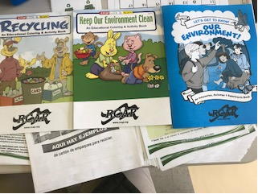
SWM – Great Lakes RCAP - Kentucky
Notes:
Melissa Melton
Upper Left – photo for local newspaper of a local service Agency receiving the Recycling Center Participation Certificate – goal here to prominently display for clients to see at all local businesses and services
Upper Right – photo for local paper of Citizen winners of Recycling Volume Contest (local businesses/agencies provided Prizes for the Winners)

Slide 12
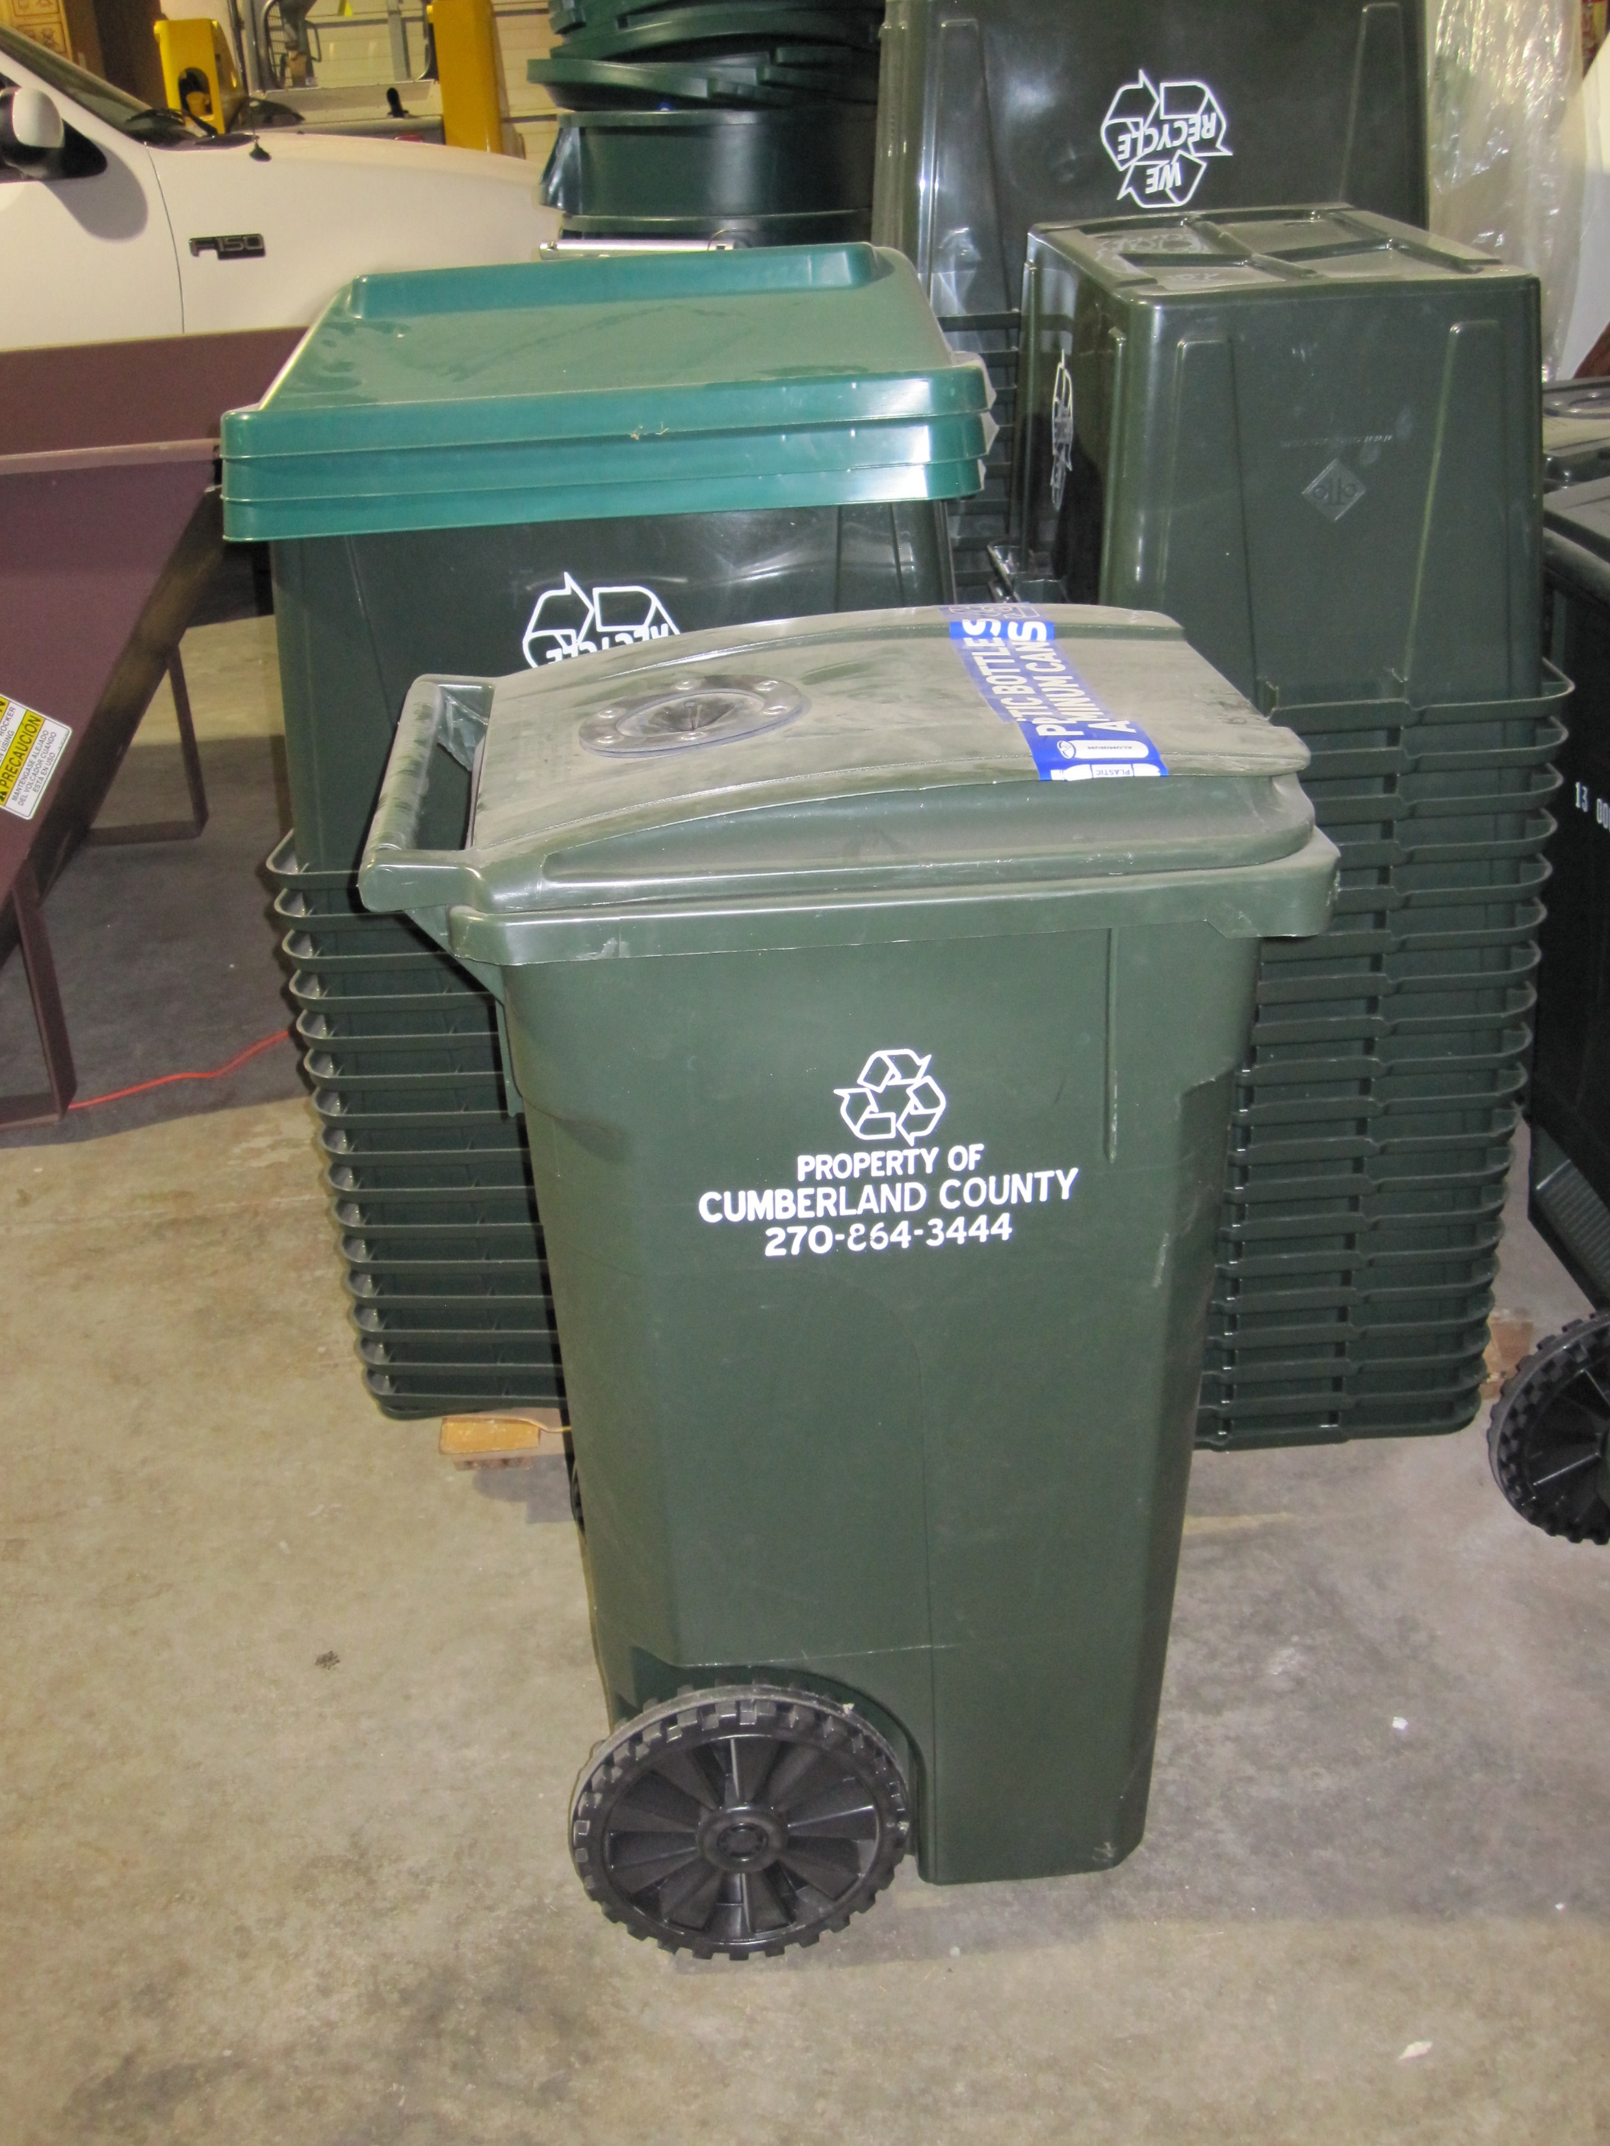
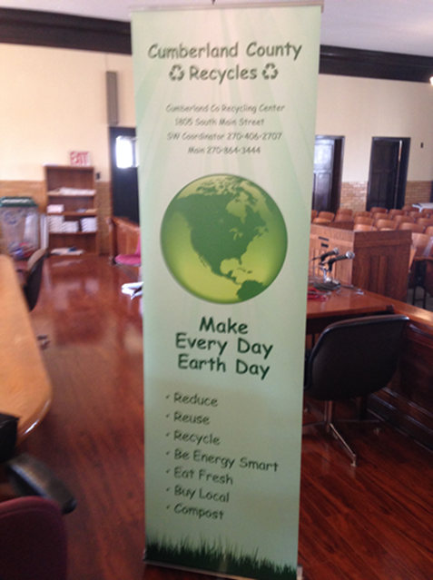
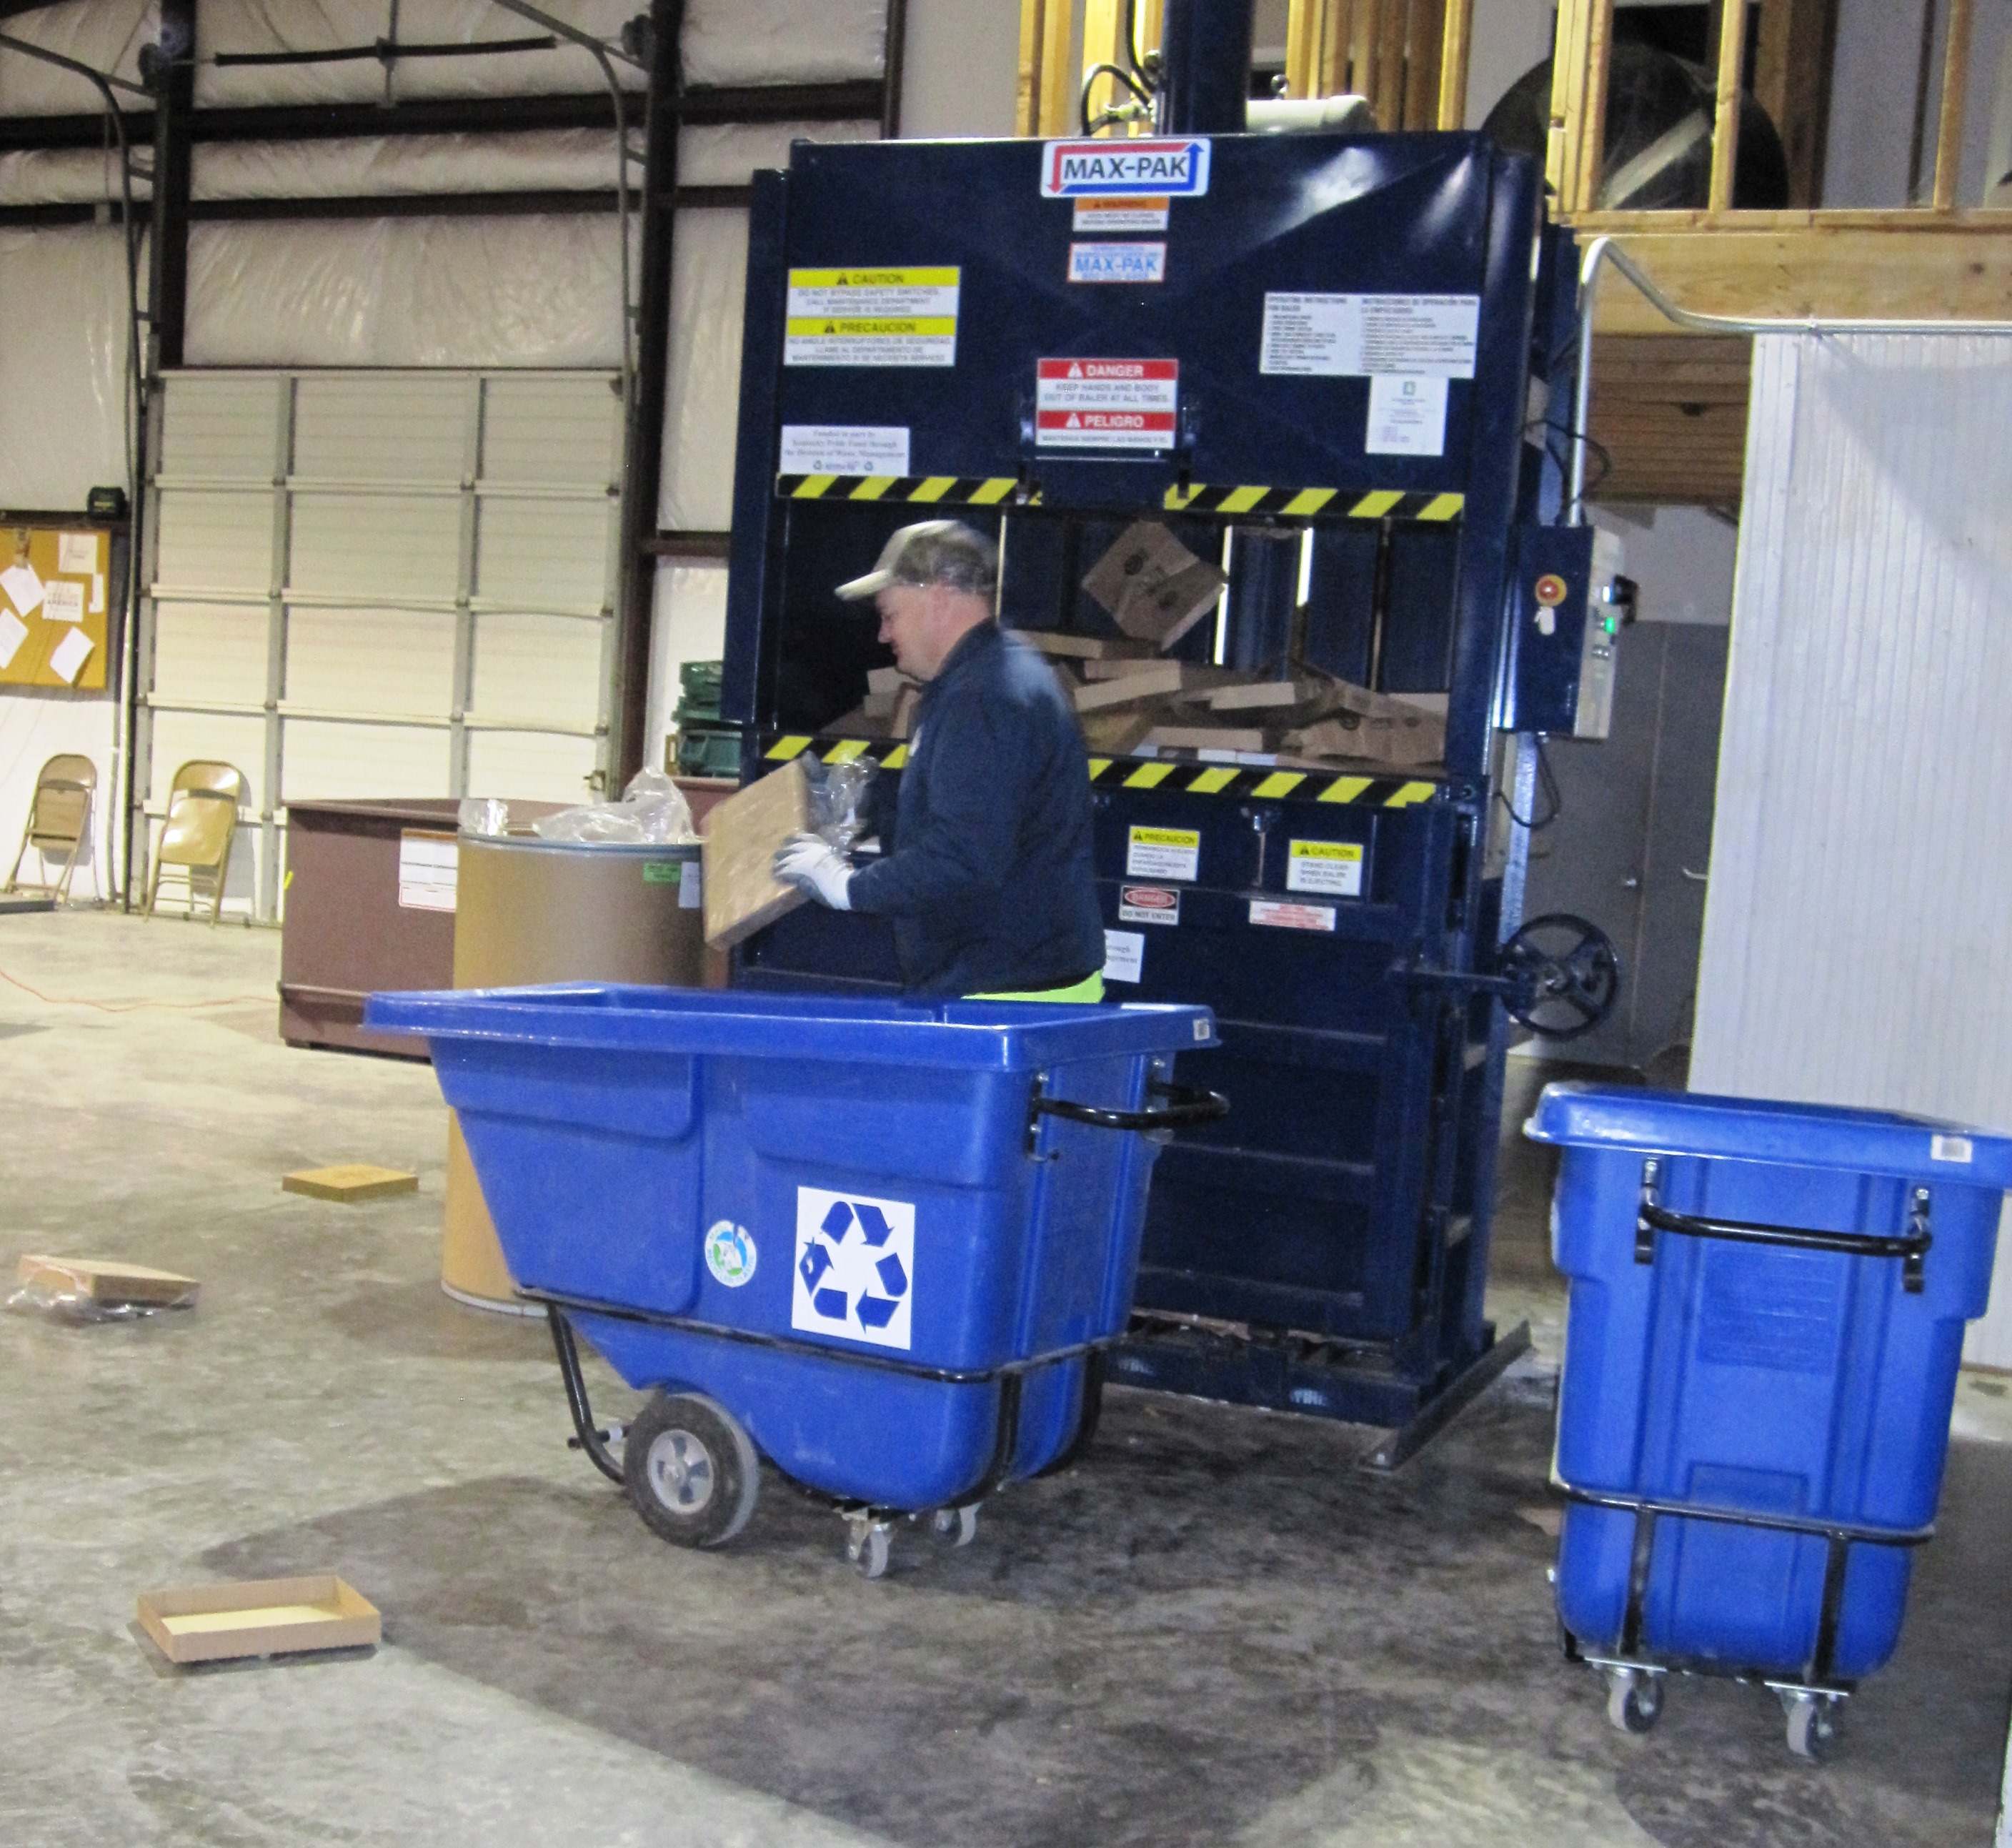
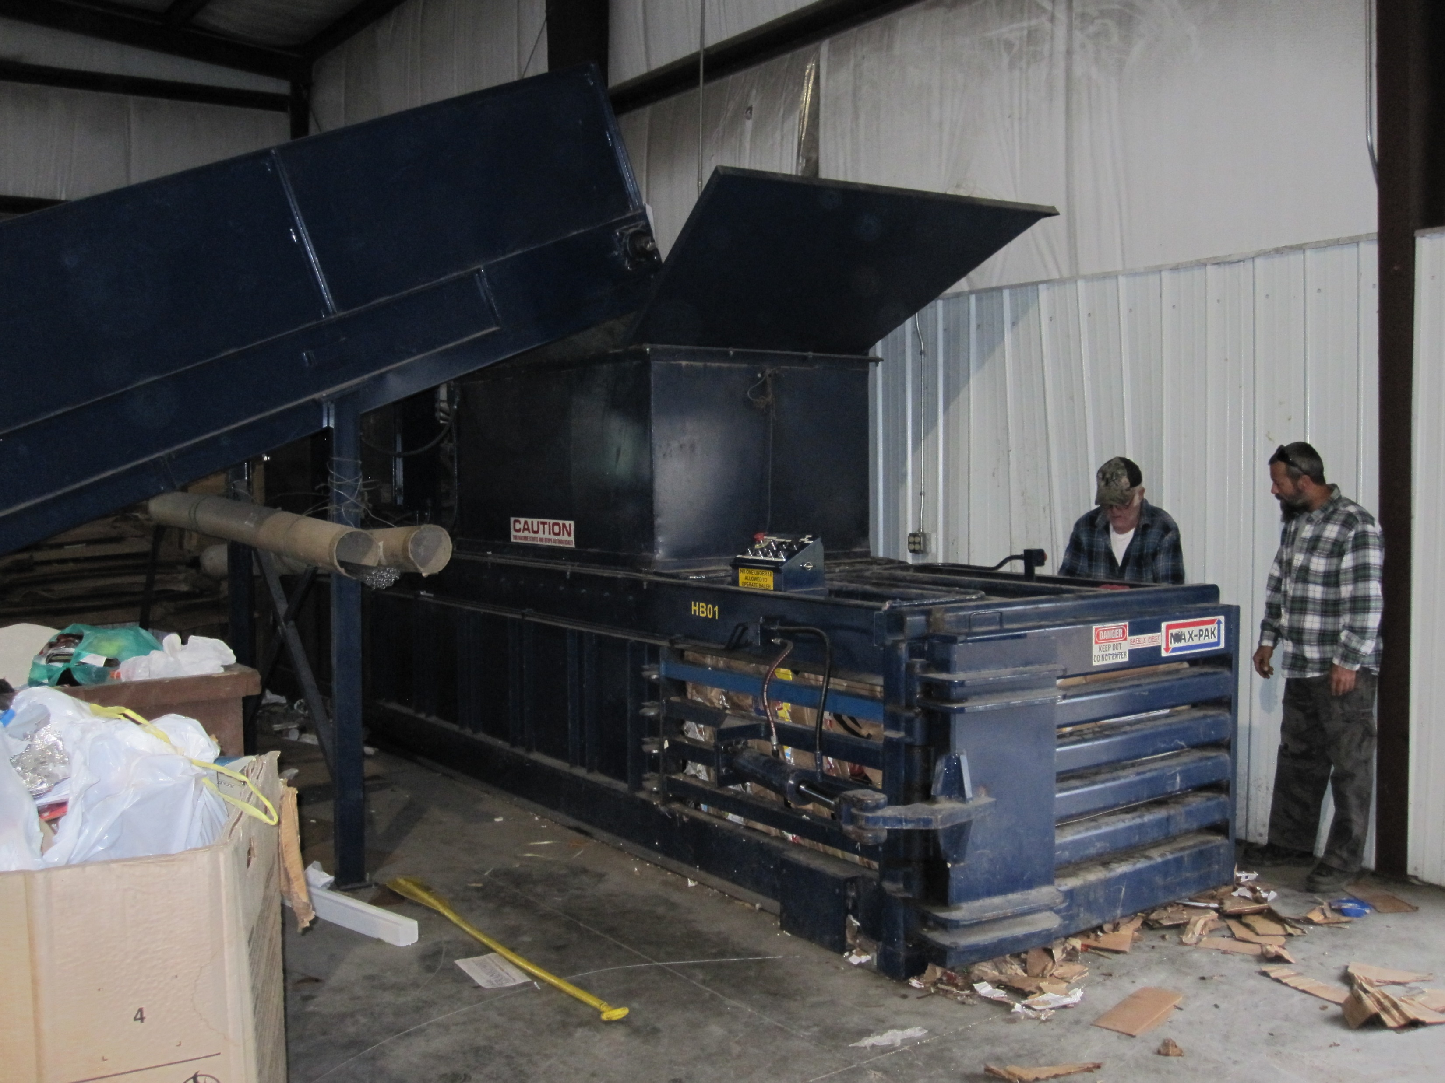
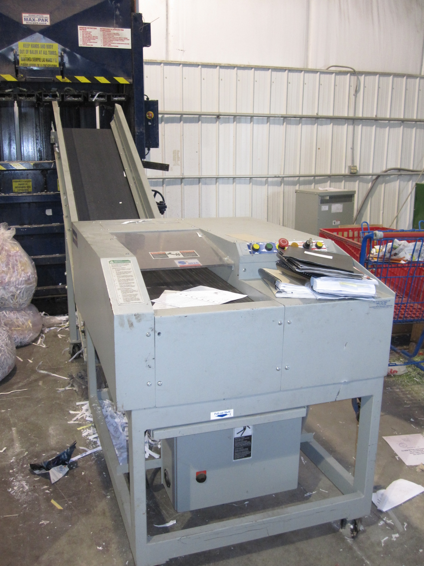
SWM – Great Lakes RCAP - Kentucky Kentucky PRIDE Grants
Notes:
Melissa Melton
The Kentucky Solid Waste Management of KY PRIDE partners w/ state businesses like Toyoto to provide state grants to local government recycling programs for equipment, educational materials, collection bins, media expenses, etc.
The Kentucky RCAP SWM Team of Kim Padgett, Chris Wells, and myself at a 5th Grade Environmental Day Camp at Dale Hollow SRP Campground.

Slide 13
SWM – Midwest Assistance Program
Notes:
Chris Jewett

Slide 14
SWM – Midwest Assistance Program
Overview
Worked Contract for Four years
Twenty-two projects
Ten TAPs
Eight States
Served 72,378 citizens
Leveraged $2,200,000
Notes:
Chris Jewett

Slide 15
SWM – Midwest Assistance Program
TASKS
(11) Develop/Update Integrated Solid Waste Management Plan
(9) Assist with Grant/Loan Applications
(3) Assist with Pre-Construction Planning & Budgeting
(2) Assist with Establishing Contract (RFP/RFQ for Goods/Services)
(2) Assist with Producing Manuals
Notes:
Chris Jewett

Slide 16
SWM – Midwest Assistance Program
Tasks
Assist with Completing USDA RD Financial Reports
Assist with Permit/Licensing Application
Assist with Recycling Program
Assist with Stake Holder Group/Task Force
Assist with Developing Regional Collaboration Plan
Conduct Waste Characterization Study/Waste Audit
Conduct Rate Study
Notes:
Chris Jewett

Slide 17
CONFERENCES/TRAININGS
SWM – Midwest Assistance Program
Blue Ridge Services Webinars
W&M Environmental Group Service
Northeast Recycling Council Webinar
National Recycling Coalition Webinars
Wyoming Solid Waste Recycling Association Conference
Michigan DEQ Waste Management Webinar
EPA Webinars
Notes:
Chris Jewett

Slide 18
CONFERENCES/TRAININGS
SWM – Midwest Assistance Program
North Dakota Solid Waste Recycling Association Training
Midwest Environmental Compliance Conference
Joint SD/ND/MT Annual SW Conference
Kansas Solid Waste Conference
Kansas Department of Health & Environment Trainings
Kansas Organization of Recyclers (KOR) WORKS Trainings
Notes:
Chris Jewett

Slide 19
TRAINING TOPICS
SWM – Midwest Assistance Program
How to Extend the Life of your Landfill through Process Improvement
RCRA Hazardous Waste Management
Getting Started with Community Composting
Health & Safety Issues with Electronic Scrap Recycling
Battery Recycling 101
Sorting Recycling Facts from Fiction
Notes:
Chris Jewett

Slide 20
TRAINING TOPICS
SWM – Midwest Assistance Program
Emerging contaminants in landfills
Efficient landfill equipment operations
Integrated solid waste management plan completion
Recycling Waste Reduction for Tribal School
Mattress Recycling in the United States
Keys to Successful Plastics Recycling
Policy and Law Changes Recommended to Increase Recycling and Sustainability
Notes:
Chris Jewett

Slide 21
TRAINING TOPICS
SWM – Midwest Assistance Program
Inert Landfill Workshop
Process Improvement for Waste Facilities: Mastering the Science of Operations
Process Improvement for Waste Facilities
Leveraging Resources for Brownfields Revitalization
Tire collection/processing
Notes:
Chris Jewett

Slide 22
TRAINING TOPICS
SWM – Midwest Assistance Program
Permits
Stormwater pollution prevention plans
Best management practices for compliance
Re-vegetating difficult sites
Manager of Landfill Operations
Leachate and Evaporation
Landfill Gas Control Systems
Animal Wastes, Incineration and Composting
Notes:
Chris Jewett

Slide 23
SWM – Midwest Assistance Program
PROJECT HIGHLIGHTS
(Discuss specific projects and accomplishments)
Notes:
Chris Jewett

Slide 24
www.rcac.org
Solid Waste Management programs (FY18) within the states of:
Washington
Utah
Alaska
Notes:
Stevan Palmer

Slide 25
Rural Community Assistance Corp
Washington- Colville Indian Reservation
Mapping of illegal dumps on reservation
Metals identification and characterization for buy-back center
Community education and outreach media materials
Utah- Goshute Indian Reservation
Solid Waste Management Plan
Community Outreach and Education
Formation of utility board (who manages SWM as well)
Alaska- Native Village of Eek
Landfill Operator Training
Source Water Protection training
Community outreach and education (how waste practices effect water sources)
Notes:
Stevan Palmer

Slide 26
Rural Community Assistance Corp
Native Village of Kotlik, AK (FY 2017 project)
Landfill leachate sampling events
Community education & outreach to protect source water from waste activities
Training video produced for water samplers to establish leachate baseline data
Jacqueline Shirley
jshirley@rcac.org
907.952.9971
Notes:
Stevan Palmer

Slide 27
https://vimeo.com/236993179
Notes:
Stevan Palmer

Slide 28
SWM – Thinking Outside the Bin Part 1
www.rcapsolutions.org/solid-waste/
Solid Waste Management programs within the states of:
New Hampshire
Notes:
Edwin Vazquez-Asencio
Will speak here

Slide 29
SWM – RCAP Solutions
Notes:
Edwin Vazquez-Asencio
Will speak here

Slide 30
SWM – RCAP Solutions
Notes:
Edwin Vazquez-Asencio
Will speak here

Slide 31
SWM – Thinking Outside the Bin Part 1
Notes:
Rachel

Slide 32
SWM – Southeast RCAP
Let’s Talk Trash Ideas for your Recycling Related Projects
Be Cool Recycle In School
By Rachel Silver
SERCAP- FL
Notes:
Rachel Silver

Slide 33
SWM – Southeast RCAP
3 Goals, 3 Outcomes
County Mixed Solid Waste and Recycling Data Summary Sheets
Outcome #1
Goal #1
Increase the County’s Total Recycling Rate (TTR)
Florida Department of Environmental Protection (FL-DEP) mandated goal of 75% by 2020
Notes:
Rachel Silver

Slide 34
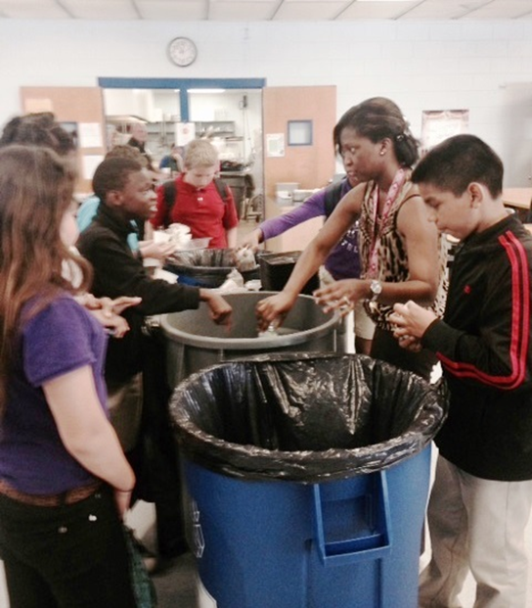
SWM – Southeast RCAP
Outcome #2
Goal #2
Create a change in behavior among students
5564 students started recycling in Sumter County
Notes:
Rachel Silver

Slide 35
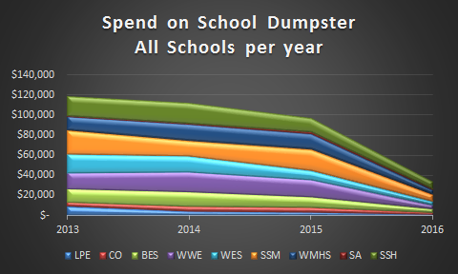
SWM – Southeast RCAP
Goal #3 Outcome #3
Save the county money (hauling trash is more expensive than hauling recyclables)
Recycle costs roughly 1/3 the price to haul away versus trash
Notes:
Rachel Silver

Slide 36
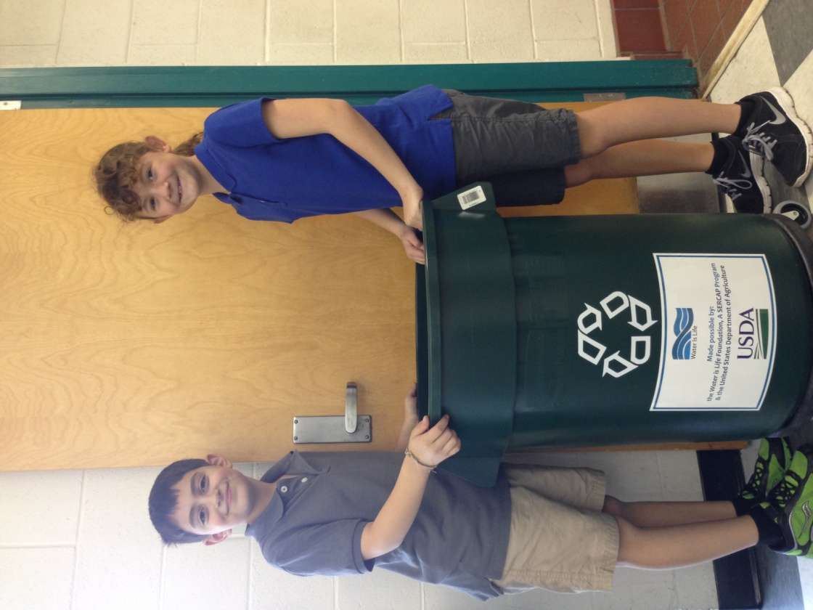
SWM – Southeast RCAP
Recommended Bins…..
Stickers for Bins
Notes:
Rachel Silver

Slide 37
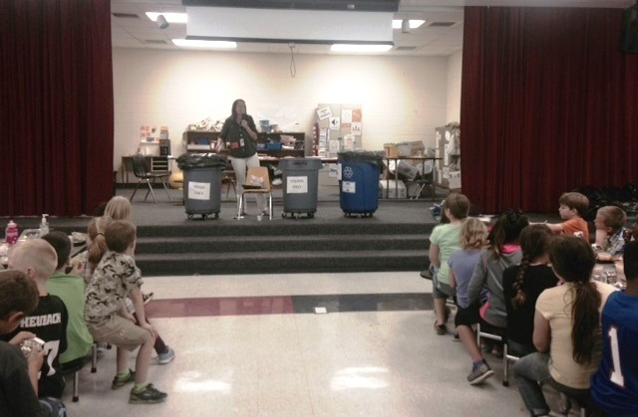
SWM – Southeast RCAP
Paper or Everything?
Paper Only Everything ♲ 1 - 6
Notes:
Rachel Silver

Slide 38
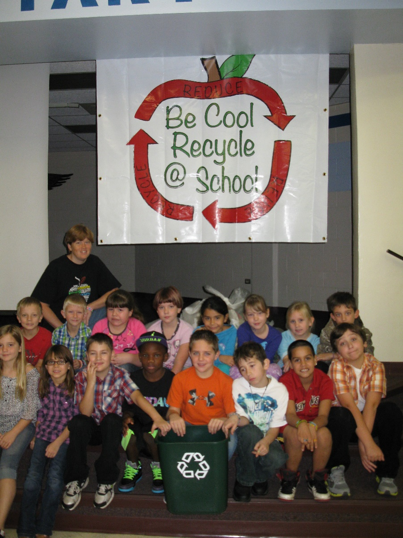
SWM – Southeast RCAP
Recycling Kick-Off
Vary in capacity:
School wide
Grade wide
Specialty programs:
Safety Patrols
Cambridge Programs
ESE
Science Clubs
Ecology Class
Invite
USDA-RD local office
Newspaper
Local Solid Waste Office
State and Federal Representatives
Notes:
Rachel Silver

Slide 39
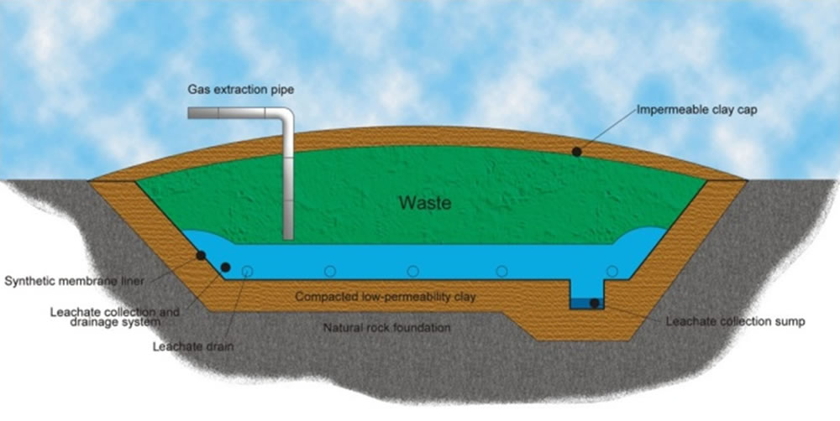
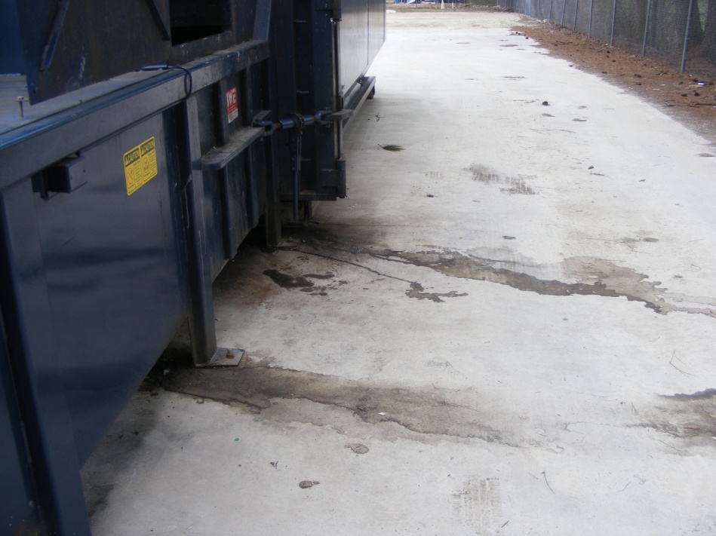
Water Quality/ Explain?
Should be treated here not there..
What is this?
Notes:
John Crowder

Slide 40
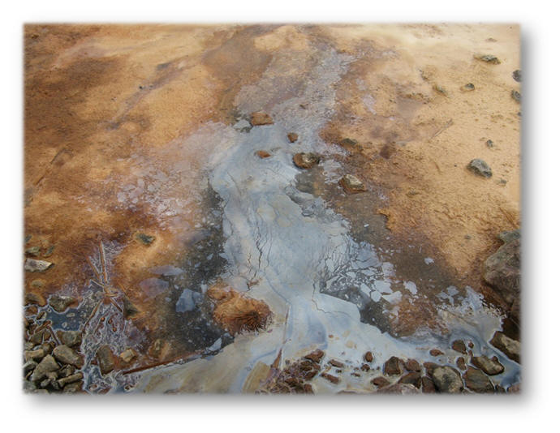
Leachate- Non-point Source
Leachate:
Water percolation through wastes inside a landfill is inevitable. As the water seeps to the bottom of the cell it picks up contaminates creating highly acidic water otherwise known as leachate. This substance can be hazardous to the soil and ground water if it is not properly collected and removed.
Leachate begins with household trash which ends up in landfills.
Non-Point Source Pollution:
Pollutants from many diffuse sources. Nonpoint-source pollution is caused
by rainfall or snowmelt moving over and through the ground. As the runoff moves, it picks up and carries away natural and human-made pollutants, finally depositing them into lakes, rivers, wetlands, coastal waters, and even underground sources of drinking water.
Storm-water picks up contaminants such as from leaking garbage containers and compactors can end up in your drinking water.
Notes:
John Crowder

Slide 41
Environmental Concerns
Chemicals that soak into the earth can pose serious risks to the environment both in terms of soil contamination and water safety. Plants will not thrive and are more prone to disease and weakness when the dirt around them is imbalanced. Much of the world’s water sources come from the ground, too, and chemical penetration into underground aquifers can cause sickness and, in some cases, even death.
Leachate that has had a lot of time to soak into the ground may also reach rivers or streams, which can poison fish and cause genetic mutations in sea life. If harmful chemicals eventually make it to the open ocean the effects can be even more devastating, damaging delicate ecosystems and causing potentially irreversible harm.
Notes:
John Crowder

Slide 42
Treatment
Notes:
John Crowder

Slide 43
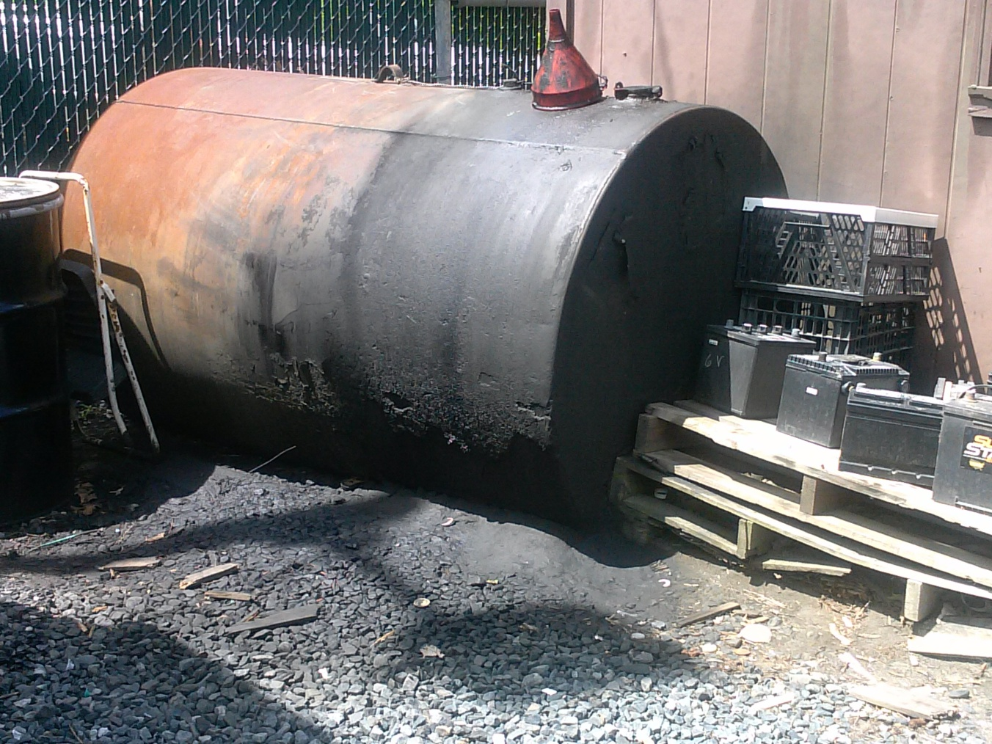
Motor oil Collection
What is wrong with this?
Notes:
John Crowder

Slide 44
Used motor oil collection-US-EPA
Oil Leaks and Spills
Take steps to prevent leaks and spills. Keep machinery, equipment containers, and tanks in good working condition and be careful when transferring used oil. Have sorbent materials available on site.
If a spill or leak occurs, stop the oil from flowing at the source. If a leak from a container or tank can't be stopped, put the oil in another holding container or tank.
Contain spilled oil. For example, containment can be accomplished by erecting sorbent berms or by spreading a sorbent over the oil and
Clean up the oil and recycle the used oil as you would have before it was spilled. If recycling is not possible, you first must make sure the used oil is not a hazardous waste and dispose of it appropriately. All used cleanup materials, from rags to sorbent booms, that contain free-flowing used oil also must be handled according to the used oil management standards. Remember, all leaked and spilled oil collected during cleanup must be handled as used oil. You are a used oil handler, you should become familiar with these cleanup methods. They may also be part of a spill response action plan.
Remove, repair, or replace the defective tank or container immediately.
Notes:
John Crowder

Slide 45
Best Management Practices
Do NOT drink the liquid!!!! Leachate….it tastes slightly “sweet” (Don’t Ask??)
Pavement is better than stone or gravel for control of storm water and leachate
Site should be well-drained; citizens don’t want to use a center full of pot-holes and standing water.
Hopefully, recycling center is not located in a low-lying area, immediately adjacent to wetland, or next to stream/river.
Oils and fuels only unloaded/poured in areas where there is containment; i.e. metal/plastic/fiberglass containers, gutters, curbs, pads, etc.
If a compactor is used on-site:
Best to use “self-contained” compactor units; otherwise need containment area
Use absorbent or similar material (cat litter) to clean up spills/liquids; can be re-mixed with trash and sent to landfill.
Catch-basin that can be pumped out is ideal
Notes:
John Crowder

Slide 46
SWM – Southeast RCAP
Notes:
John Crowder

Slide 47
SC Rural County C&D Landfill
SWM – Southeast RCAP
Notes:
Patrick Walker

Slide 48
Funding for Repair/Replacement of Transfer Stations
SWM – Southeast RCAP
Notes:
Patrick Walker

Slide 49
Electronics Waste Recycling
SWM – Southeast RCAP
Notes:
Patrick Walker

Slide 50
SERCAP South Carolina Rural County Recycling Project
SWM – Southeast RCAP
Overall State Recycling Rate (2016): 25.4%
Rural County (22) Recycling Rate: 15.8%
Urban County (24) Recycling Rate: 27.5%
State Recycling Goal: 40% by 2020
Notes:
Patrick Walker

Slide 51
South Carolina Rural County Recycling Workgroup Meeting
SWM – Southeast RCAP
Notes:
Patrick Walker

Slide 52
End the Myth that Recycling is Free
SWM – Southeast RCAP
Recycling is not free. It never was!
Originally promoted to residents that recycling would pay for itself through revenue earned from the sale of recovered material combined with avoided disposal costs.
Every material recycled has great value….NOT!
You are paying for two basic solid waste management options: Disposal and Recycling
Notes:
Patrick Walker

Slide 53
“Examples” of Recycling Workgroup Comments/Recommendations
SWM – Southeast RCAP
Rural recycling efforts focus on too many commodities.
Need a “model” rural county recycling collection site.
Single stream collections don’t work well in rural areas.
Recycling agency needs to reformulate grants process.
Rural counties need to form regional recycling co-ops.
Rural counties need priority funding to promote recycling.
*Rural counties should stay away from collecting glass.*
Notes:
Patrick Walker

Slide 54
Target Specific Recyclables Foundation: Paper, Plastic, Metal
SWM – Southeast RCAP
Notes:
Patrick Walker

Slide 55
SWM – Thinking Outside the Bin Part 1
Questions
?
Notes:
Are there any questions?

Slide 56
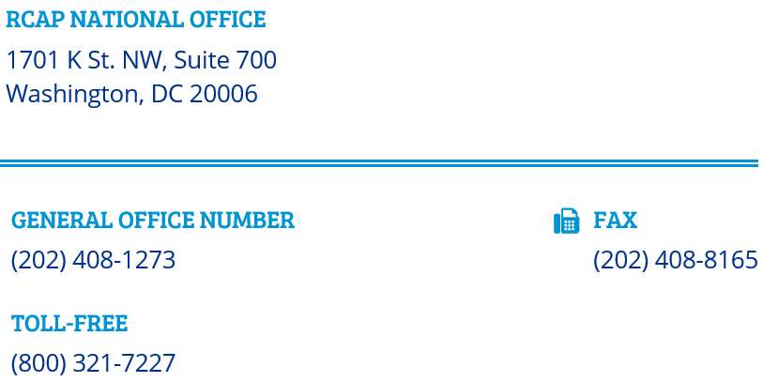

Slide 57
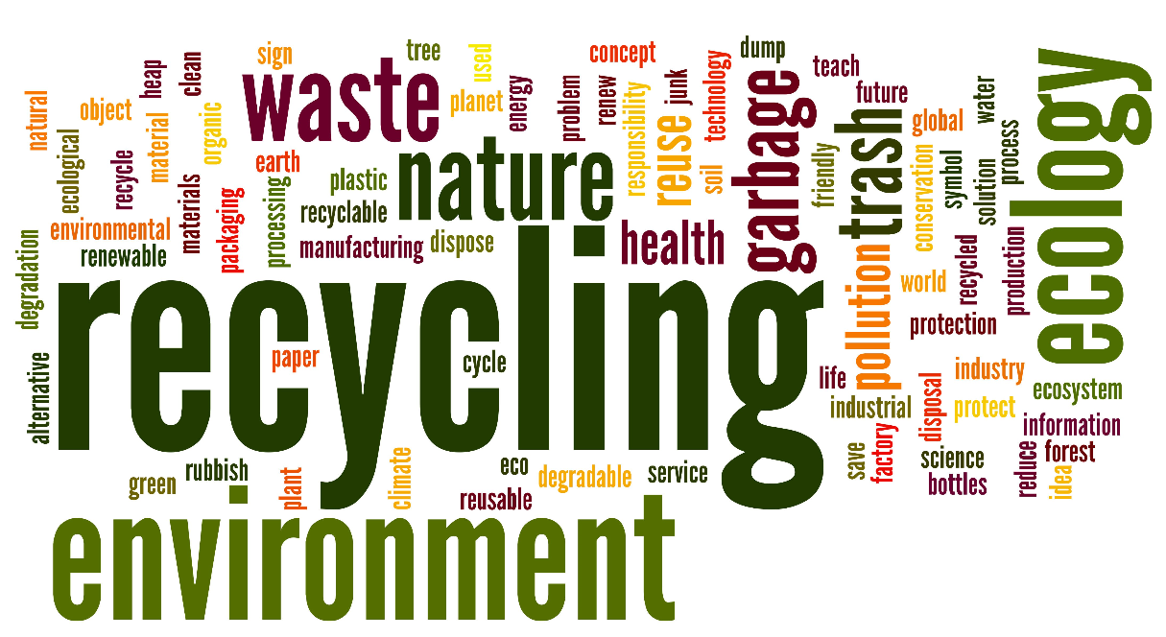
Time for a Break
SWM – Thinking Outside the Bin Part 2 NEXT

