Slide 1




Workshop in a Box:
A Treasure Chest of
Value to Small Systems
RCAP National Conference
April 25, 2018
Laura Dubin, RCAC - NM
Mark Johnson, RCAP Solutions - VT

Slide 2
Today’s Objectives
Cover critical elements of the Rural and Small Systems Guidebook and Workshop in a Box
Introduce new materials
Practice the self assessment
Share tips for reaching key audiences
  Decision makers
  Local officials
Take an idea, leave an idea

Slide 3
Agenda
Today’s Agenda
Introductions
Workshop in a Box Overview
Updated Materials
Improvement Self Assessment Tool/Discussion
What Worked and Didn’t – RCAP Summary
WIB Super Tour 2017
Closing

Slide 4



Introductions
But first, inquiring minds want to know who you are:
  Name and/or pirate alias
  Which RCAP
  Number of years served
  Have you conducted or participated in a WIB before?
Notes:
The introduction slide for each person to share with the group

Slide 5
WIB Overview
Logistics:
All workshop materials are free
Access them from the USDA RD website or the EPA sustainability website (or just google them)
  https://www.rd.usda.gov/programs-services/services/sustainable-management-tools
  https://www.epa.gov/sustainable-water-infrastructure/workshop-box-sustainable-management-rural-and-small-water-and

Slide 6
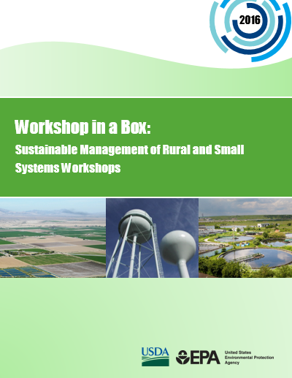
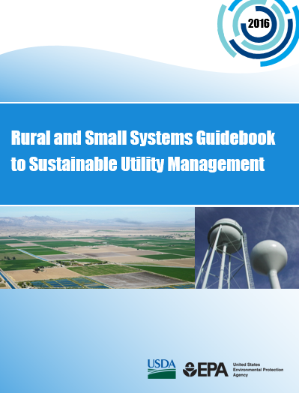
Training Materials
Conduct the Workshop
Guidebook for participants
Notes:
2013- USDA & EPA developed the WIB for rural/small systems to improve performance and be more sustainable
the Workshop in a Box- this is the tool you will use to plan and conduct the workshop, and it includes all of the materials
The Rural and Small Systems Guidebook to Sustainable Utility Management (which we will refer to as ‘the Guidebook’) – this is what the participants use and fill out in the class- it’s their textbook
The Guidebook and Workshop in a Box were updated earlier this year.
They remain largely the same as the materials that you are used to, but we will describe the changes a bit later in today’s session.

Slide 7
Sustainability Objectives
Help rural and small systems improve their performance and sustainability
Enable rural and small systems to:
  Complete a preliminary self-assessment
  Develop an action plan based on their self-assessment results
  Use the Guidebook with staff, decision makers, and stakeholders in their communities
  Learn from their peers about practical solutions to common challenges
  Make connections
Notes:
As a refresher, the workshop objectives are:
1. Help rural and small systems improve their performance and sustainability
2. Enable rural and small systems to:
Complete a preliminary self-assessment based on the Guidebook
Develop an action plan based on their self-assessment results
Use the Guidebook with staff, decision makers, and stakeholders in their communities
Mulit-system workshop: Learn from their peers about practical solutions to challenges faced by rural and small systems

Slide 8
Intended Audience
Utility managers
Other utility staff
  Think outside the box
  Who has something to contribute?
  Operators? Accountants? Planners?
Decision makers
  Utility board members
  Local decision makers (e.g., elected officials)
Notes:
Over the past two years, we have heard repeatedly about the importance of having decision makers in attendance at the workshops.
In response, we have developed some new materials to support workshop hosts and trainers in reaching decision makers
And materials for workshop attendees use in post-workshop communications with decision makers.

Slide 9
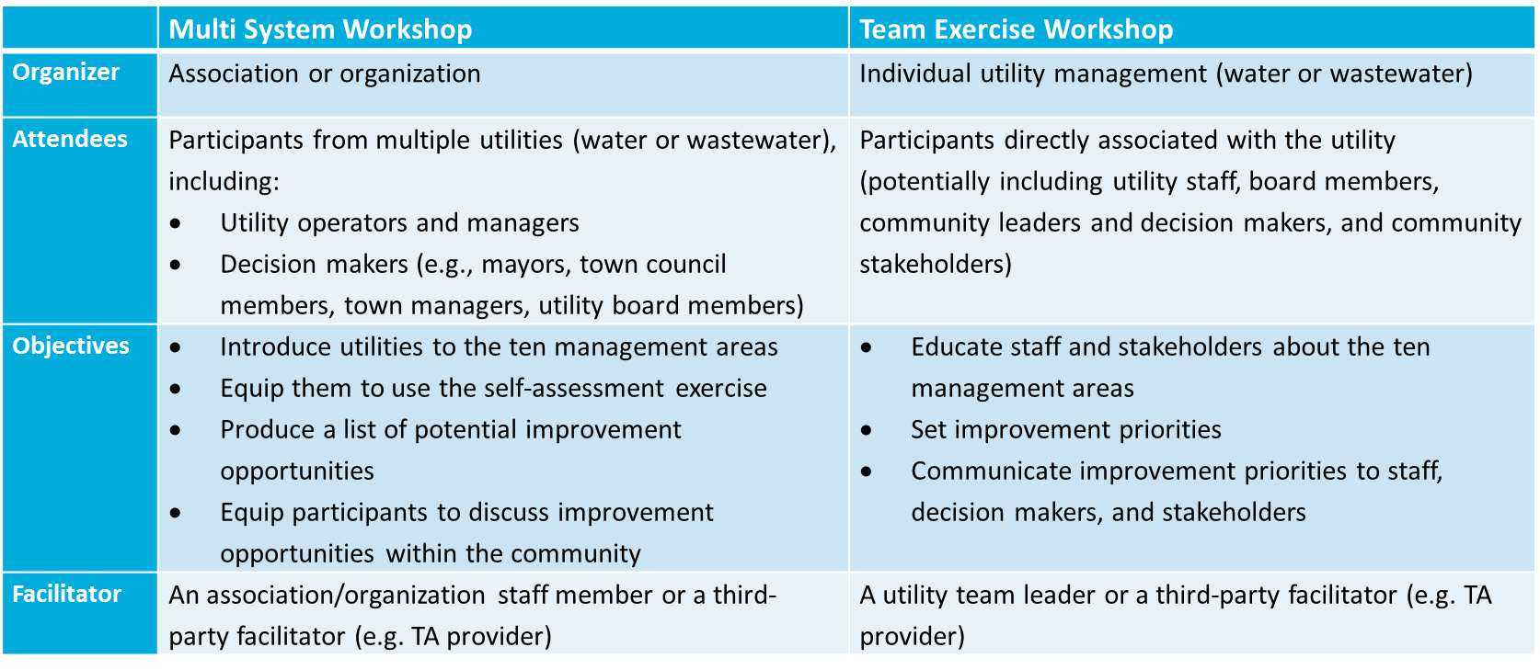
Multi System vs. Team Workshop
Notes:
First and foremost there are two kinds of workshops you can hold, but the material and objectives are basically the same
multi-utility system workshop format,
where an outside facilitator conducts the workshop for participants from multiple utility systems,
and the participants learn from each others’ experiences;
team workshop,
where participants at the workshop are all from the same system (or community),
and the facilitator is typically a TA provider or an in-house staff person.
This session is geared toward the multi system workshop track in the Workshop in a Box guide, but this information can still be helpful to those who seek to run a team workshop as well.
Review differences in multi-system and team exercise workshop

Slide 10
WIB Process
Step 1: RATE your system’s level of achievement (practice and performance) for each management area
Step 2: RANK the importance of each area
Step 3: PLOT the results
Step 4: IMPROVE by exploring high achievement-related practices
Step 5: Create an Action Plan

Slide 11
The Ten Key Management Areas
Sustainably Managed Utility
Product Quality
Operational Optimization
Community Sust. & Econ. Dev.
Customer Satisfaction
Operational Resiliency
Stakeholder Understanding & Support
Employee Leadership & Development
Water Resource Adequacy
Financial Viability
Infrastructure Stability
Notes:
The ten management areas are building blocks for what utilities should strive for- basically outcomes
There is no priority or order for the management areas – this is determined by the individual system.
Most water and wastewater utilities pay attention to these areas and likely perform well in at least some of them
but the purpose of these workshops is to highlight areas utilities can improve on, and give options to do that.
the self-assessment is how students can figure out which areas they should focus on.
Refer to pages 4-6 in the Guidebook.

Slide 12
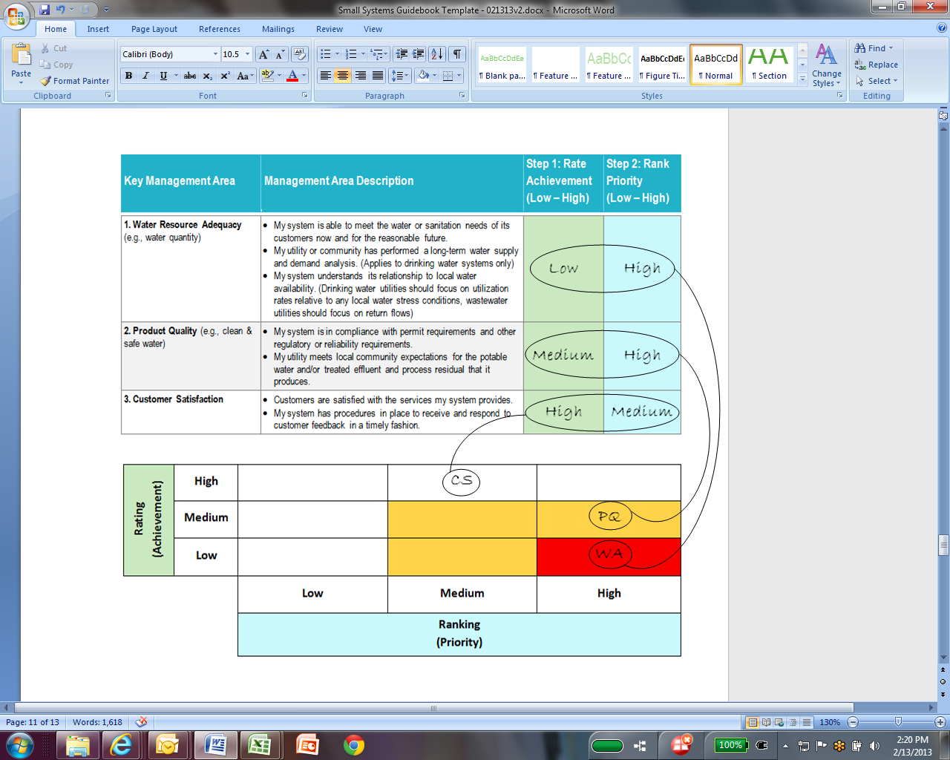
The Self-Assessment Exercise
Notes:
Workshop participants complete a self-assessment of their utility for each of the 10 key management areas:
Rate Achievement – answers question “How are we currently doing?
Rank Importance – answers “How important is this to our system?”
Plot results-where they intersect- to identify critical areas of improvement – “What are most important areas to focus on?”
The Self Assessment is covered on pages 8-11 in the Guidebook.

Slide 13
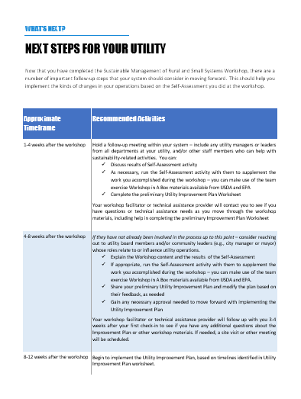
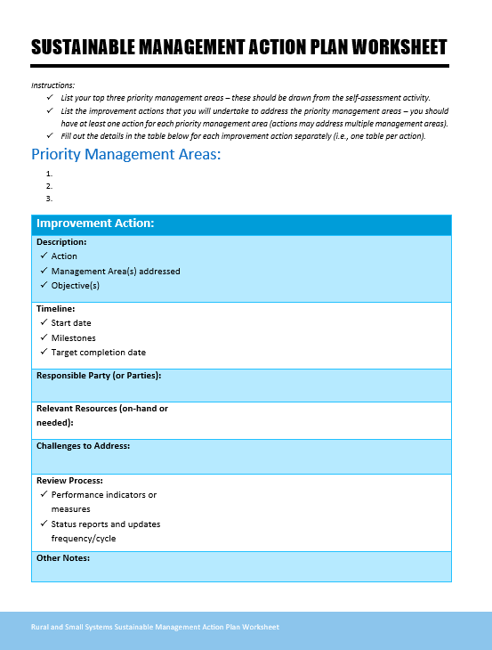
Materials to Create an Action Plan
Notes:
Using the priority areas in the self assessment, now we help the participants figure out how to move forward using 2 worksheets

Slide 14
Creating an Action Plan
Two worksheets for this process:
Next steps handout:
  Their encyclopedia to use for the action plan worksheet
  Potential actions to improve the critical management areas
  Timeline and connections to working with a TA provider
Action Plan:
  Your individual outline for moving forward
  Pick top 3 priority management areas
  Then ID the action & logistics using the next steps references
Notes:
Creating an action plan is an important component of the Guidebook and was added as a session in the new Workshop in a Box material based on feedback that we received about its importance in moving activities forward for workshop attendees - refer to pages 18-21.
It is also an important component of internal team workshops.
Participants in multi-system workshops will fill out one Sustainable Management Action Plan Worksheet, and should feel equipped to complete additional worksheets after the workshop to create a more complete plan
USDA and EPA expect follow-up by workshop trainers with participants to encourage action plan development.
We encourage participants take this plan back to their utility and focus on the most pressing issues for the system. This plan can work with their capital improvement plan, asset management plans, and any other plans they may already have.
This plan is the reason for the intended audience to be decision makers. Decision makers usually have the authority to do the actions set forth in the plan.

Slide 15

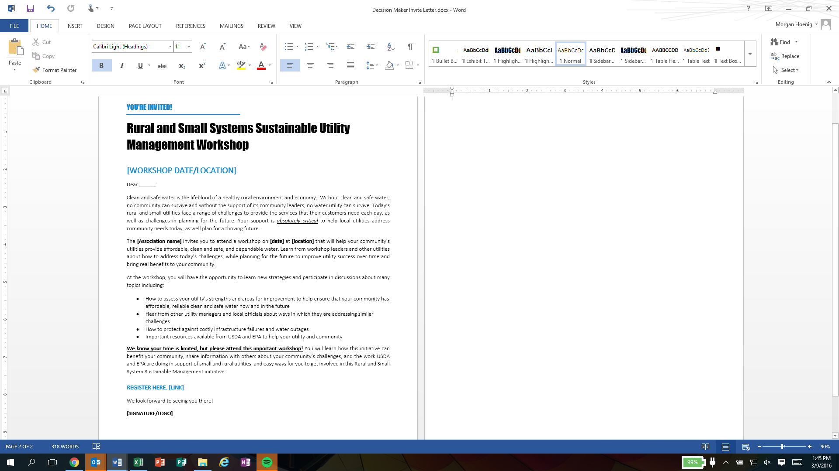
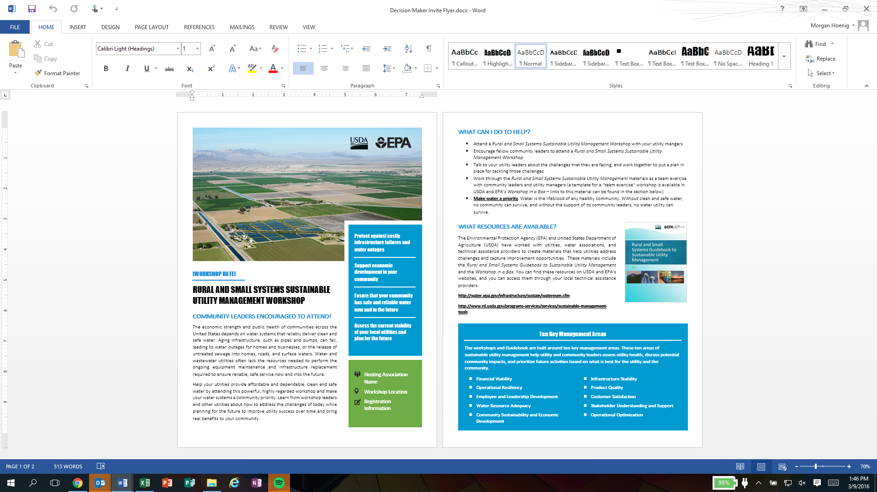
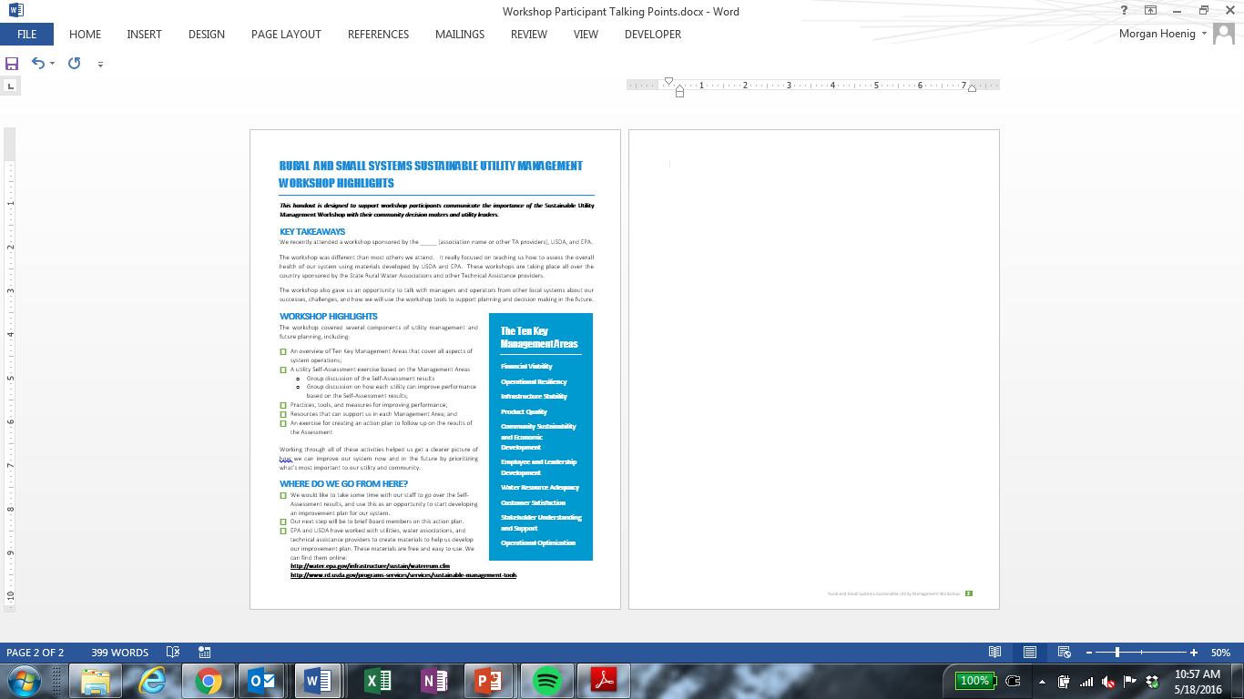
Effective Outreach
Notes:
In early 2016, USDA and EPA released three new resources to support workshop hosts and attendees in reaching decision makers.
Letter:
send directly to decision makers
Highlights importance, community benefits, and most importantly, Invites them to attend the workshop.
Flyer:
The second is a promotional flyer that encourages decision makers to attend workshops.
This flyer can either be sent to decision makers as a standalone invitation, or along with the invite letter.
Handout
The third new resource is a handout for facilitators to give to workshop attendees at the end of the workshop.
The handout is a quick guide of talking points that participants can use to talk to their utility leaders
what the workshop covered, and how to take action on key management areas.

Slide 16
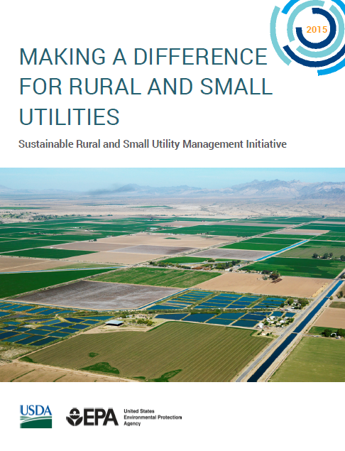
Updates & Case Studies
USDA and EPA gathered feedback in 2015 via webinars and case studies
An “Accomplishments Report” was developed to explain the initiative
Provides real-life examples of how utilities have benefitted from attending the workshops and utilizing the concepts
Notes:
Feedback webinars:
Held 4 Feedback webinars with NRWA between January and April 2015 (61 participants from 36 states)
Asked about key challenges faced, particularly with Workshop follow-up, attracting decision makers as participants in these workshops, and the self-assessment exercise in the workshop
We received not only feedback about the challenges, but also feedback on suggested solutions and actions to help resolve the issues faced.
We used the feedback to refresh the materials and develop resources to address the key challenges
Accomplishments Report:
explains the initiative and provides real-life examples of how utilities have benefitted from attending the workshops and utilizing concepts from the Guidebook and Workshop in a Box
Posted on the USDA website

Slide 17

USDA Staff Quick Start Guide: What is it?
A quick reference document to help RD field staff to recognize opportunities to refer current or potential borrowers to the Workshop in a Box tools or a workshop hosted by a TA provider (i.e. RCAP or NRWA)
Goal was to help connect the dots of what you are already doing on a daily basis to the terminology in the Workshop in a Box tools
Notes:
Explain how this Quick Start Guide came about:
What we did:
Conduct research on Rural Development staff key duties, roles, and daily activities to better understand how the Initiative can fit in with their work (e.g., through calls with USDA). Found:
When you recognize that a system/utility you are working with has one or more of the following scenarios:
When planning for and submitting a new loan application
When conducting a rate study or when modifying rates
During the planning phase for infrastructure expansion, upgrades, or replacements
When creating or updating a long-term plan (e.g. capital improvement plan)
In the event of a delinquent loan
Board Turnover or a change in a utility’s leadership
Unusually high volumes of customer complaints

Slide 18
WIB: What Works and
What Doesn’t
Tales from Landlubbers and Sea Dogs
Notes:
The idea behind this presentation was to be able to share some experiences, both from our regions and from a national perspective…what works, what doesn’t, and how can we improve? A former colleague and I had started out with the idea of presenting on some Workshops that we had put together in New England last summer. Essentially we had planned to put together 4 workshops in a week and called it the WIB Supertour. Basically, we were looking to provide the training effectively, quickly, and have some fun doing it. It was all of those things, and exhausting. I’ll talk a little more about that later.

Slide 19


WIB: What Works and What Doesn’t
Planning Stages
Format of the Workshop
Post-Workshop Follow-up
Notes:
We’ll go through some things that worked well, some shortcomings, hear some of your ideas / experiences, and hopefully also have a chance to see a short video produced for the USDA WIB and featuring Deb Patton from RCAC .

Slide 20

WIB: What Works and What Doesn’t
  How do we know?
  Our own regions’ experiences
  Feedback & evaluations from TAPs and workshop participants
Scuttlebutt
Notes:
First off, who are we to say what works and what doesn’t?
We don’t have the most experience with these workshops – that’s sort of the idea, though. It seems like every year, we are giving more of these workshops. Let’s share what we’ve observed and improve our delivery.
In pirate lingo…scuttlebutt = rumor or gossip, but in nautical terms, a scuttlebutt is an open cask of drinking water on a ship. The former definition evolved out of the nautical sense, as sailors would engage in idle chat while gathered around their version of the office water cooler.
***much like the pirates of yesteryear, We used SurveyMonkey to gather feedback.

Slide 21
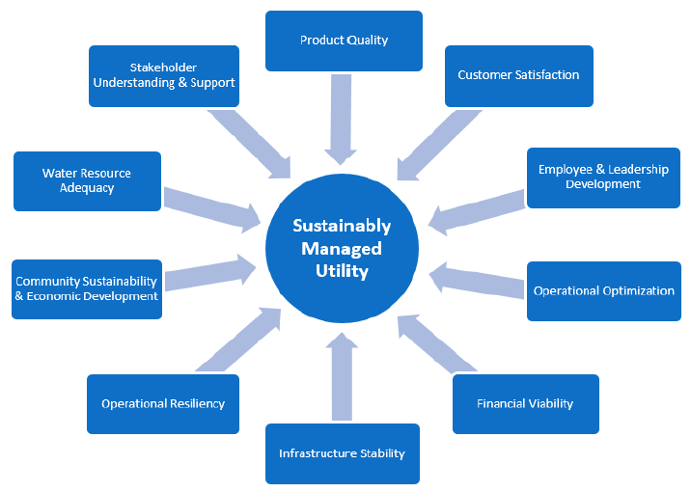
WIB: Key Management Areas
Notes:
Review of the 10 KMAs…each one gets an acronym that gets plotted for prioritization

Slide 22
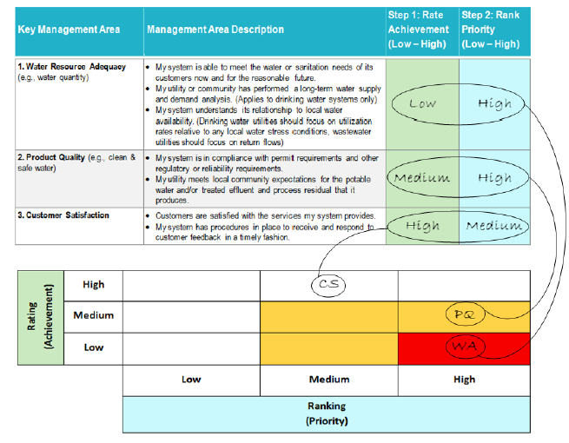
WIB: Key Management Areas
Notes:
Here you can see (maybe) the acronyms on the prioritization chart

Slide 23
WIB: Discussion
  What makes for a successful workshop? How do you know?
SE
  Are the participants engaged?
PD
  Are the right people in attendance?
WL
  Do we have enough TAPs in the room? Is it the right room?
GS
  Do outside / guest speakers add to the workshop?
Notes:
Can be difficult to know what a successful workshop is, we’re going to look a little more closely at a few “Workshop Management Areas”
SE = system engagement
PD = participant diversity
WL = Workshop Logistics
GS = Outside / Guest Speakers

Slide 24
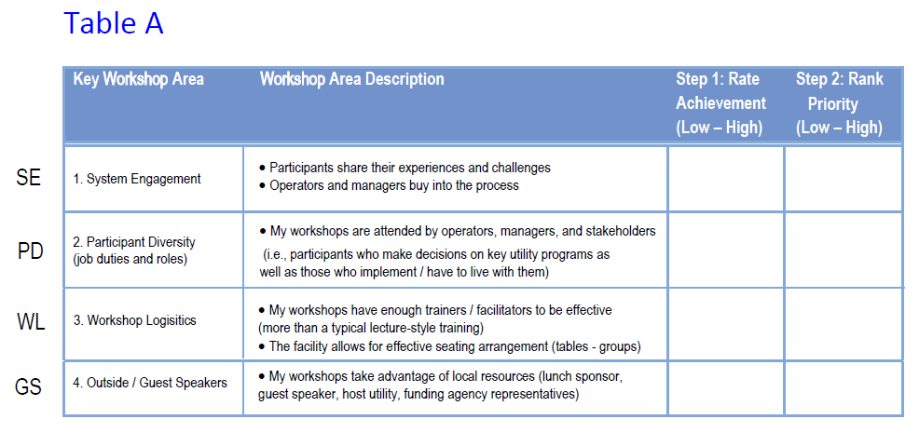
Self-Assessment Activity – Part 1
Notes:
Group activity – Some of the feedback that I got from TAPs was that the KMA Prioritization was tricky. So Laura and I thought about going through a case study for a troubled utility, and plotting/prioritizing the KMAs. But this is not intended to be a tutorial on Workshop in a Box; we’re here to talk about our experiences giving it. So we decided to combine the concepts and create “Key Workshop Areas”…fill this out, and we’ll get back to it in a little while.

Slide 25
WIB: Workshop Logistics
  Getting the Right People in the Room: RCAP Network
  Having multiple trainers / facilitators seems to improve outcomes
  A low attendee to trainer ratio (5:1) has been successful
    Provides opportunity for intense facilitation, if necessary
    A facilitator at every table during activities
    What worked: Planning events in a location central to trainers
    What didn’t work: Having lots of staff at events can be a financial strain, depending on travel time and location
Notes:
Now we’ll talk a little about those Key Workshop Areas and share some of the feedback and experiences we talked about.
Getting the right people in the room: RCAP side. If you are going to have a team to provide the workshop and facilitate discussion, planning becomes critical. Having enough staff to provide energized participation is helpful.

Slide 26
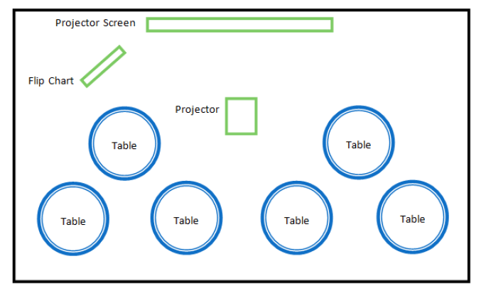
WIB: Workshop Logistics
Notes:
This is a recommended setup for these workshops

Slide 27
WIB: Participant Diversity
  Getting the Right People in the Room: Attendees
  Who will the target audience be?
  What is the energy like in the room?
  How much experience is in the room?
  Are there any decision makers?
  Do the attendees know what to expect?
Notes:
Getting the right people in the room: attendee side.
Success of WIB seems to hinge on who is in attendance, whether multi-system or team exercise

Slide 28
WIB: Participant Diversity
  Getting the Right People in the Room: Attendees
    What worked:
    Inviting system managers, decision makers, and community leaders – in addition to operators
        Tip: Decide beforehand if you want to split them up or allow them to sit together
    Why it worked:
    Managers act as advocates for new practices and programs
Notes:
It’s fantastic when you can have at least one manager / decision maker from each community in attendance with the system operator. While we often try to break up operators into different tables when they are from the same system for typical training events, letting managers and operators discuss their system during the course of the day allows for a mini “team exercise” format. You may lose a little of the interaction and learning from other systems, but it can also be a great opportunity!
Value the contributions of both operators and managers alike
Board members quickly realize that the operator’s nagging about issues like asset management, reserve accounts, etc. was credible
Board members love hearing operators’ tall tales
Managers act as advocates for new practices and programs related to the key management areas

Slide 29
WIB: Participant Diversity
  Getting the Right People in the Room: Attendees
    What didn’t work:
    Promoting the event in the same way that operator trainings are promoted
    Why it didn’t work:
    Events with few board members / decision makers in attendance were not as productive
    How to fix: Add a title or role to the registration form to be clear on the makeup of registrants – and scramble to fix any shortfalls!
Notes:
Using traditional marketing channels – such as operator email lists or phone numbers, might not cut it. Branch out to town administrators or managers, bring flyers to public meetings / selectboard meetings, etc.
Per trainers, events with few board members in attendance were not as productive.
How to Fix: Reach out to registered operators to encourage them to bring system managers. Contact town administrators, selectboard members, and other stakeholders.

Slide 30
WIB: Format
  What format should we choose for our workshops?
Notes:
Types of workshops -
Most common in network – seemed to be the Multi System Workshop- target audience is staff members who have management responsibilities at their utilities, and decision makers who have connection to utility policies and budgets
1. Team Workshop, which is attended by only internal staff members of the utility; and
2. Team-Stakeholder Workshop, which is attended by utility staff, and some combination of board members and other community stakeholders.
While the team workshop is intended for individual utilities, the format is conducive to being led by a TAP
Positives from both formats, and hard to compare which is “better” – DEPENDS on NEED /number of attendees?

Slide 31
WIB: System Engagement
  If Running a Single System Workshop…
    What worked:
    Emails sent out to all attendees of the single-system workshop to introduce them to the workshop, topics to be discussed, and why it is important for their system.
    Why it worked:
    Attendees are aware of the goals of the workshop and come prepared to discuss priorities for their systems. May provide more buy-in to the process.
Notes:
With a single-system (team) workshop, it’s good to make sure that attendees know what to expect, in terms of the material, length of workshop, etc. Sometimes, attendees of the single-system workshop do not realize the breadth of the workshop. How to fix: Sending out the promotional emails is a good way to make sure that attendees know the purpose of the workshop and come in with the right attitude.

Slide 32
WIB: System Engagement
  If Running a Single System Workshop…
    What didn’t work:
    Decision makers that do not arrive with an open mind, or have never attended a multi-system workshop.
    Why it didn’t work:
    Some managers are less likely than others to value the input of their employees – and vice-versa!
    How to fix: Have each person do the assessment / plotting activity as individuals to ensure that all viewpoints are noted.
Notes:
(example: Operator wants to move ahead with asset management or GIS, manager may not think it is necessary. Opposite can be true.
Operator may get lots of complaints and see customer service as an issue that a board member may not –each view is important
Ensure that decision makers understand the scope of the workshop and the importance of getting input on the planning process.

Slide 33

WIB: System Engagement
  What worked for attendees:
  Having multiple systems in the room
  New perspective and practices
  New opportunities for collaboration
  Format made for relaxed atmosphere
  It made it less stressful to think about our problems, knowing that other systems were having the same issues
  I enjoyed hearing how others have overcome challenges
Notes:
Generally, the rest of the slides discuss the more popular multi-system format.
Tangible success stories are great! Encourage sharing
New opportunities for collaboration / assistance / increasing purchase power

Slide 34



WIB: System Engagement
  What didn’t work:
  Packing too much material into the day.
  Why it didn’t work:
  Spending too much time covering all of the content leaves little (or no) time to work through the action plan in a meaningful way.
  How to fix: Be sure to end the day on an optimistic note – with an action plan in hand!
Notes:
Customizing material, being okay not covering all of the workshop content.
While it is nice to have guest speakers or lunch presentations, need to make sure you don’t overbook
Consistently seen on evaluation forms:
“An overwhelming amount of information”
Fix: Attendees enjoy hearing about others’ experiences.
Action Plan, Sustainable Management Action / Improvement Plan – at least identify the priority areas and talk about a few actions. Can follow up with the utility to set a timeline, etc. – turns into a project!
Having enough time to expand on good conversation is important, but ending the day with an action plan is critical

Slide 35
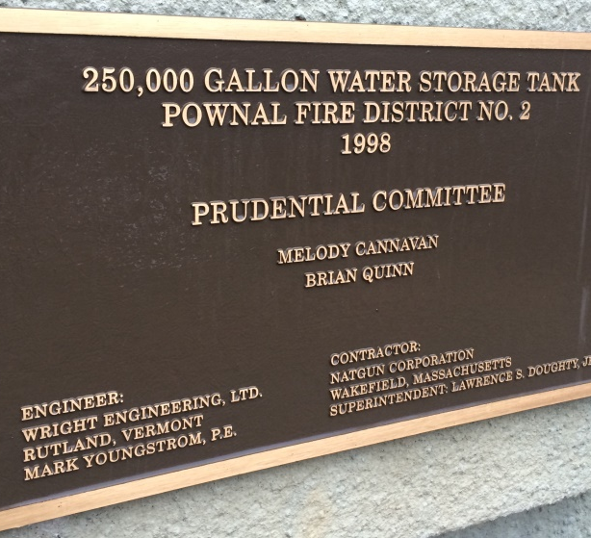
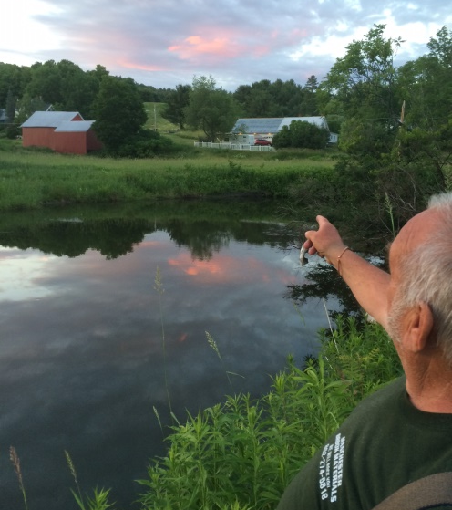
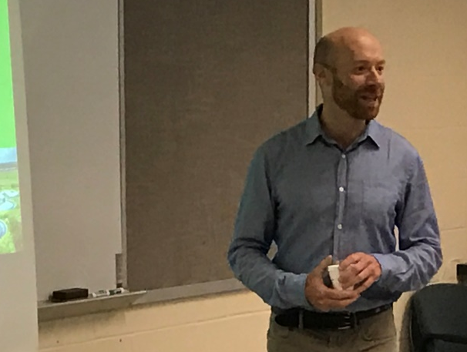
WIB: Outside / Guest Speakers
    What worked:
    Asking a past participant / system who has created an action plan and made progress to come and talk about their experience
    Asking local funders to come in to talk about grant or loan opportunities (eg. asset management grants, planning loans, etc.)
Notes:
It is hard for utilities to make progress on some of the key management areas. When they do, they are usually very happy to talk about it. Funders (invite SRF and USDA, for ex.)

Slide 36

WIB: Outside / Guest Speakers
  What worked:
  Working lunches!
    Guest speaker? Funders?
    Host utility? Successful outcome?
  Why it worked:
  Conversation tends to be comfortable.
  Attendees appreciate the free lunch.
  An active lunch can minimize the dreaded post-lunch trough.
Notes:
Customizing material, being okay not covering all of the workshop content.
While it is nice to have guest speakers or lunch presentations, need to make sure you don’t overbook
Consistently seen on evaluation forms:
“An overwhelming amount of information”

Slide 37



WIB: Outside / Guest Speakers
  What didn’t work:
  Keeping people from eating
  What didn’t work:
  Giving sponsors a gratuitous commercial
  What didn’t work:
  Allowing lunch presenters to go over allotted time – disruptive!

Slide 38
WIB: System Engagement
  Helpful feedback:
  At least one attendee wanted more examples of how action plans improve outcomes.
  How to fix:
  Prompt systems to talk about their success stories.
  Talk about the importance of assigning the “who” and “when”
  Identify actions taken by high-performing utilities (Guidebook)
    Ask if anyone has taken these actions
    Helps attendees know what to strive for
Notes:
There was a comment from an attendee about wanting concrete examples of how action plans improve outcomes. Attempted to improve for next workshop.
“plant” systems in audience by bringing some of the systems you work with. Otherwise, research systems and their success stories and ask them to discuss.

Slide 39

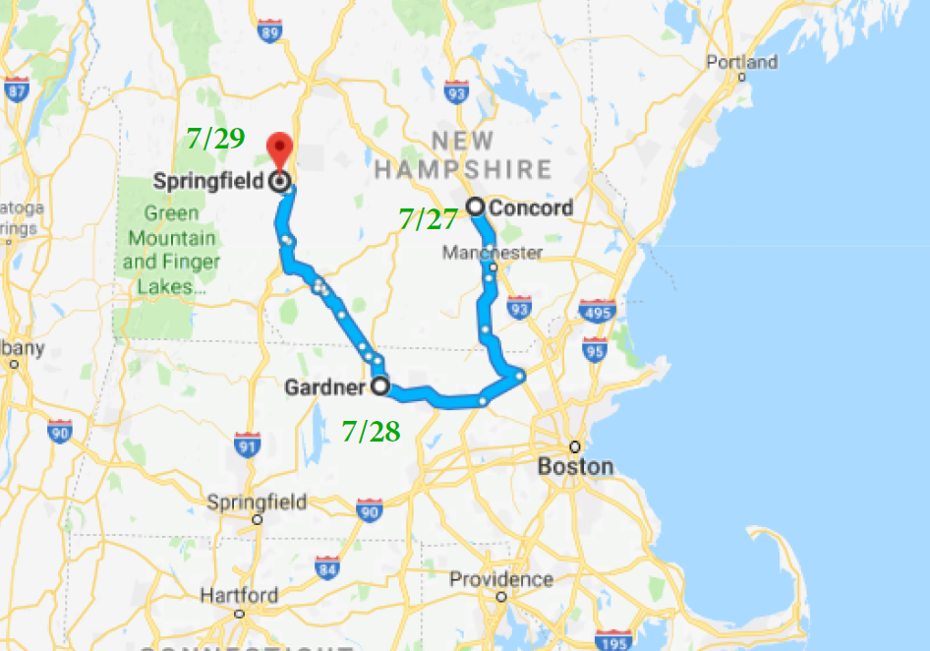
WIB: Super Tour 2017
In 2017, RCAP Solutions staff planned and executed a multi-state WIB “Super Tour”

Slide 40
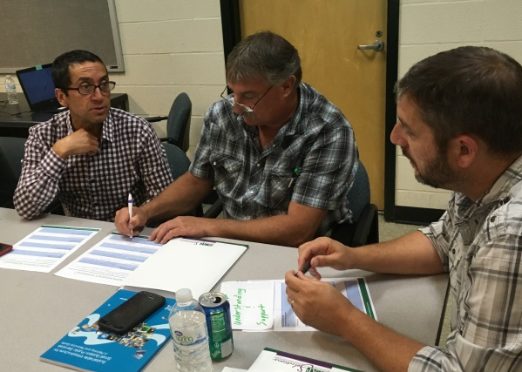
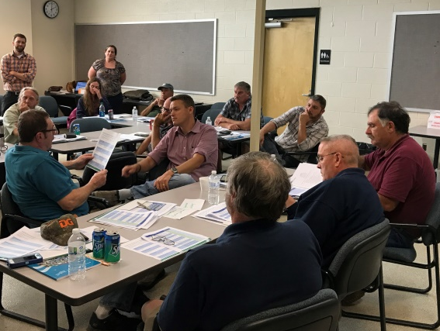
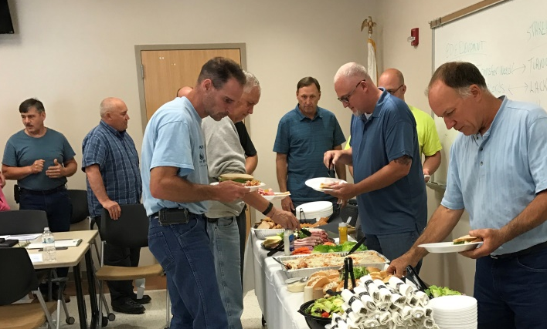
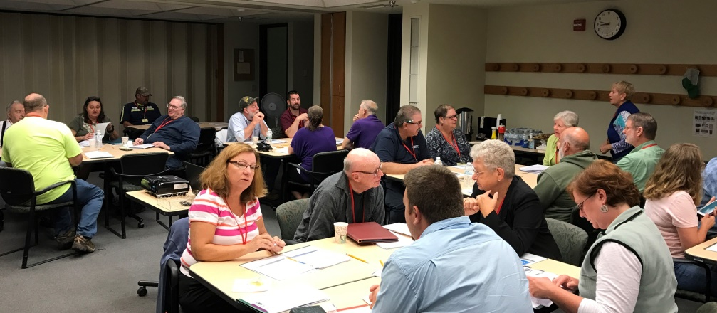
WIB: Super Tour 2017
65 attendees over 3 days
40+ systems represented
Multiple projects resulted from our workshops

Slide 41
WIB: System Engagement and Follow-up
  What worked:
  Taking some notes during the training on most pressing issues in each system
  Taking a photo of a good action plan – follow up with the system!
  Preparing a general follow-up email before hand
    Acknowledge the time commitment
    Links to additional local resources and funders
      Next Steps for Utilities!
    Information on upcoming training opportunities
    Contact list for attendees to keep in touch
    Encourage team exercise
Notes:
Taking notes – here is where it helps to have multiple trainers!
Mention the Next Steps handouts

Slide 42
WIB: Super Tour 2017
  Lessons Learned:
  Very helpful to have multiple trainers when doing back-to-backs
  Need to leave adequate time for action plans
  Incorporate more success stories
  Invite utilities to show off their projects and how they achieved milestones
  Critical to find marketing avenues to attract managers
  Use the templates / material available online
Notes:
- Use the handouts : Next Steps for Utilities, Talking Points, etc.

Slide 43
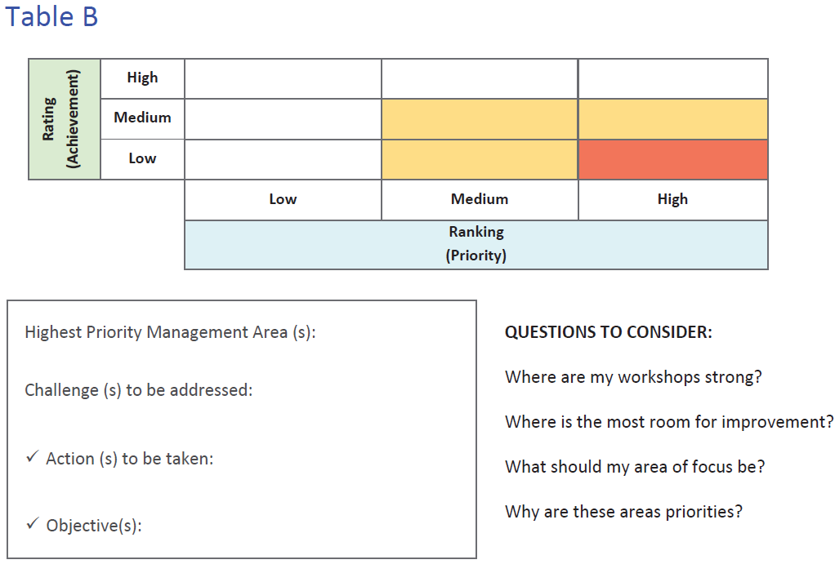
Self-Assessment Activity – Part 2
Notes:
Group activity

Slide 44

WIB Video
Notes:
Background of video before playing
https://youtu.be/9ASpsYlF5ms

Slide 45
Wrap-up
Questions?
?
Notes:
Are there any questions?

Slide 46
Mark Johnson
RCAP Solutions
State Lead, VT
(802) 505-1037
mjohnson@rcapsolutions.org
Laura Dubin
RCAC | ENVIRONMENTAL SERVICES
Rural Development Specialist | New Mexico
(505) 819-8511
ldubin@rcac.org

