Slide 1
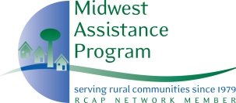
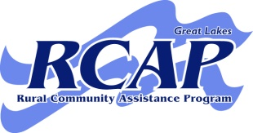
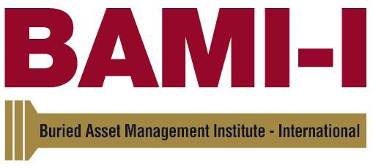
An introduction and overview of the CTAM program

Slide 2
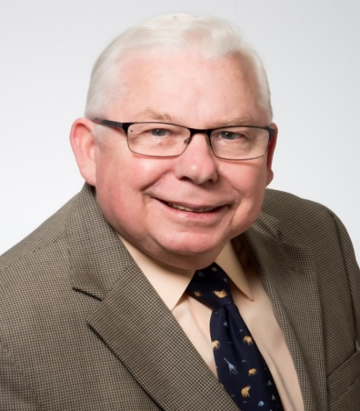
Presenter: Professor Tom Iseley, Ph. D., P.E., Dist. M. ASCE
CETF Professor, Civil Engineering
Eminent Scholar Chair in Construction
Trenchless Technology Center
Assoc. Director, International Operations
Louisiana Tech University
Chair, BAMI-I Board of Directors
Director, UNITRACC International
Adjunct Professor, Xi’an Jiaotong University, China

Slide 3
AM Water & Sewer
Definition
Address customers’ immediate service requirements while managing the system assets to meet long-term requirements reliably & cost effectively
Long-term AM results in:
Increased Asset Life
Decreased Maintenance Costs
Decreased Capital Costs
Permits planned spending based on critical needs.
Allows scarce financial resources to be effectively used.
Potentially increases revenues by revealing opportunities to sell or lease land or retired assets, sell excess capacity, provide outside services, or initiate new business.

Slide 4
AM: Origins in the Utility Industry
1972 Clean Water Act (PL 92-500)
Launched NPDES (National Pollutant Discharge Elimination System)
First steps towards SSES (Sewer System Evaluation Survey)
AM Continued Advancement
CMOM (Capacity, Management, Operation, Maintenance Program)
GASB 34 (General Accounting Standards Board) - requirements

Slide 5
Water & Sewer Champion
Mayor Shirley Franklin – Atlanta’s Sewer Mayor
Atlanta Journal-Constitution – July 15, 2002
Atlanta eager to develop world-class sewer system
People worldwide dream of living in a community with clean water, plentiful jobs and affordable housing. Over the Next 12 years, Atlanta will make its largest investment ever in such a dream. To assure high water quality and long-term economic stability for ourselves, our children and grandchildren, we are embarking on a $3B sewer improvement program.
Most of this investment is required under a federal court order --- it is our opportunity to develop a world-class sewer system (water program)

Slide 6
The Roadmap to Accomplish Mayor Franklin’s Vision Requires AM for Assuring Sustainability
Requires:
Innovation
Validation
Education

Slide 7
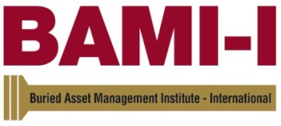
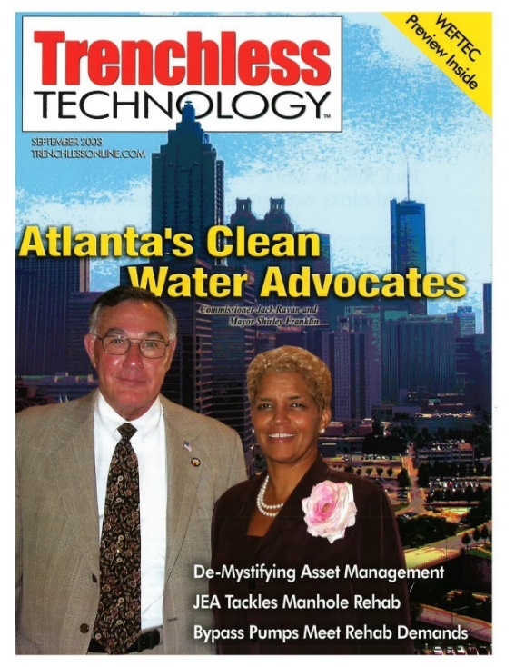
In 2003, formed in Atlanta’s Department of Watershed Management as a result of inspiration & leadership by Mayor Shirley Franklin & Commissioner Jack Ravan.
In June 2004, formed as non-profit organization.
Serves to provide a center of excellence for owners of underground water infrastructure to join with industry and researchers:

Slide 8
ESTABLISHING A PATHWAY FOR ACHIEVING WATER UTILITY INFRASTRUCTURE MANAGEMENT EXCELLENCE

Slide 9
Our Roadmap and Vision for Engaging Current and Future Decision-Makers Must Address:
Five Core Components of an Asset Management Framework
Resource: EPA Asset Management_Best Practices

Slide 10
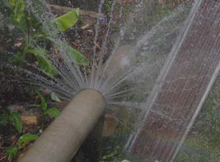
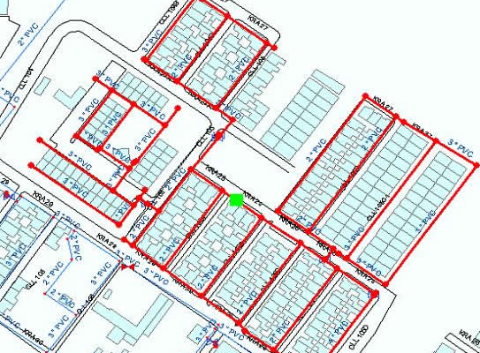
Asset Management Strategies
1- What is current state of my assets?
What assets do we have – Inventory
Where are they located - Mapping
What are their condition - PCA
Determine remaining life
Determine renewal/replacement cost & date

Slide 11
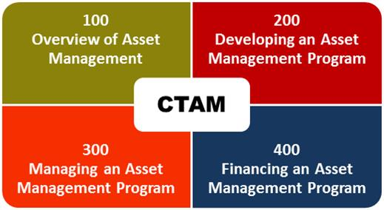
What is CTAM?
Certification of Training in Asset Management
Exclusive four-part series training

Slide 12
Levels of Certification
Certificate of Completion.
Issued for any CTAM course upon completion.
Associate Water Asset Manager (AWAM). Required:
Completion of CTAM 100-400
Apply to BAMI-I Asset Mgt. Certification Board
Professional Water Asset Manager (PWAM). Required:
Completion of CTAM 100-400
Four years of relevant asset mgt. experience
Apply to BAMI-I Asset Mgt. Certification Board

Slide 13
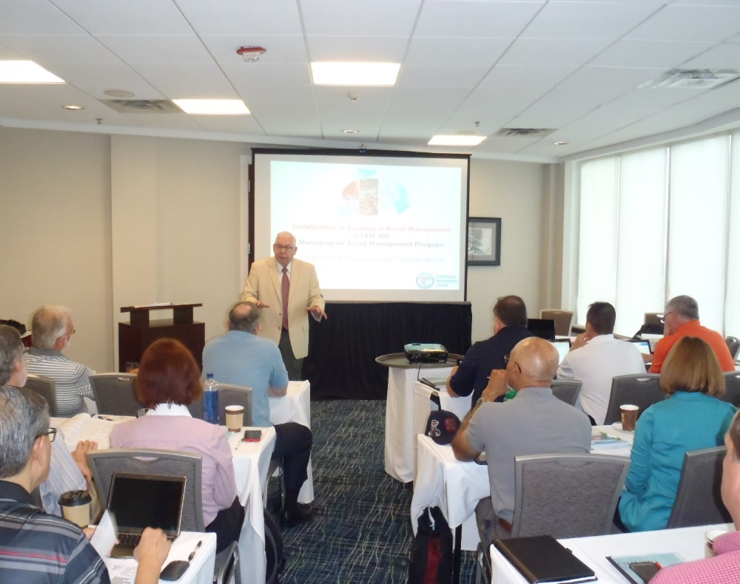
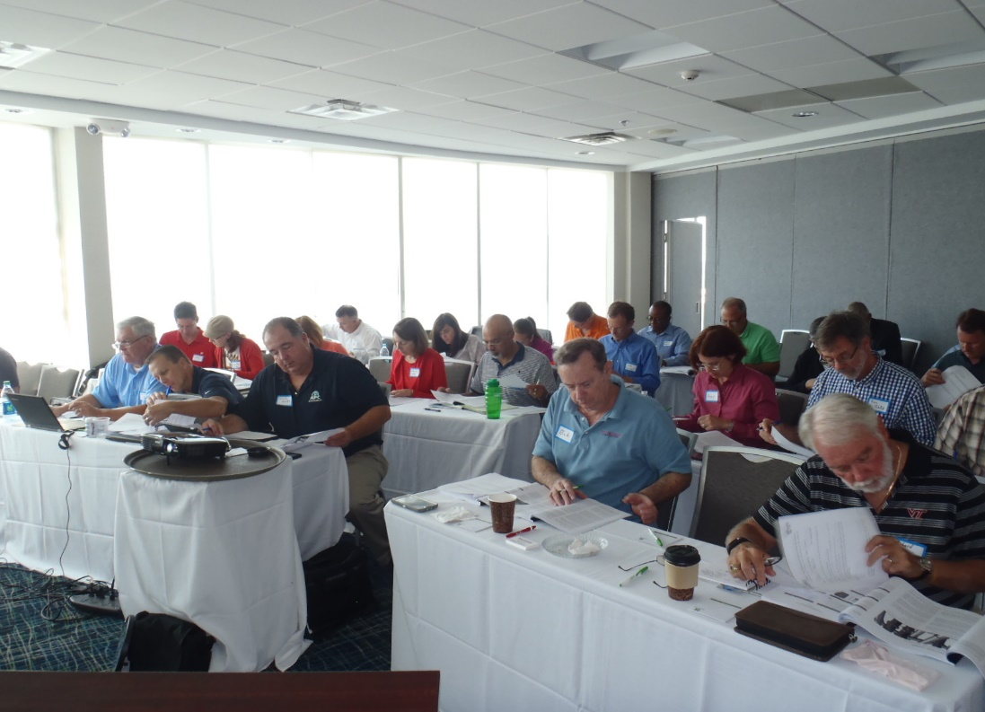
TTC AND BAMI-I LAUNCH A COMPREHENSIVE ASSET MANAGEMENT CERTIFICATION PROGRAM
Raleigh, NC August 17 – 20, 2015

Slide 14
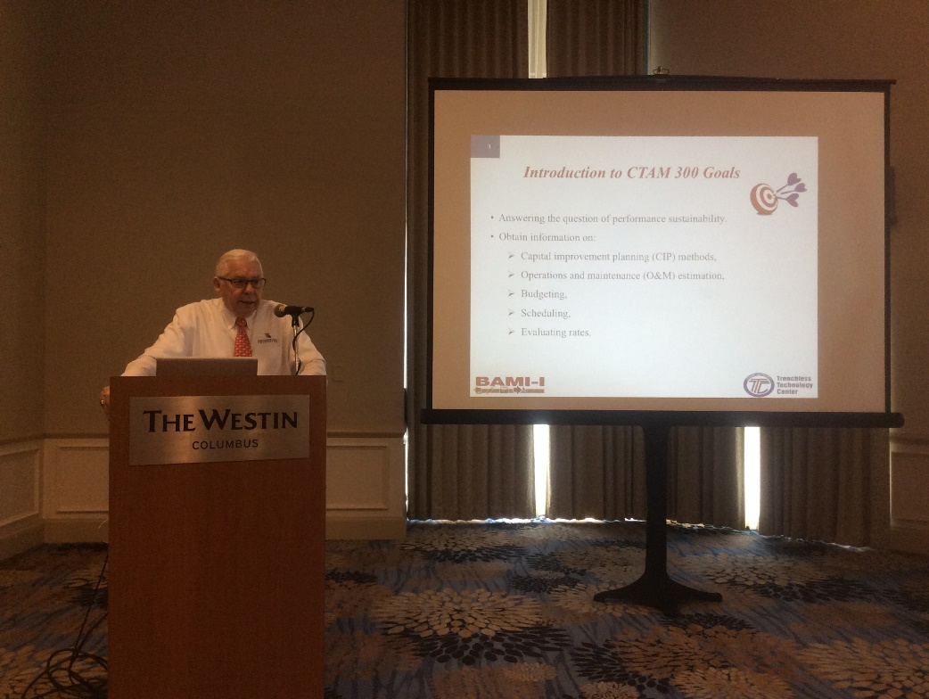
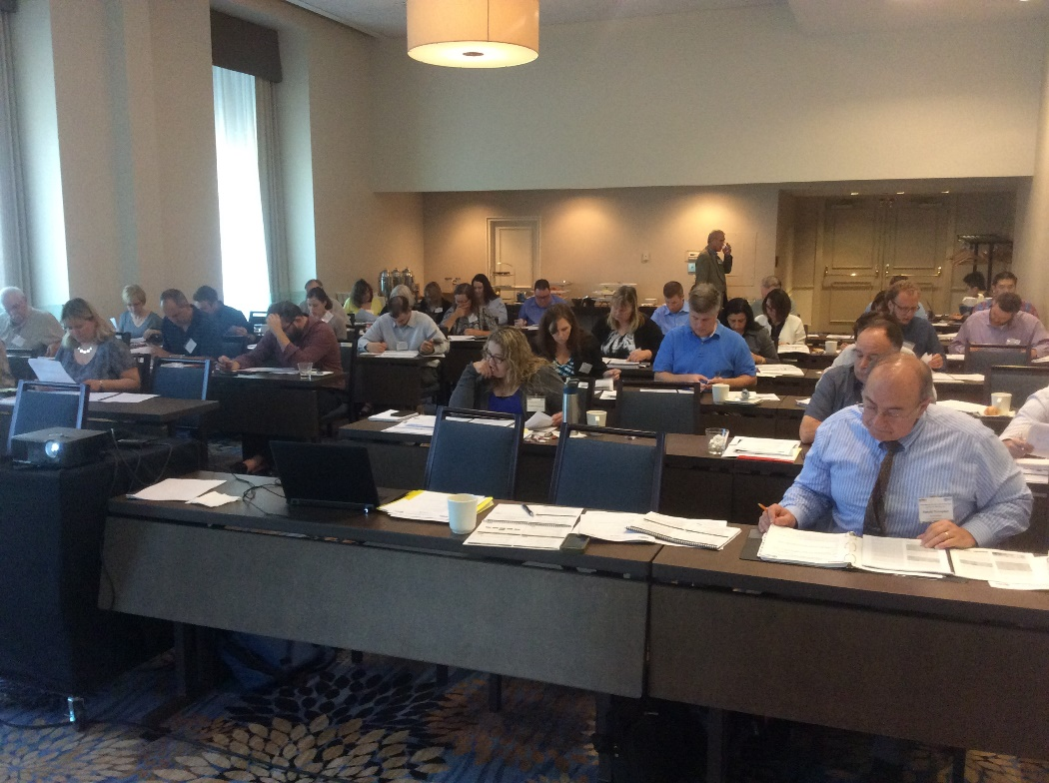
TTC AND BAMI-I LAUNCH A COMPREHENSIVE ASSET MANAGEMENT CERTIFICATION PROGRAM
Columbus, OH - May 16 – 19, 2017

Slide 15
CTAM 100
Overview of Asset Management

Slide 16
CTAM 100 Contents
Introduction to Asset Management
Sharing Asset Management Knowledge on a Global Scale
Asset Management Technologies
Risk Management
Government Regulations
Case Studies

Slide 17
CTAM 200 Developing Buried Asset Management Programs

Slide 18
CTAM 200 Contents
Total Asset Management Plan (TAMP)
Buried Asset Management Program (BAMP)
Asset Registry
Wastewater & Water Data Management Assessment
Condition Assessment

Slide 19
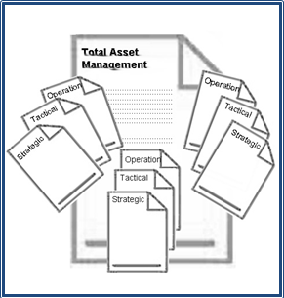
Total Asset Management Plan (TAMP)
Provides a framework to tailor individual departmental plans while retaining the integrity of the organization’s goals
Three Level Plan:
Strategy – Set attainable goals. Long range strategic planning 10-30 years.
Tactics – Implement Strategies. Tactical planning to support Level 1 strategies.
Operation Plans – Tactical Support. Detailed plans to support Level 2 tactics.

Slide 20
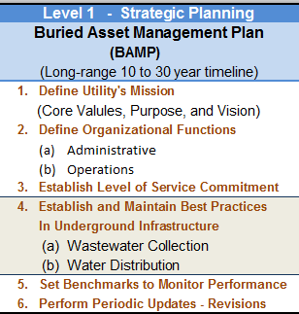

Slide 21
CTAM 300 Managing an Asset Management Program

Slide 22
CTAM 300 Contents
Levels Of Service
Condition Assessment
Repair/Restore Options
Priority Development
Tabulation and Presentation of Priority-Based Long-Term Plan

Slide 23
CTAM 400 Financing Asset Management Programs

Slide 24
CTAM 400 Contents
Accounting Principles
Infrastructure Stewardship
Strategic Financial Tools
Contracting Methods
Case Study

Slide 25
Utility Rate Charges
Development Contributions
Other Supplemental Sources
Special Districts
Internal Financing Tools
Creative Use of Reserve Funds
Tax Increment Financing (TIF)

Slide 26
Municipal Bonds
Public-Private Partnership (PPP)
Federal Funding Opportunities
External Financing Tools
Private Financing
Federal Funding Sources for Small Community Wastewater Systems
Regional Opportunities
Other State Funding Programs
State Revolving Funds

Slide 27
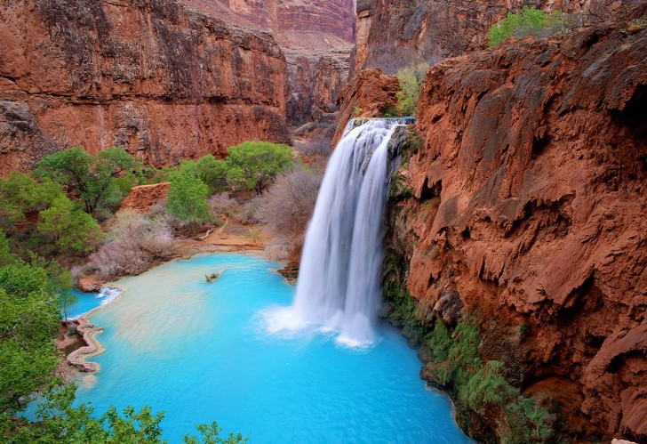
Thanks for your attention!
Questions?
Contact information
Tom Iseley, LA Tech / TTC
Tel.: (318) 257- 4072
E-mail: dtiseley@latech.edu
Website: http://ttc.latech.edu

