Slide 1
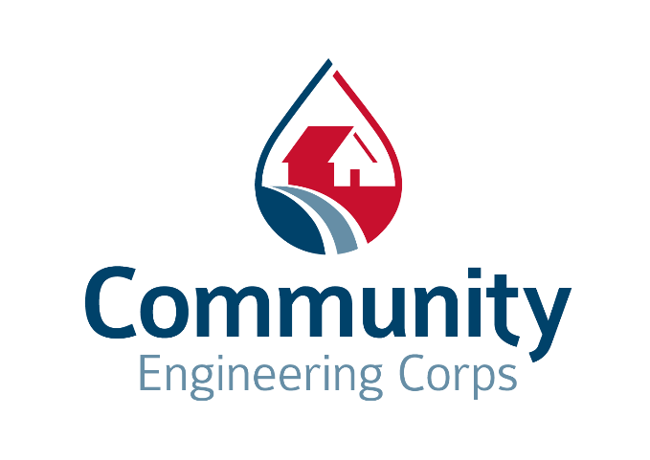
Partnering to Assist Rural Communities

Slide 2
Agenda
Who We Are
The Need
CECorps Services
Partnerships and Projects
Discussion/Q&A

Slide 3
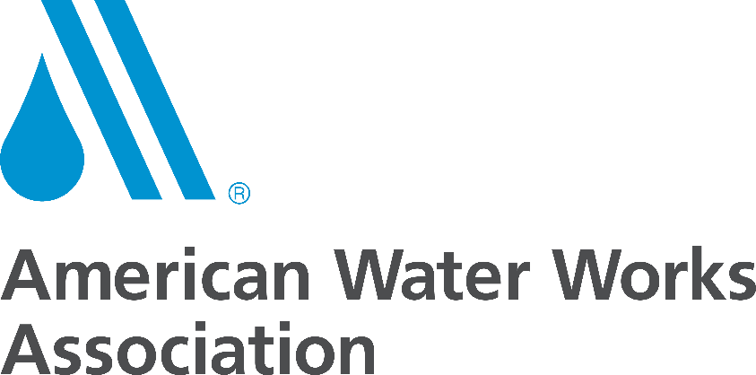
Who We Are
A Powerful Alliance –
Bringing more than 200,000 technical professionals and students together to serve communities in the US.
3

Slide 4
Vision
All communities in the United States have the infrastructure they need to thrive.
Mission
Community Engineering Corps brings underserved communities and volunteer engineers together to advance local infrastructure solutions.
4

Slide 5
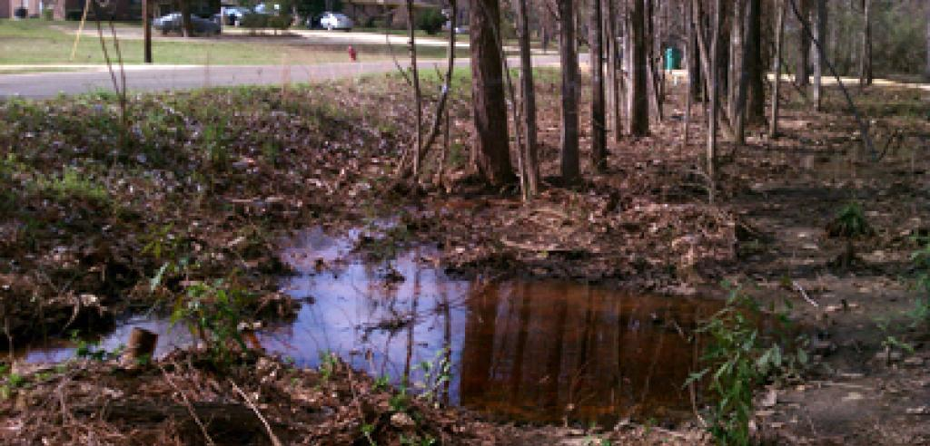
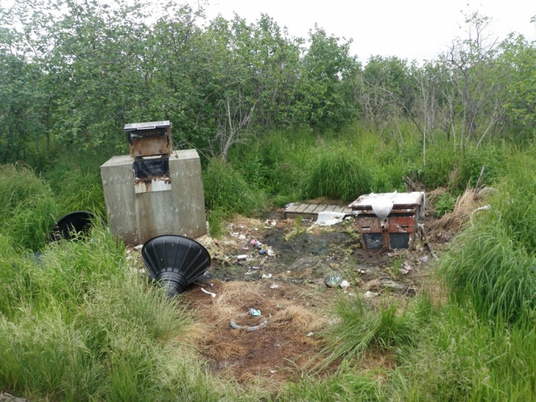
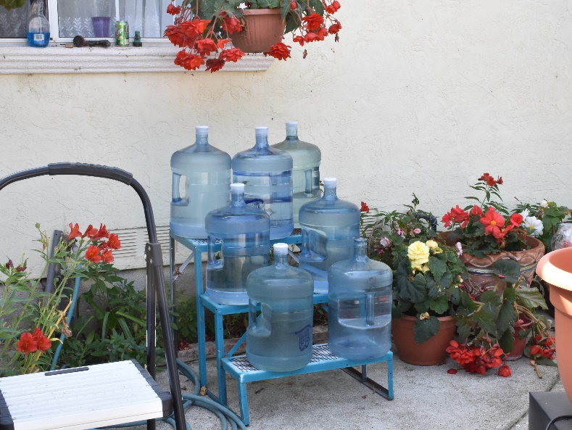
The Need
2017 ASCE Infrastructure Report Card:
“Infrastructure is the foundation that connects the nation’s businesses, communities, and people, driving our economy, and improving our quality of life.”
5

Slide 6
CECorps Services
2
6

Slide 7
Communities
At the heart of what we do –
“Community” broadly encompasses many people, groups, and organizations that contribute to a community’s well-being.
7

Slide 8
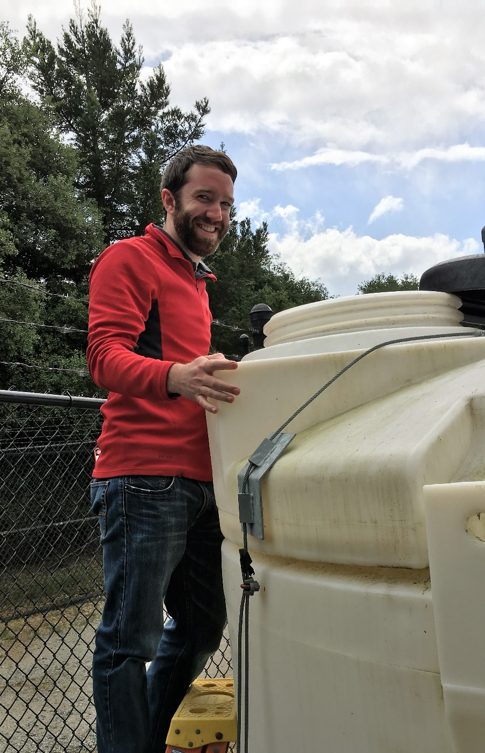
Volunteers
The engine that drives us –
Community Engineering Corps projects take place across the country and are made possible through the great work of our volunteers.
8

Slide 9
Projects
Engineering Impact for our Communities
2
9

Slide 10
Project Process
Technical Review
Technical Review
Step 1: Identify appropriate projects
Step 2: Find the right project team
Step 3: The project team, working with the community, develops a work plan and an ESA
Step 4: The project team, working with the community, completes the assessment and design work
Application Review
Staff Review
Legal Review
10

Slide 11
CECorps Services
Pro-Bono Engineering Services
Consultation, investigation, evaluation
Planning and design of engineering works and systems
Engineering studies
Owner’s Rep - assuring substantial compliance with drawings and specifications
2
11

Slide 12
CECorps Services
Outside our scope of services:
Compete where for-hire service is attainable
Fund project team expenses*
Fund capital costs
Construct projects
Work on non-engineering projects
*Except where USDA or other grant funding is available
2
12

Slide 13
Where We Work
2
13

Slide 14
Effective Partnerships
RCAP – nationwide
USDA - nationwide
Environmental Justice Coalition for Water (EJCW) – California
Alabama Center for Rural Enterprise (ACRE) - Alabama
PathStone – Puerto Rico
2
14

Slide 15
RCAP and CECorps
RCAP is already in the communities that may benefit from CECorps services
CECorps can be a technical resource for RCAP
Creates a stronger community to project team
Similar mission/vision
2
15

Slide 16
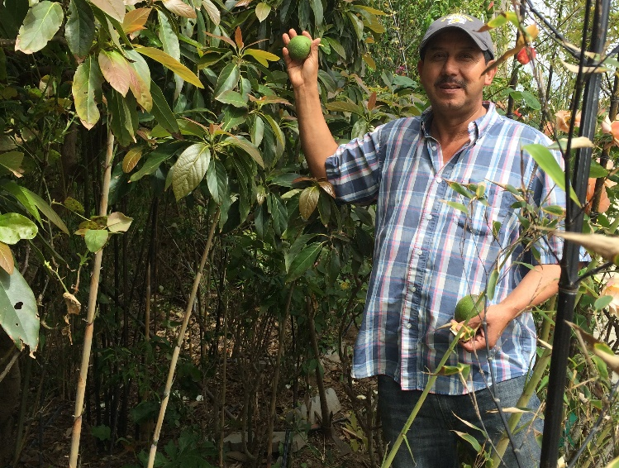
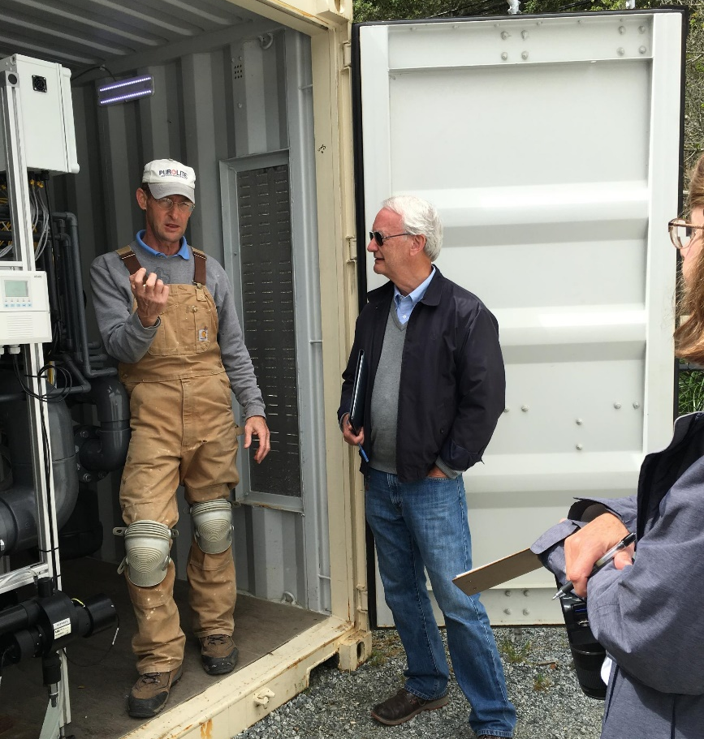
Salinas Valley, California
RCAP Region: RCAC
Project Team: Multiple CECorps project teams
Engineered alternatives to drinking water source contamination. Currently seeking funding for implementation.
16

Slide 17
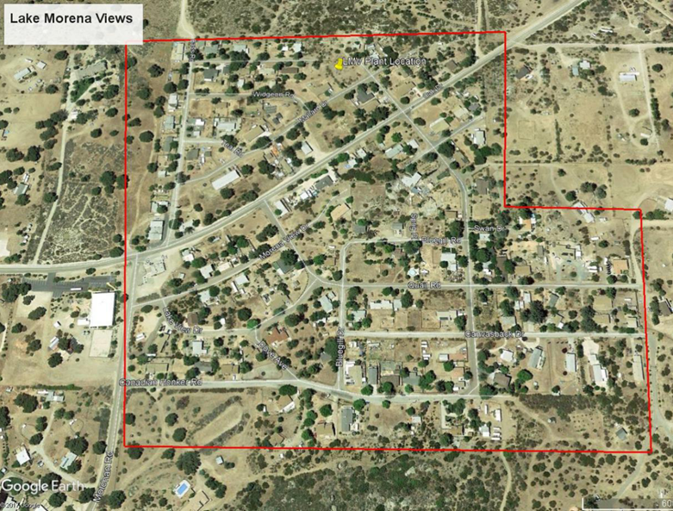
Lake Morena, Colonias, California
RCAP Region: RCAC
Project team: TBD
Requesting assistance on water source and hydrogeologic investigation; Preliminary Engineering Report

Slide 18
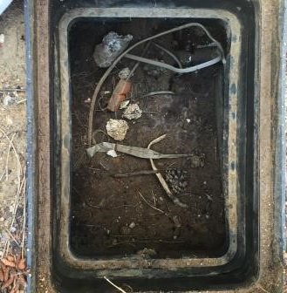
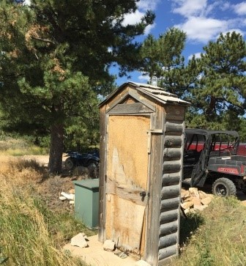
Red Feather Lakes, Colorado
RCAP Region: RCAC
Project team: AWWA Rocky Mountain Section
Developing an engineering assessment and design for water and wastewater distribution systems. Also assisting with community education and potential funding options.

Slide 19
Grover Hill, Ohio
RCAP Region: Great Lakes RCAP
Project team: AWWA Ohio Section
Identified collection system repair and replacement alternatives and provided a cost analysis of evaluated options. Village now evaluating options.

Slide 20
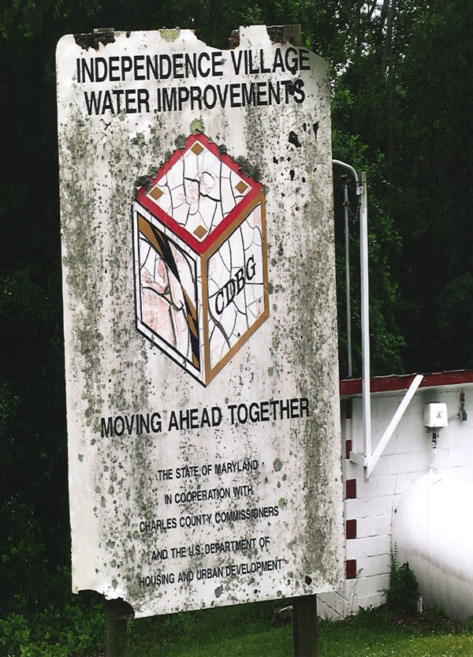
Independence Village, Maryland
RCAP Region: SERCAP
Project team: TBD
Requesting a study of options and costs for providing safe drinking water to its 24 homes.
20

Slide 21
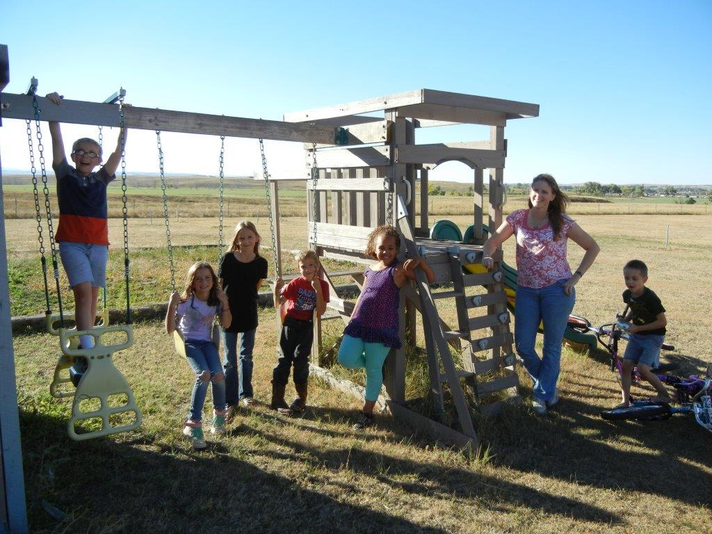
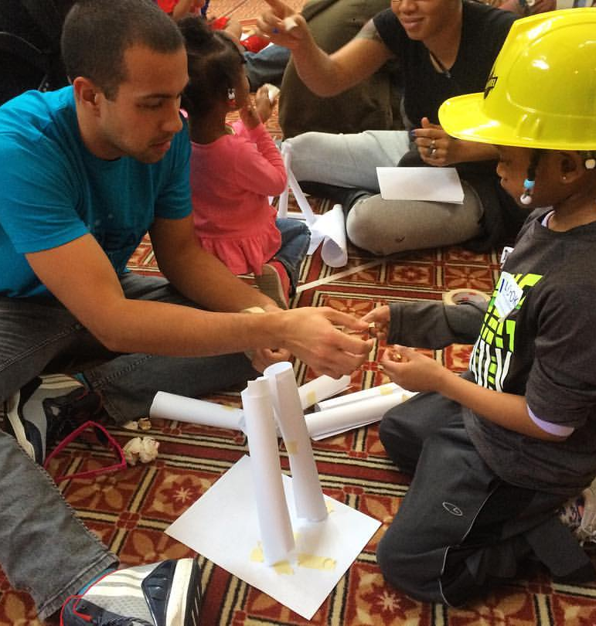
Cedar Gulch, South Dakota
RCAP Region: MAP
Project team: EWB-USA Norther Virginia Professionals
Provided recommended alternatives with cost evaluation addressing contamination and distribution system issues. Community pursuing available funding.
21

Slide 22
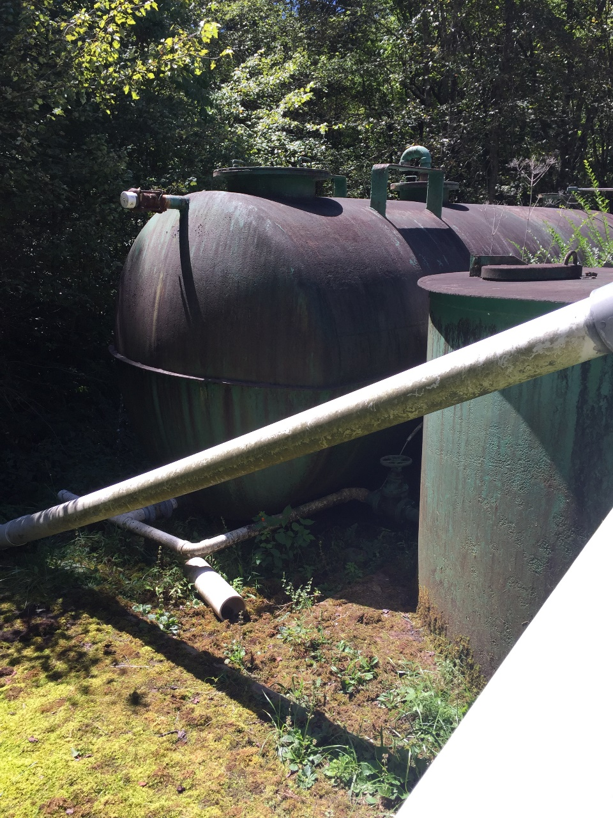
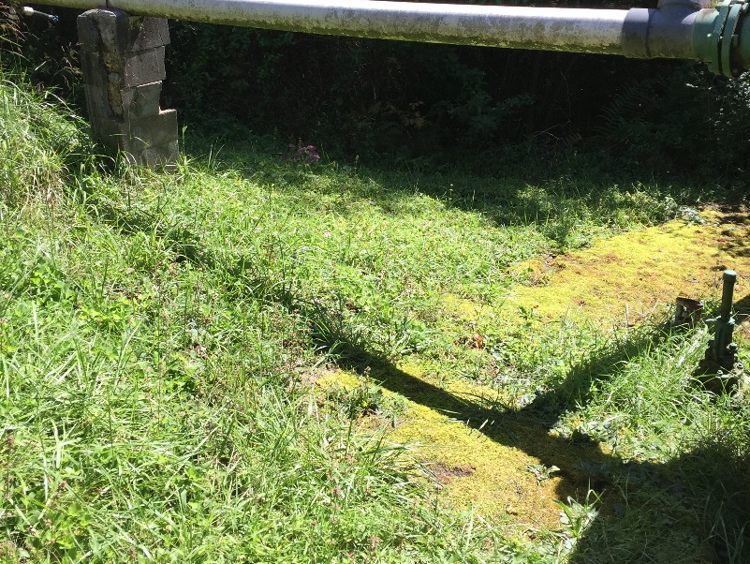
Cherokee Hills, Tennessee
RCAP Region: Communities Unlimited
Project team: AWWA Tennessee Section
Request for assistance with metering and a rate study. Additionally, inspect water source, treatment process, and distribution systems and provide recommendations for improvement /optimization
22

Slide 23
Tangier Island, Virginia
RCAP Region: SERCAP
Project team: AWWA Virginia Section
Provide recommendations and design to renovate water well heads and distribution system. Also assess water tower electrical components.
23

Slide 24
What is CECorps Impact?
Improved infrastructure
CECorps volunteers provide essential engineering service
?
Community identifies funding source
Community Identifies Infrastructure Need(s)
Notes:
Animated slide demonstrating CECorps impact.

Slide 25
Discussion
Project ideas
Thoughts on CECorps approach
What’s in My Backyard Challenge
25

Slide 26
Conclusion
We are here to help!
Website: www.communityengineeringcorps.org
Email: CECinfo@ewb-usa.org
Community Engineering Corps Staff:
EWB-USA
Clare Haas Claveau – clare.haas.claveau@ewb-usa.org
Lauren Butner – lauren.butner@ewb-usa.org
AWWA
Coming soon!
ASCE
Melissa Prelewicz – mprelewicz@asce.org
2
26

