Slide 1
Increase Access and Consumption of Safe Drinking Water in Schools and Communities
George Schlender
Rural Community Assistance Corporation (RCAC)

Slide 2
Agua4All
Serves rural and low-income urban schools and public places in California
Is funded through many different sources
More than 350 water bottle filling stations installed to date
Pilot project treated more than 200,000 gallons to provide arsenic-free drinking water in schools and community locations
Notes:
Provides technical assistance, access to water bottle filling stations, education and water treatment if needed.
Funding sources: state, nonprofit, foundations, financial institutions, manufacturers, suppliers

Slide 3
Agua4All Initiative
Project Funders

Slide 4
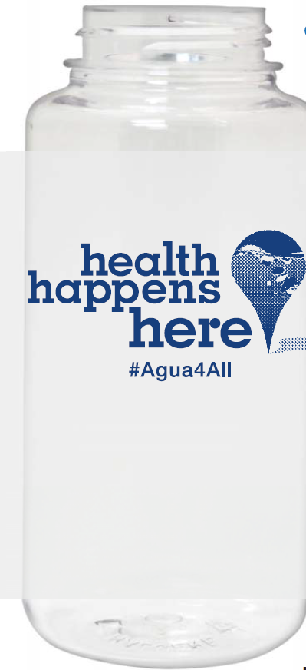
Why Agua4All?
Increase awareness of water quality problems in CA
Provide safe, appealing drinking water for students and community members
Reduce waste from disposable bottles by encouraging tap water and reusable bottle use
Encourage good health for local residents through increased water consumption
Receive much-needed fountain infrastructure upgrades

Slide 5
Drinking Water for Schools
$9.5 million awarded to California schools located in disadvantaged communities
RCAC and three subcontractors provide technical assistance to eligible entities
Addressing water quality and access issues in 28 schools in 18 counties throughout the state

