Slide 1
Regional Perspectives for Successful Tribal Interactions
Rural Community Assistance Partnership
Practical solutions for improving rural communities
Presenter:
Karen Thomas - TAP
Notes:
This slide can be shown while participants enter the room and find their seats.
The notes at the bottom of each page are not a script for the trainer to read word-for-word but are intended to provide some prompts to the trainer in order to elaborate on the information in the slides projected to the trainees.
Presenters may alter/amend the content and context as needed.
Show this slide as participants enter the training space and find their seats.
Edit this slide (replace words in brackets) as appropriate.
Provide an overview of your professional background.
Explain your role within the RCAP network.
Original content and modules created by RCAC, the Western RCAP (www.rcac.org; 916/447-2854) on behalf of the Rural Community Assistance Partnership, Inc. © RCAP, Inc. 2013

Slide 2
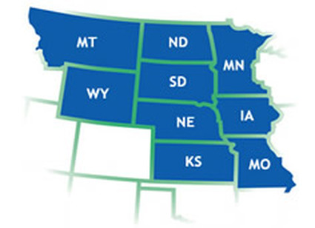
Midwest Assistance Program

Slide 3
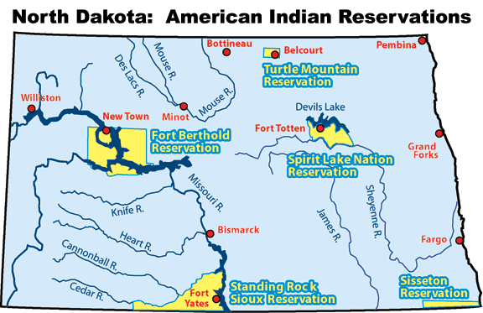
North Dakota Reservation Map

Slide 4
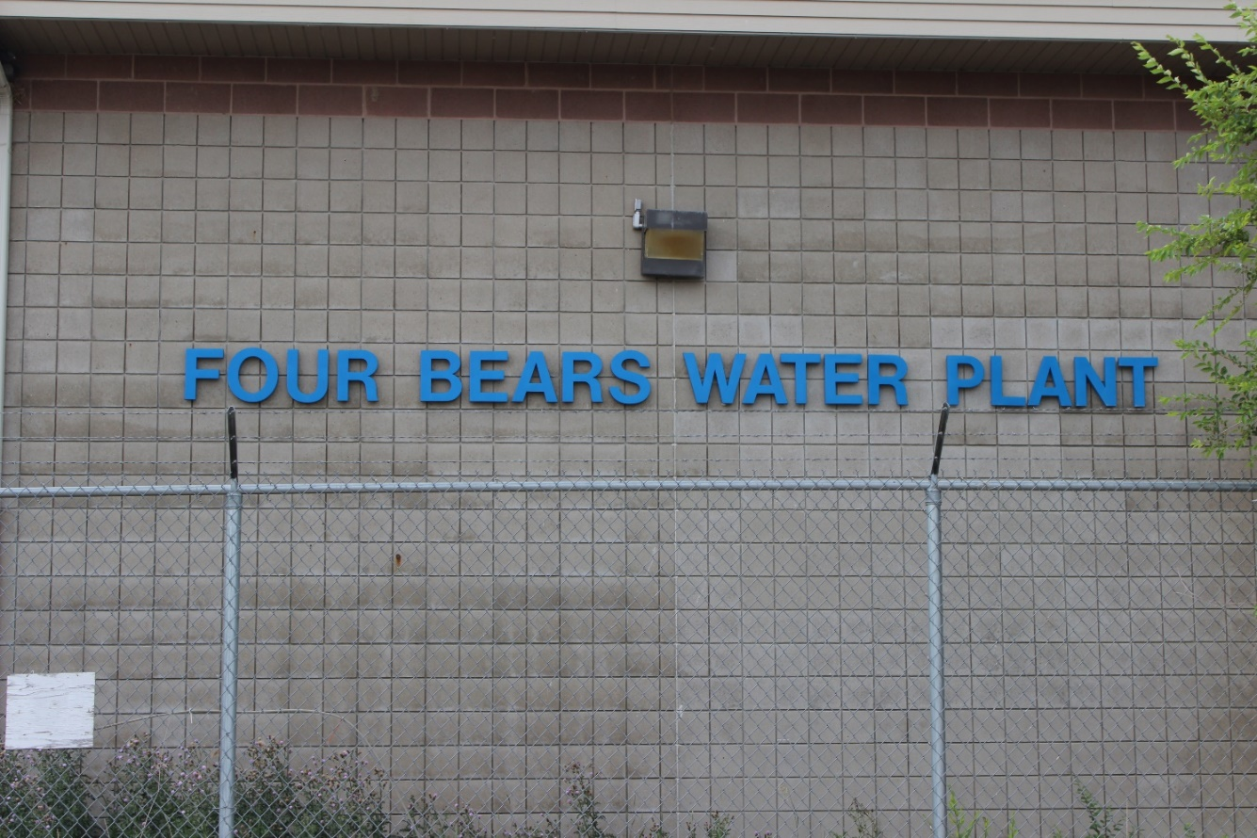
Existing Tribal Contracts
TRIBAL TECHNITRAIN
RD Reporting Assistance
Emergency Response Plans
Vulnerability Assessments
EPA REGION 8
Water Operator Basic Math Workshops
Water Operator Treatment and Distribution Trainings

Slide 5
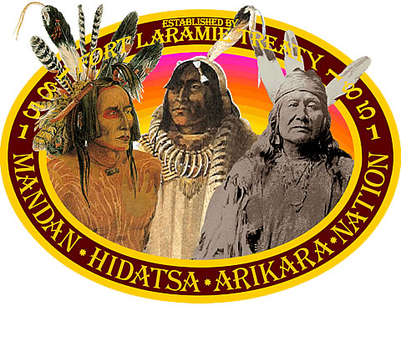
Tips For New TAPs
Establish Trust
Create a good rapport with the operators or other tribal entities
Start with projects that are simple and more straight forward
Notes:
Emergency response plans are a great way to start. Talk to your RD office to see if tribal communities have loans and if any need ERP updating.

Slide 6
Tips For New TAPs
Be Prepared
Know your EPA regional contact
Region 8 – Andrea Griese
Know the unique partners or players in your region or state
ND tribes and Bureau of Reclamation
Indian Health Services
Rural Development

Slide 7
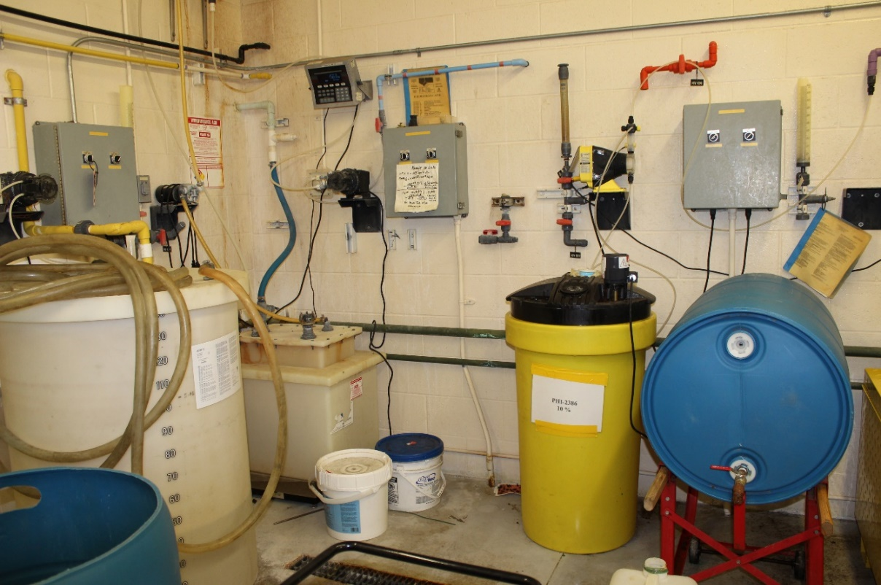
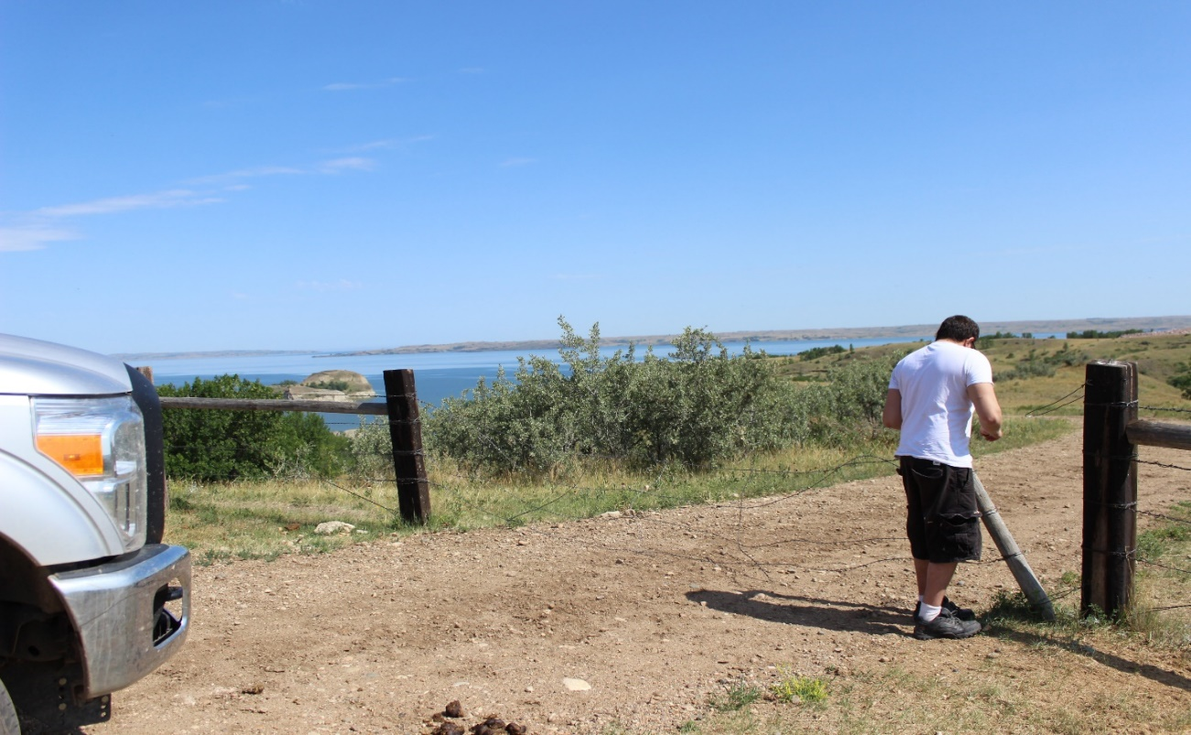
Tips For New TAPs
Ask Questions
Twin Buttes Water Plant in the Fort Berthold Rural Water District
Notes:
Water operators are more than happy to explain or show you their facility. Being new, I asked a lot of questions and this operator even took me to the intake at Lake Sakakawea

Slide 8
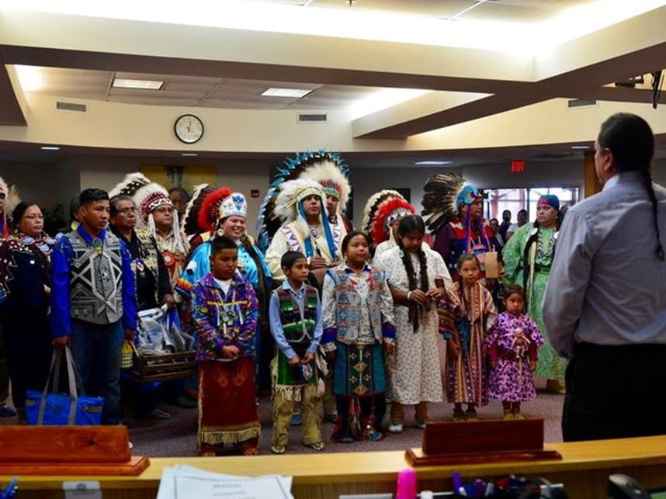
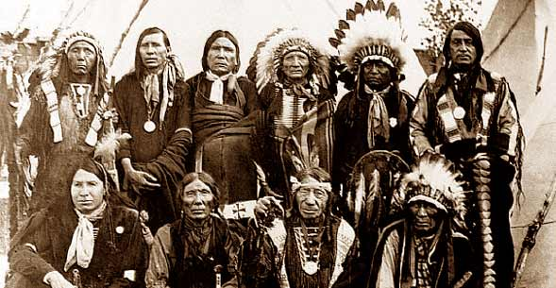
Know Your Tribal Community
Research
History of the tribe
Council and government
Current events
Notes:
Knowing what tribe or tribes are living at that reservation or community is important. Know the name of the important players, like the tribal chair. The tribes should each have their own website, for example MHAnation.com or TMBCI.org, that can be helpful. I have read some of the local newspapers as well and learned a little about their community and what current events are going on? Pow-wows or other events that are important to that community…..or could be controversial

Slide 9
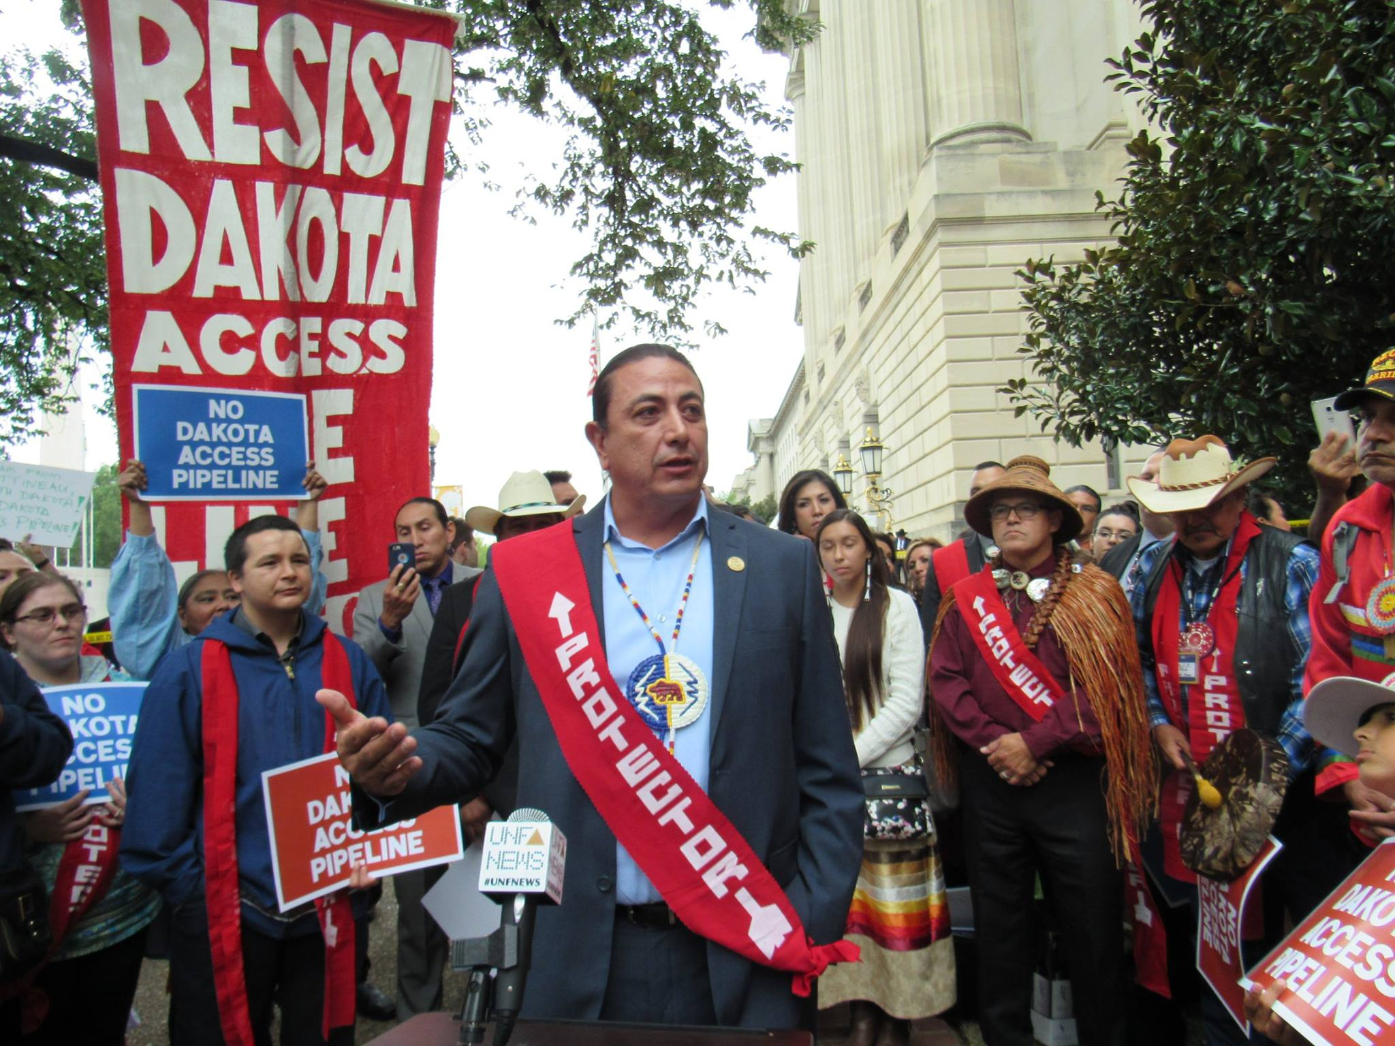
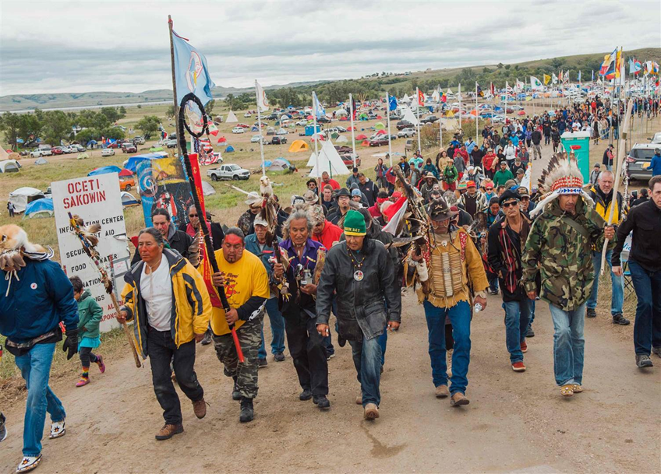
Dakota Access Pipeline
Standing Rock Reservation, ND
Notes:
This was at the Standing Rock reservation, a community that we serve. This was a very hot topic and controversial. Some of the operators or other community leader could have been part of the actions going on, so be sensitive to the subject.

Slide 10
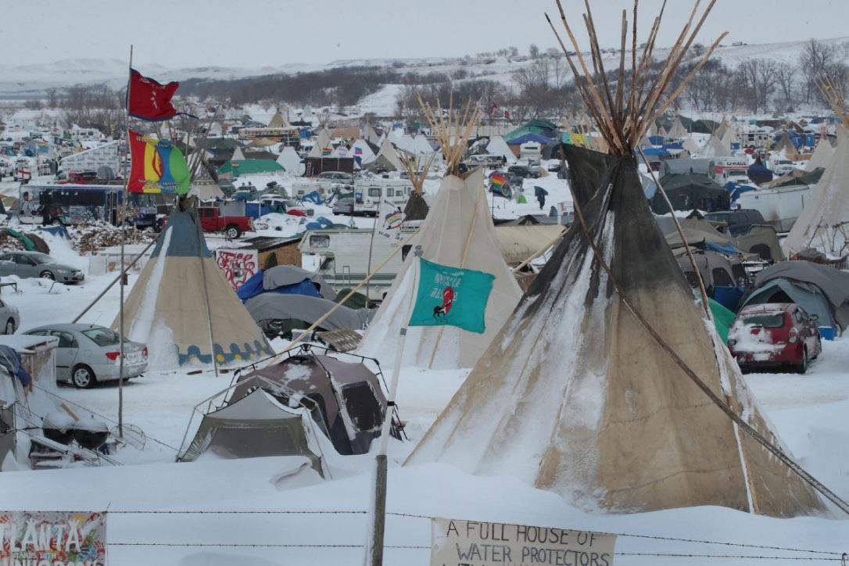
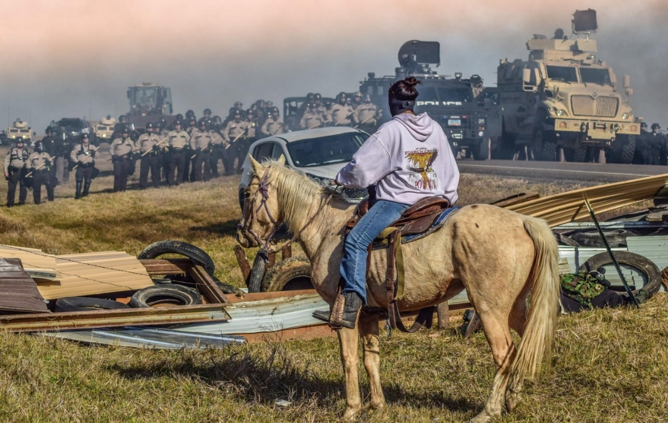
Dakota Access Pipeline
Stay safe
Plan accordingly
Avoid language or actions that could offend
Notes:
This was an unusual situation, but it was eye-opening for someone like myself who is new to living near to and working with tribal communities.

Slide 11
Wrap-up
Questions
?
Contact Information:
Karen Thomas
kthomas@map-inc.org
(805) 341-2188
Notes:
Are there any questions?
Edit this slide (replace words in brackets) as appropriate.

