Slide 1
Advocacy Toolkit:
How to Effectively Engage Members of Congress to Support RCAP Funding in FY20 & Educating New Members of Congress
Notes:
Be sure to type in your name and organization. Scroll to the left to drag your region’s logo onto this page.

Slide 2
Agenda Review
Fly-in agenda and other information can be found here

Slide 3
Overview
Advocacy Outreach for the RCAP National Fly-In
Support Letter Templates
Tips for a Successful Meeting
Tips on How to Engage with your Member of Congress via Social Media
Current Funding for RCAP Programs
Supplemental Materials
Contact Information

Slide 4
I. Advocacy Outreach for the RCAP National Fly-In
FY2020 Congressional Asks: Appropriations
$9 million in Agriculture-Rural Development appropriations to improve the operation and management of small water and wastewater systems with populations of 3,300 or less
$8 million in Agriculture-Rural Development appropriations of the Rural Community Development Initiative (RCDI)

Slide 5
I. Advocacy Outreach for the RCAP National Fly-In
FY2020 Congressional Asks: Appropriations Continued
$11.25 million in HHS appropriations to provide technical assistance to low-income rural communities who are developing water and wastewater systems
$17.7 million in EPA appropriations for technical and regulatory assistance to small communities
$25 million in EPA appropriations for small treatment works technical assistance

Slide 6
II. Support Letter Templates
Sample Letter/Email to MoC to Support RCAP EPA Funding
Dear [insert name of MoC]:
I am writing in support of the Small Systems Technical Assistance Grants from the Offices of Water and Wastewater at EPA authorized in Section 1442 (e) of the Safe Drinking Water Act. This program provides assistance to small rural communities and reservations to develop and manage water and wastewater systems. The need for assistance to help small systems maintain compliance with federal clean and safe water standards is substantial. Therefore, we request you provide $17 million of funding available under current budget constraints for this important program in the Fiscal Year 2020 Interior-Environment Appropriations Bill.
According to the American Community Survey’s numbers, 662,411 U.S. households lack adequate access to water and wastewater systems. For over 20 years, EPA’s Offices of Water and Wastewater has provided funding for technical assistance training to help address this problem. This program allows the six regional Rural Community Assistance Partnership (RCAP) service providers, including [Insert Organization Name] to work with federal and state agencies in all fifty states and Puerto Rico to help small communities address their drinking water and wastewater treatment concerns. RCAP partners work with all levels of state government to develop appropriate affordable financing options and they also work on compliance issues, and help communities prepare preliminary budgets for their projects.
[Insert 2-3 personal sentences about your organization’s impact on communities within the state/district using this funding]
The financial burden of maintaining safe water systems is quite high for small rural communities so this program is critical. Each year, RCAP assists over 2,200 rural communities, including hundreds of drinking water and wastewater projects serving over 3 million Americans.
I appreciate your consideration of this program to help small rural communities remain in compliance with safe standards and build management capacity at the local level to facilitate rural water and wastewater system improvements.
Sincerely,
[Name
Organization
City/State]

Slide 7
II. Support Letter Templates
Sample Letter/Email to MoC to Support RCAP USDA Funding
Dear [insert name of MoC]:
I am writing in support of the Technical Assistance and Training Grants from the Rural Utilities Service at USDA authorized in Section 306 of the Consolidated Farm and Rural Development Act for multi-state regional assistance to communities with populations of 3,300 or less. This program provides assistance to small rural communities and reservations to develop and manage water and wastewater systems. The need for assistance to help small systems maintain compliance with federal clean and safe water standards is substantial. Therefore, we request you provide $9 million of funding available under current budget constraints for this important program in the Fiscal Year 2020 Agriculture Appropriations Bill.
According to the American Community Survey’s numbers, 662,411 U.S. households lack adequate access to water and wastewater systems. For over 30 years, USDA’s Rural Utilities Service (RUS) has provided funding for technical assistance and training to help address this problem. The TAT Program allows the six regional Rural Community Assistance Partnership (RCAP) service providers, including [Insert Organization Name] to work with federal and state agencies in all fifty states and Puerto Rico to help small communities address their drinking water and wastewater treatment concerns. RCAP partners work with all levels of state government to develop appropriate affordable financing options and they also work on compliance issues, and help communities prepare preliminary budgets for their projects.
[Insert 2-3 personal sentences about your organization’s impact on communities within the state/district using this funding]
The financial burden of maintaining safe water systems is quite high for small rural communities so this program is critical. Each year, RCAP assists over 2,200 rural communities, including hundreds of drinking water and wastewater projects serving over 3 million rural Americans.
I appreciate your consideration of this program to help small rural communities remain in compliance with safe standards and build management capacity at the local level to facilitate rural water and wastewater system improvements.
Sincerely,
[Name
Organization
City/State]

Slide 8
II. Support Letter Templates
Sample Letter/Email to MoC to Support RCAP HHS Funding
Dear [insert name of MoC]:
I am writing in support of the Rural Community Facilities technical assistance program authorized in Section 680(a)(3)(B) of the Community Services Block Grant Act. This program provides assistance to small rural communities and reservations to develop and manage water and wastewater systems. The need for assistance to help small systems maintain compliance with federal clean and safe water standards is substantial. Therefore, we request you provide $11.25 million of funding available under current budget constraints for this important program in the Fiscal Year 2020 Labor-HHS Appropriations Bill.
RCAP and other organizations can more effectively help small communities plan for critical infrastructure rehabilitation projects. With the current administration’s push for infrastructure projects, this will help ensure that water and wastewater projects in rural America are not left out.
According to the American Community Survey’s numbers, 662,411 U.S. households lack adequate access to water and wastewater systems. For over 30 years, the Department of Health and Human Services (HHS) has provided funding for rural community facilities technical assistance to help address this problem. Rural Community Facilities funding allows the six regional Rural Community Assistance Partnership (RCAP) service providers, including [organization] to work with federal and state agencies in all fifty states and Puerto Rico to help small communities address their drinking water and wastewater treatment concerns. RCAP partners work with all levels of state government to develop appropriate affordable financing options and they also work on compliance issues, and help communities prepare preliminary budgets for their projects.
[Insert 2-3 personal sentences about your organization’s impact on communities within the state/district using this funding]
The financial burden of maintaining safe water systems is quite high for small rural communities so this program is critical. Each year, RCAP assists over 2,200 rural communities, including hundreds of drinking water and wastewater projects serving over 3 million rural Americans.
I appreciate your consideration of this program to help small rural communities remain in compliance with safe standards and build management capacity at the local level to facilitate rural water and wastewater system improvements.
Sincerely,
[Name
Organization
City/State]

Slide 9
III. Tips for a Successful Meeting
Be prepared
MOC’s and their staff members are incredibly busy, make sure you go into the meeting prepared with talking points
Be concise
Be personal
MOC’s are elected by their constituents to represent their individual districts; make sure they understand the importance of RCAP’s asks through their specific district’s needs
Remain bipartisan

Slide 10
IV. Tips on How to Engage with your MoCs via Social Media
Use #RCAPontheHill on Twitter to share your organization's impact with your MoC and/or the community’s MoC
Include a photo of your work and/or community or an infographic that demonstrates your impact
NOTE: Photos do not affect the 280 character count
Share a highlight of how your organization played a role in the communities success or highlight impact data
Follow #RCAPontheHill throughout the week and retweet your fellow colleagues and RCAP: @RCAPInc

Slide 11
Social Media Challenge
Whoever posts the most pictures:
With MOC's
With MOC staff/office
With RCAP Network members
Engaging in fly-in activities
You will win a prize!
Make sure to:
Tag @RCAPinc
Hashtag #RCAPOnTheHill, and your regional organization

Slide 12
IV. Current Funding for RCAP Related Programs
Federal Funding Programs-RCAP Releated | FY 17 Final | FY 18 Final | FY 19 Final
USDA-Rural Development
RUS-Water-Wastewater Disposal Program Accounts
RUS-Water-Wastewater Direct Loans | 1,200 | 1,200 | 1,400
RUS-Water-Wastewater Grants | 391.98 | 400 | 475
RUS-Technical Assistance and Training Grants | 20 | 40 | 23.7
RUS-Small System TAT Set-Aside | 6.5 | 8 | 8
RUS-Water-Wastewater Guarantee | 50 | 50 | 50
RUS-Solid Waste Grants | 4 | 4 | 4
RUS-Water Well Program | 0.993 | 0.993 | 1.5
RUS-Small Systems Revolver | 1 | 1 | 1
RHS-Community Facility Direct Loans | 2,600 | 2,600 | 2,800
RHS-Community Facility Grants | 30 | 30 | 45.77
RHS-CF-RCDI Set-Aside | 4 | 4 | 6
RHS-Community Facility Guarantee | 148.305 | 148.305 | 148.28
RHS-CF-TAT Program Set-Aside | 1.5 | 1.5 | 2.2
EPA
Clean Water SRF | 1393.8 | 1393.8 | 1694
Safe Drinking Water SRF | 863.2 | 863.2 | 1164
EPA-National Prority Areas TA Program | 12.6 | 12.6 | 15
HHS
HHS – CSBG Discretionary: Rural Facilities | 7.5 | 8 | 9

Slide 13
V. Supplemental Materials
Appropriations Committees
Link to House Appropriations Committee
Link to Senate Appropriations Committee
Go to your MoC’s “Contact Me” tab on their website and click on the “Email or Message Me” tab
Type your message, record your contact information, and click “send”
Note: You may need to insert your zip code to verify you are a constituent of that Congressional district before you can send an email
House Appropriations Committee Members Twitter Handles
Senate Appropriations Committee Members Twitter Handles
Map of Capitol Hill

Slide 14
V. Supplemental Materials
House Appropriations Committee Members
Democrats Committee Chair: Lowey (NY-17)
Republican Ranking Member Granger (TX-12)
Kaptur (OH-9)
Visclosky (IN-1)
Serrano (NY-15)
DeLauro (CT-3)
Price (NC-4)
Roybal-Allard (CA-40)
Bishop (GA-2)
Lee (CA-13)
McCollum (MN-4)
Ryan (OH-13)
Ruppersberger (MD-2)
Wasserman-Schultz (FL-23)
Cuellar (TX-28)
Pingree (ME-1)
Quigley (IL-5)
Kilmer (WA-6)
Cartwright (PA-8)
Meng (NY-6)
Pocan (WI-2)
Clark (MA-5)
Aguilar (CA-31)
Frankel (FL-21)
Bustos (IL-17)
Watson Coleman (NJ-12)
Lawrence (MI-14)
Torres (CA-35)
Crist (FL-13)
Kirkpatrick (AZ-2)
Case (HI-1)
(Hal) Rogers (KY-5)
Calvert (CA-42)
Harris (MD-1)
Aderholdt (AL-4)
Martha (AL-2)
Cole (OK-4)
Amodei (NV-2)
Fleischmann (TN-3)
Carter (TX-31)
Diaz-Balart (FL-25)
Stewart (UT-2)
Valadao (CA-21)
Joyce (OH-14)
Palazzo (MS-4)
Herrera-Beutler (WA-3)
Granger (TX-12)
Graves (GA-14)
Simpson (ID-2)
Womack (AR-3)
Newhouse (WA-4)
Rutherford (FL-4)
Fortenberry (NE-1)
Moolenaar (MI-4)

Slide 15
V. Supplemental Materials
Senate Appropriations Committee Members
Republican Committee Chair: Shelby (AL)
Democrats Vice Chairman: Leahy (VT)
McConnell (KY)
Alexander (TN)
Collins (ME)
Murkowski (AK)
Graham (SC)
Blunt (MO)
Moran (KS)
Hoeven (ND)
Boozman (AR)
Capito (WV)
Lankford (OK)
Daines (MT)
Kennedy (LA)
Rubio (FL)
Hyde-Smith (MS)
Murray (WA)
Feinstein (CA)
Durbin (IL)
Reed (RI)
Tester (MT)
Udall (NM)
Shaheen (NH)
Merkley (OR)
Coons (DE)
Schatz (HI)
Baldwin (WI)
Murphy (CT)
Manchin (WV)
Van Hollen (MD)

Slide 16
House Twitter Handles - Democrats
Kaptur (OH-9) @RepMarcyKaptur
Visclosky (IN-1) @RepVisclosky
Serrano (NY-15) @RepJoseSerrano
DeLauro (CT-3) @rosadelauro
Price (NC-4) @RepDavidEPrice
Roybal-Allard (CA-40) @RepRoyballAllard
Bishop (GA-2) @SandfordBishop
Lee (CA-13) @RepBarbaraLee
McCollum (MN-4) @BettyMcCollum04
Ryan (OH-13) @RepTimRyan
Ruppersberger (MD-2) @Call_Me_Dutch
Wasserman Schultz (FL-23)@RepDWStweets
Cuellar (TX-28) @RepCuellar
Pingree (ME-1) @chelliepingree
Quigley (IL-5) @RepMikeQuigley
Kilmer (WA-6) @RepDerekKilmer
Cartwright (PA-8) @RepCartwright
Meng (NY-6) @RepGraceMeng
Pocan (WI-2) @repmarkpocan
Clark (MA-5) @RepKClark
Aguilar (CA-31) @RepPeteAguilar
Frankel (FL-21) @RepLoisFrankel
Bustos (IL-17) @RepCheri
Watson Coleman (NJ-12) @RepBonnie
Lawrence (MI-14) @RepLawrence
Torres (CA-35) @NormaJTorres
Crist (FL-13) @RepCharlieCrist
Kirkpatrick (AZ-2) @RepKirkpatrick
Case (HI-1) @RepEdCase

Slide 17
House Twitter Handles – Appropriations Republicans
(Hal) Rogers (KY-5) @RepHalRogers
Calvert (CA-42) @KenCalvert
Harris (MD-1) @RepAndyHarrisMD
Aderholdt (AL-4) @Robert_Aderholt
Roby (AL-2) @RepMarthaRoby
Cole (OK-4) @TomColeOK04
Amodei (NV-2) @MarkAmodeiNV2
Fleischmann (TN-3) @RepChuck
Carter (TX-31) @JudgeCarter
Diaz-Balart (FL-25) @MarioDB
Stewart (UT-2) @RepChrisStewart
Valadao (CA-21) @RepDavidValadao
Joyce (OH-14) @RepDaveJoyce
Palazzo (MS-4) @CongPalazzo
Herrera-Beutler (WA-3) @HerreraBeutler
Granger (TX-12) @RepKayGranger
Graves (GA-14) @RepTomGraves
Simpson (ID-2) @CongMikeSimpson
Womack (AR-3) @rep_stevewomack
Newhouse (WA-4) @RepNewhouse
Rutherford (FL-4) @RepRutherfordFL
Fortenberry (NE-1) @JeffFortenberry
Moolenaar (MI-4) @RepMoolenaar

Slide 18
Senate Twitter Handles – Appropriations Republicans
Shelby (AL) @SenShelby
McConnell (KY) @senatemajldr
Alexander (TN) @SenAlexander
Collins (ME) @SenatorCollins
Murkowski (AK) @lisamurkowski
Graham (SC) @LindseyGrahamSC
Blunt (MO) @RoyBlunt
Moran (KS) @JerryMoran
Hoeven (ND) @SenJohnHoeven
Boozman (AR) @JohnBoozman
Capito (WV) @SenCapito
Lankford (OK) @SenatorLankford
Daines (MT) @SteveDaines
Kennedy (LA) @SenJohnKennedy
Rubio (FL) @marcorubio
Hyde-Smith (MS) @SenHydeSmith

Slide 19
Senate Twitter Handles – Appropriations Democrats
Leahy (VT) @senatorLeahy
Murray (WA) @PattyMurray
Feinstein (CA) @SenFeinstein
Durbin (IL) @Senator Durbin
Reed (RI) @SenJackReed
Tester (MT) @SenatorTester
Udall (NM) @SenatorTomUdall
Shaheen (NH) @SenatorShaheen
Merkley (OR) @SenJeffMerkley
Coons (DE) @ChrisCoons
Schatz (HI) @SenBrianSchatz
Baldwin (WI) @SenatorBaldwin
Murphy (CT) @ChrisMurphyCT
Manchin (WV) @Sen_JoeManchin
Van Hollen (MD) @ChrisVanHollen

Slide 20
V. Supplemental Materials
Please share with the RCAP National Office how your congressional visits went and what additional follow-up with offices might be needed. Please e-mail this information to tstiger@rcap.org

Slide 21
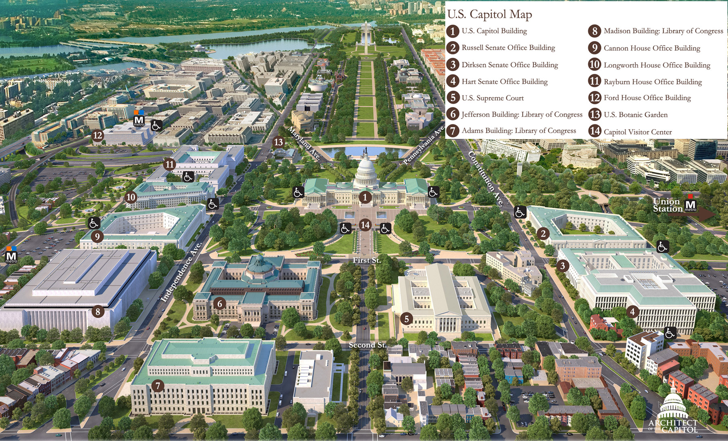
Map of Capitol Hill

Slide 22
Hotel Location
2019 RCAP Fly-In Hotel:
The Liaison Capitol Hill
415 New Jersey Ave NW
Washington, DC 20001
Union Station Metro Stop (Red Line)
See Capitol Hill Complex Map for location of Union Station

Slide 23
VI. RCAP Public Policy Team Contact Information
Nathan Ohle, Executive Director
nohle@rcap.org
Washington, DC
Ted Stiger, Senior Director, Government Relations & Policy
tstiger@rcap.org
Washington, DC
Ashley Zuelke, Senior Director, Research & Programs
azuelke@rcap.org
Denver, CO

